Slide 1
BSEE - Oil Spill Preparedness Division (OSPD): Renewable Energy Program
RRT 3: May 20, 2021
John Calvin
Senior Preparedness Analyst
BSEE - OSPD
john.calvin@bsee.gov
(504) 736-2640
Bryan Rogers
Preparedness Verification Branch Chief
BSEE - OSPD
bryan.rogers@bsee.gov
(504) 736-3242
Tommy Tregle
Senior Preparedness Analyst
BSEE - OSPD
thomas.tregle@bsee.gov
(504) 736-3279
“To promote safety, protect the environment and conserve resources offshore through vigorous regulatory oversight and enforcement.”
Notes:
FYI - You need to view the presentation in slideshow mode to see the animations.
Hello. My name is John Calvin and I am an Analyst for the Oil Spill Preparedness Division within the Bureau of Safety & Environmental Enforcement (BSEE).
My colleague, Lisa Grant, is a Senior Advisor in BSEE’s Office of Offshore Regulatory Programs and will be available with me during the live Q&A session for this event.
We appreciate your interest in viewing our presentation today on Lessons Learned and Corrective Actions from BSEE Source Control Exercises.

Slide 2
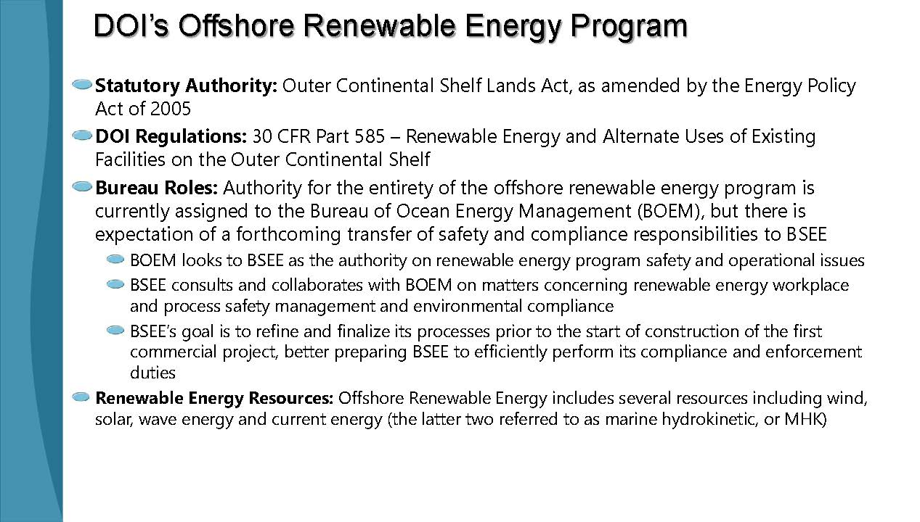

Slide 3
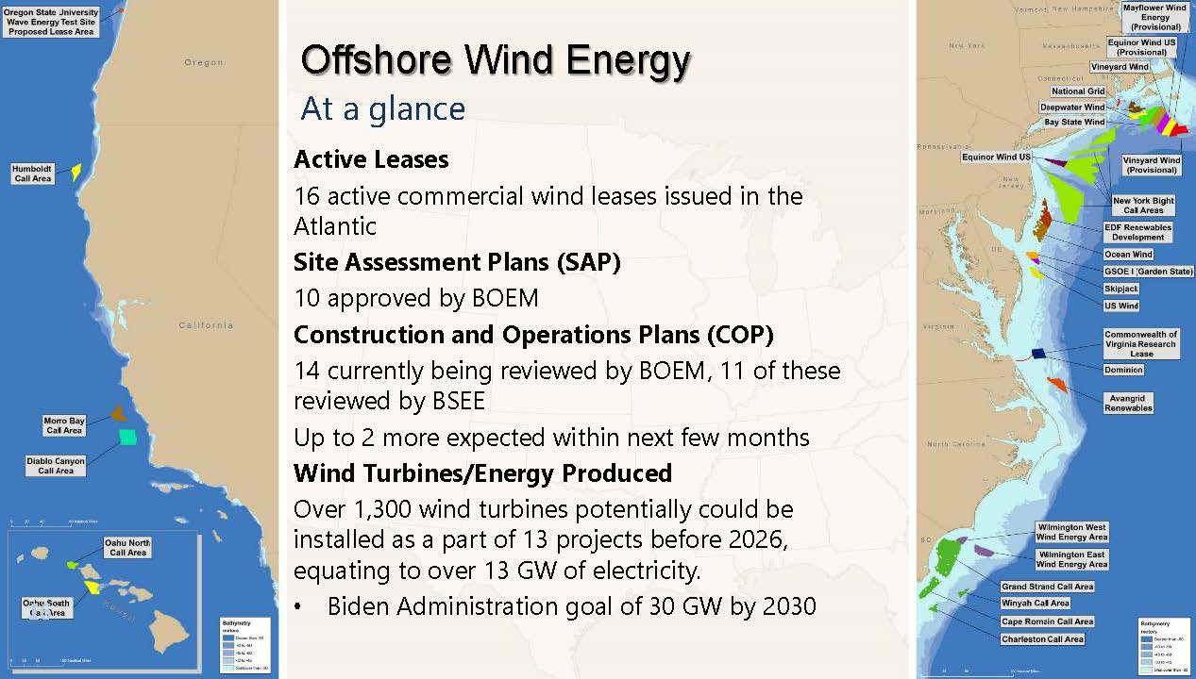

Slide 4
