Slide 1
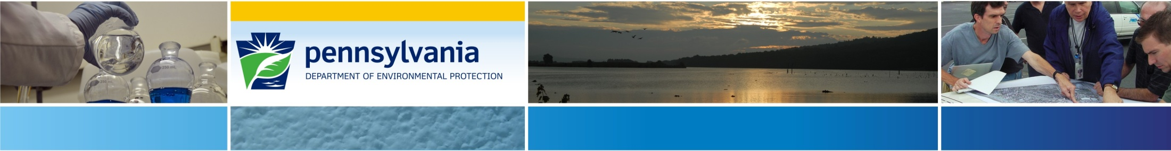
Former Easton Plating & Metal Finishing, Inc. Facility
215 S. Delaware Drive, Easton City, Northampton County, Penna.
May 20, 2021
Jonathan Ulanoski
(Acting) PA DEP Emergency Response Program Manager
Tom Wolf, Governor
Patrick McDonnell, Secretary

Slide 2
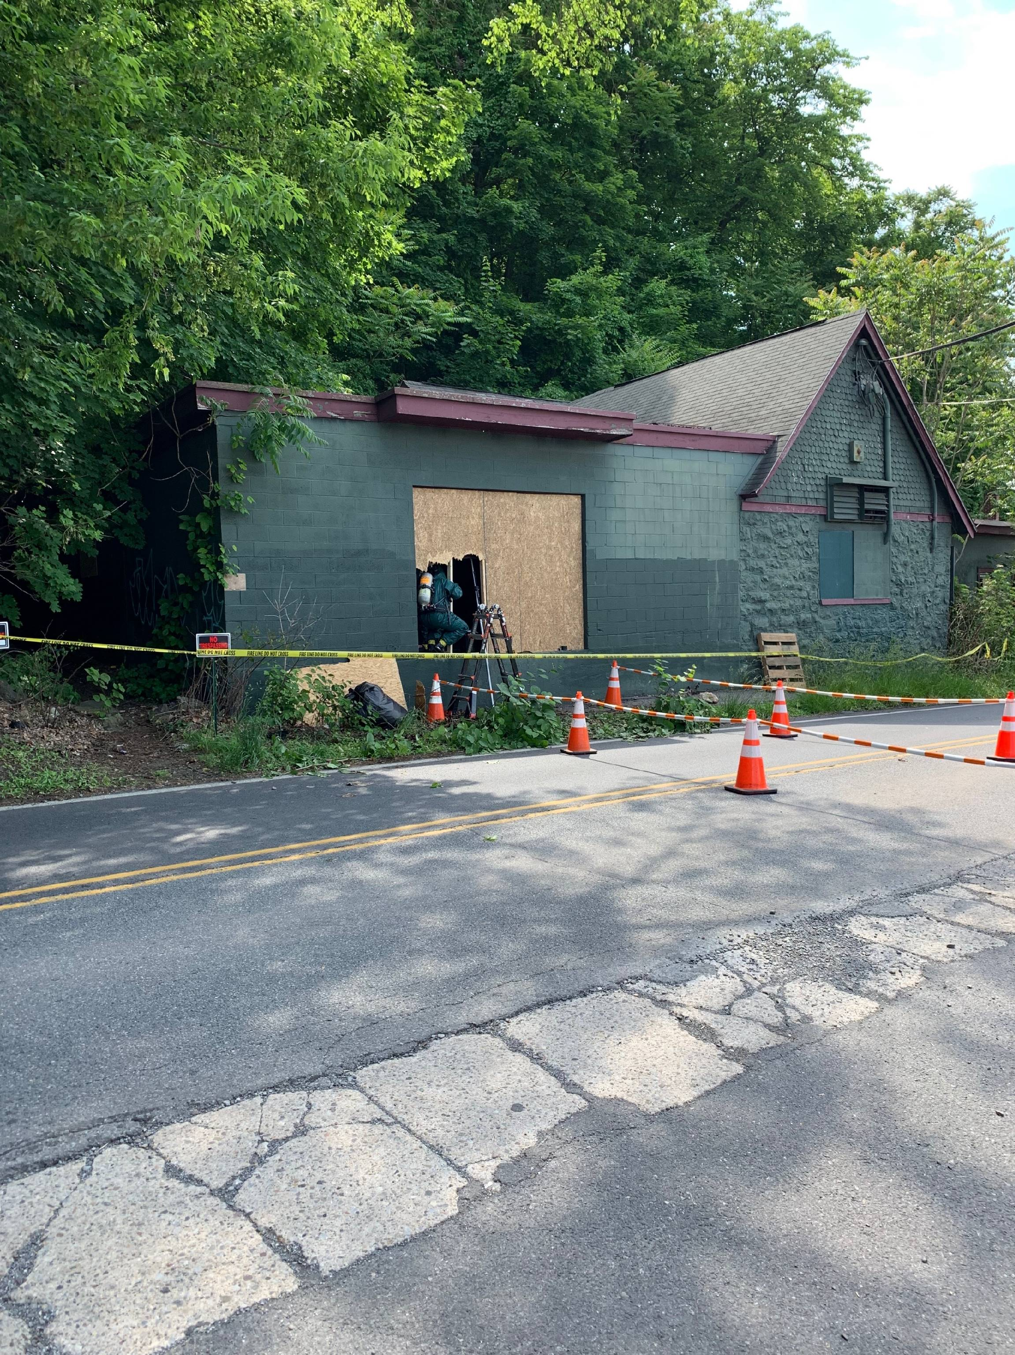

Local Examples

Slide 3
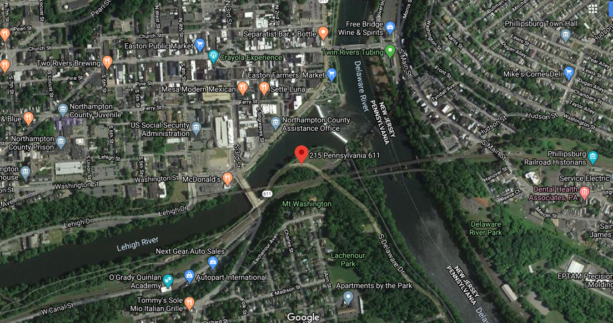
Local Examples

Slide 4
Local Examples
Call from PEMA initially received by PaDEP @ approx. 2220 on June 3, 2020.
Began as local FD call involving fire.
Abandoned building.
LOTS of drums/containers/unknowns.

Slide 5
Local Examples
Initial plans were to:
Arrange meeting at site on June 4, 2021 with Local/State/Fed reps.
Emergency Response manager/coordinator and 2 team members (Chemistry/Waste Management).

Slide 6
Local Examples
Last known info:
DEP conducted last inspection @ last known location for Easton Plating on/about November 2009 (@ a “Newer facility” approx. 5 miles away).
Building abandoned for some time.
Numerous attempts at tax sale.

Slide 7
Local Examples
Last known info (cont’d):
December 20, 2000 - facility provided notice to Easton Area Joint Sewer Authority (EAJSA) that they were closing.
Industrial Pretreatment Closing Inspection conducted following week.
Listed limited items (small quantities) still present at the site.

Slide 9
Local Examples
Last known info (cont’d):
Follow-up inspection on June 13, 2001.
Limited number of items, including several drums, were noted, planned to be removed, etc.
Plug ~5 drains.

Slide 11
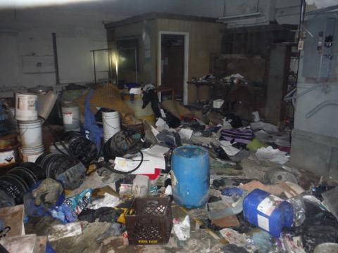
Local Examples

Slide 12
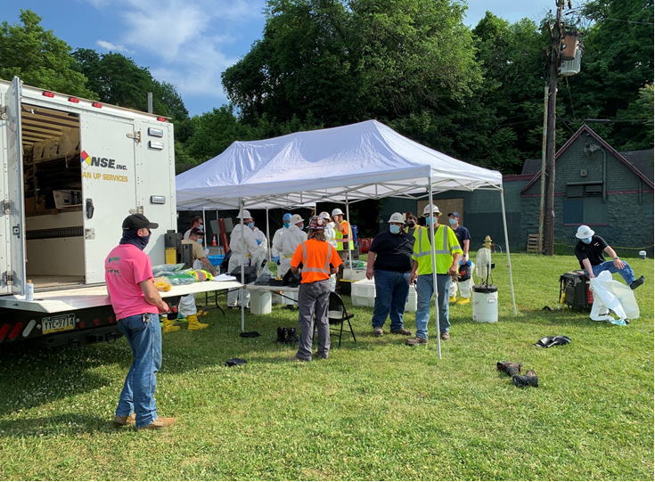
Local Examples
Easton City had contracted with Rapid Response (HazMat team) – conducted initial response/entry/inventory.

Slide 13
Local Examples
NUMEROUS unknowns/hazards:
Debris! Debris! Debris!
No power + no windows, etc. = DARK!
Limited access to/around building.
adjacent to roadway and across from park.
Needed to shut down roadway.

Slide 14
Local Examples
More hazards:
Structural integrity?
Basement access obstructed by additional debris/waste.
Inventory included 300+ containers of varying size/concern.
Directly adjacent to active railway.

Slide 15
Jonathan Ulanoski julanoski@pa.gov

Slide 16

Easton Plating Site
Dominic Ventura
On Scene Coordinator
US EPA Region 3

Slide 17
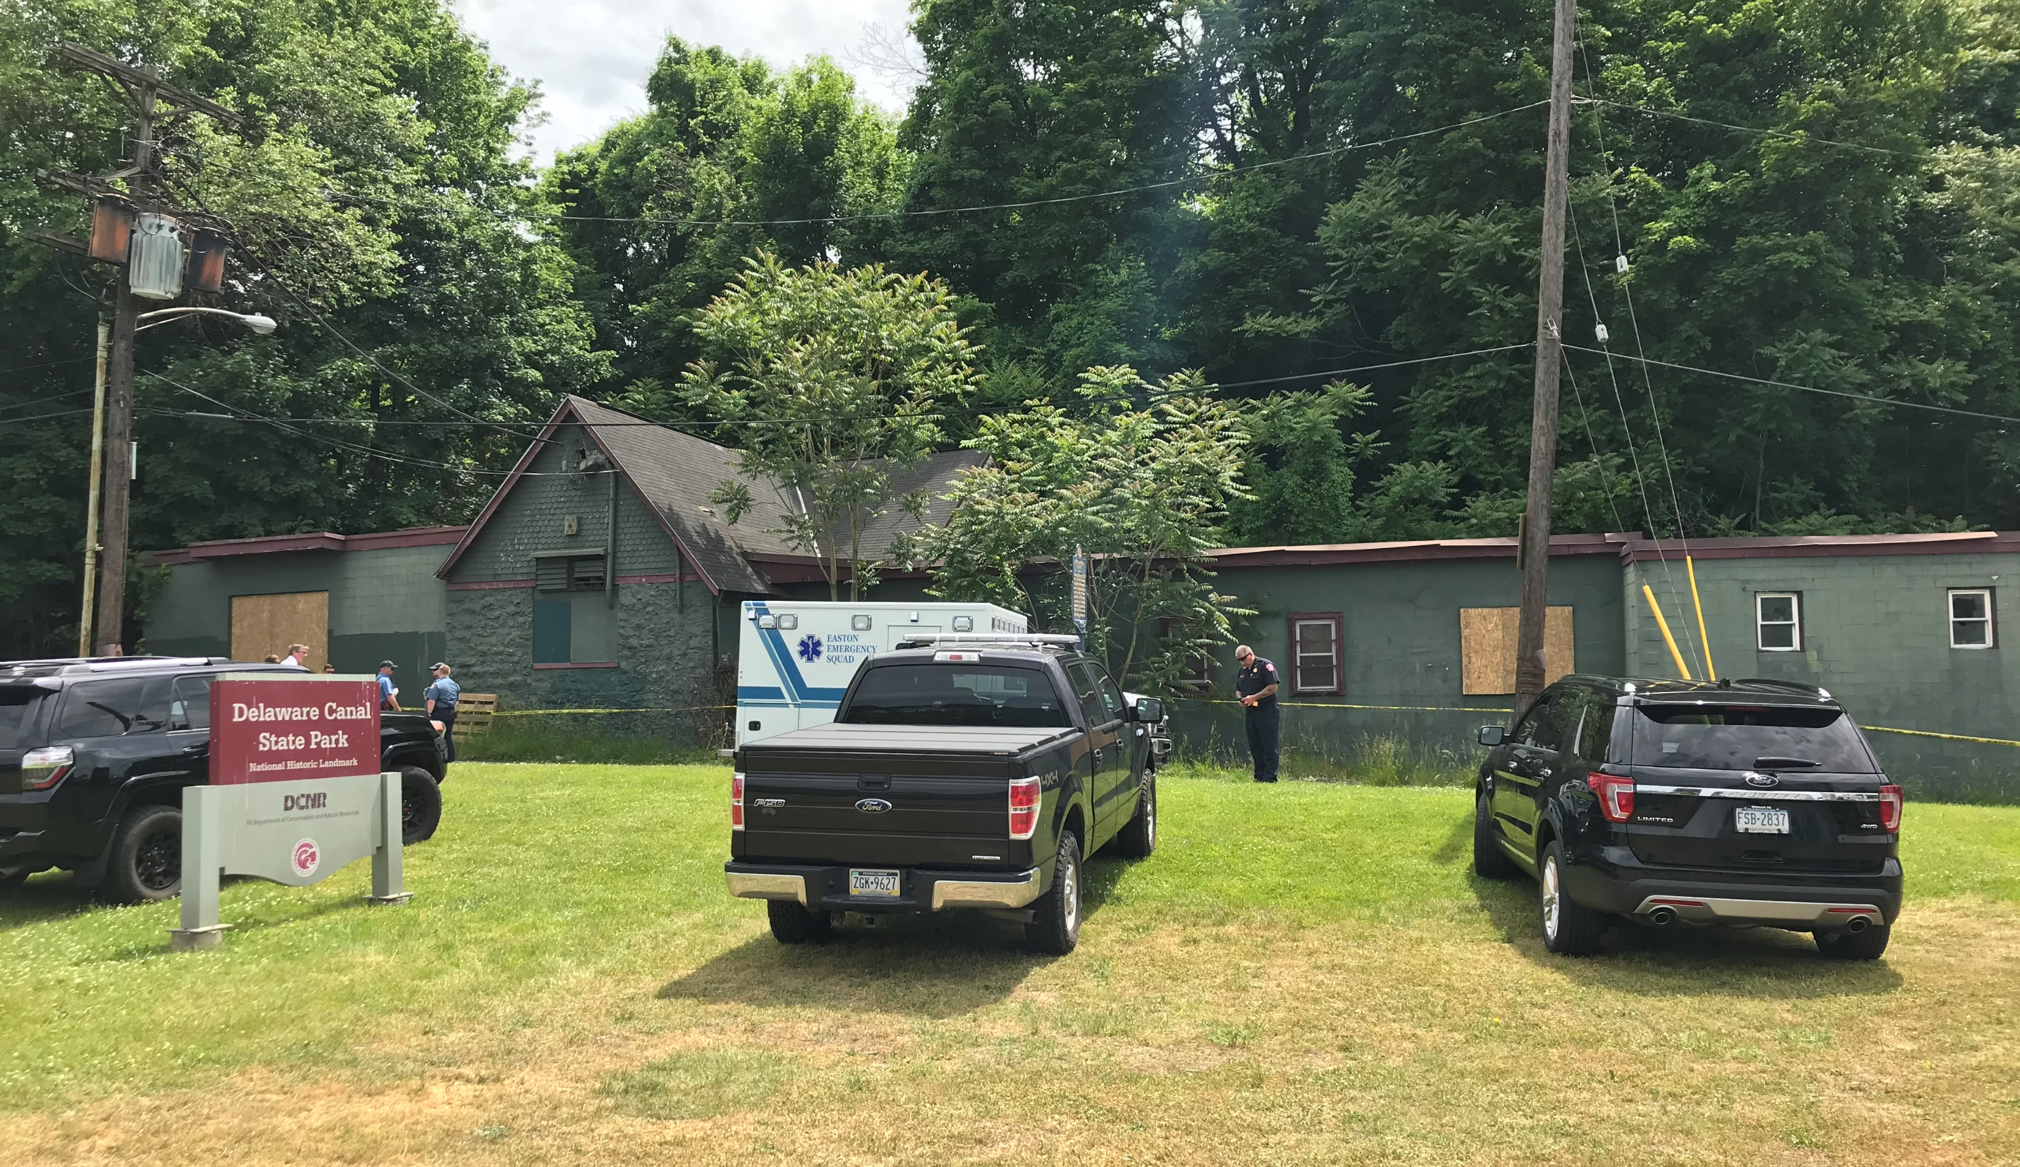
Easton Plating Site
Received call from PADEP ER Program Manager on morning of June 4.
Attended a meeting on site at 1000 on June 4 along with PADEP, Northampton and Lehigh County EMAs, and representatives from the City of Easton.
FD and County EMA made entries into building on June 3.
The Mayor indicated during the meeting that the City would prefer to conduct response actions at the site.

Slide 18
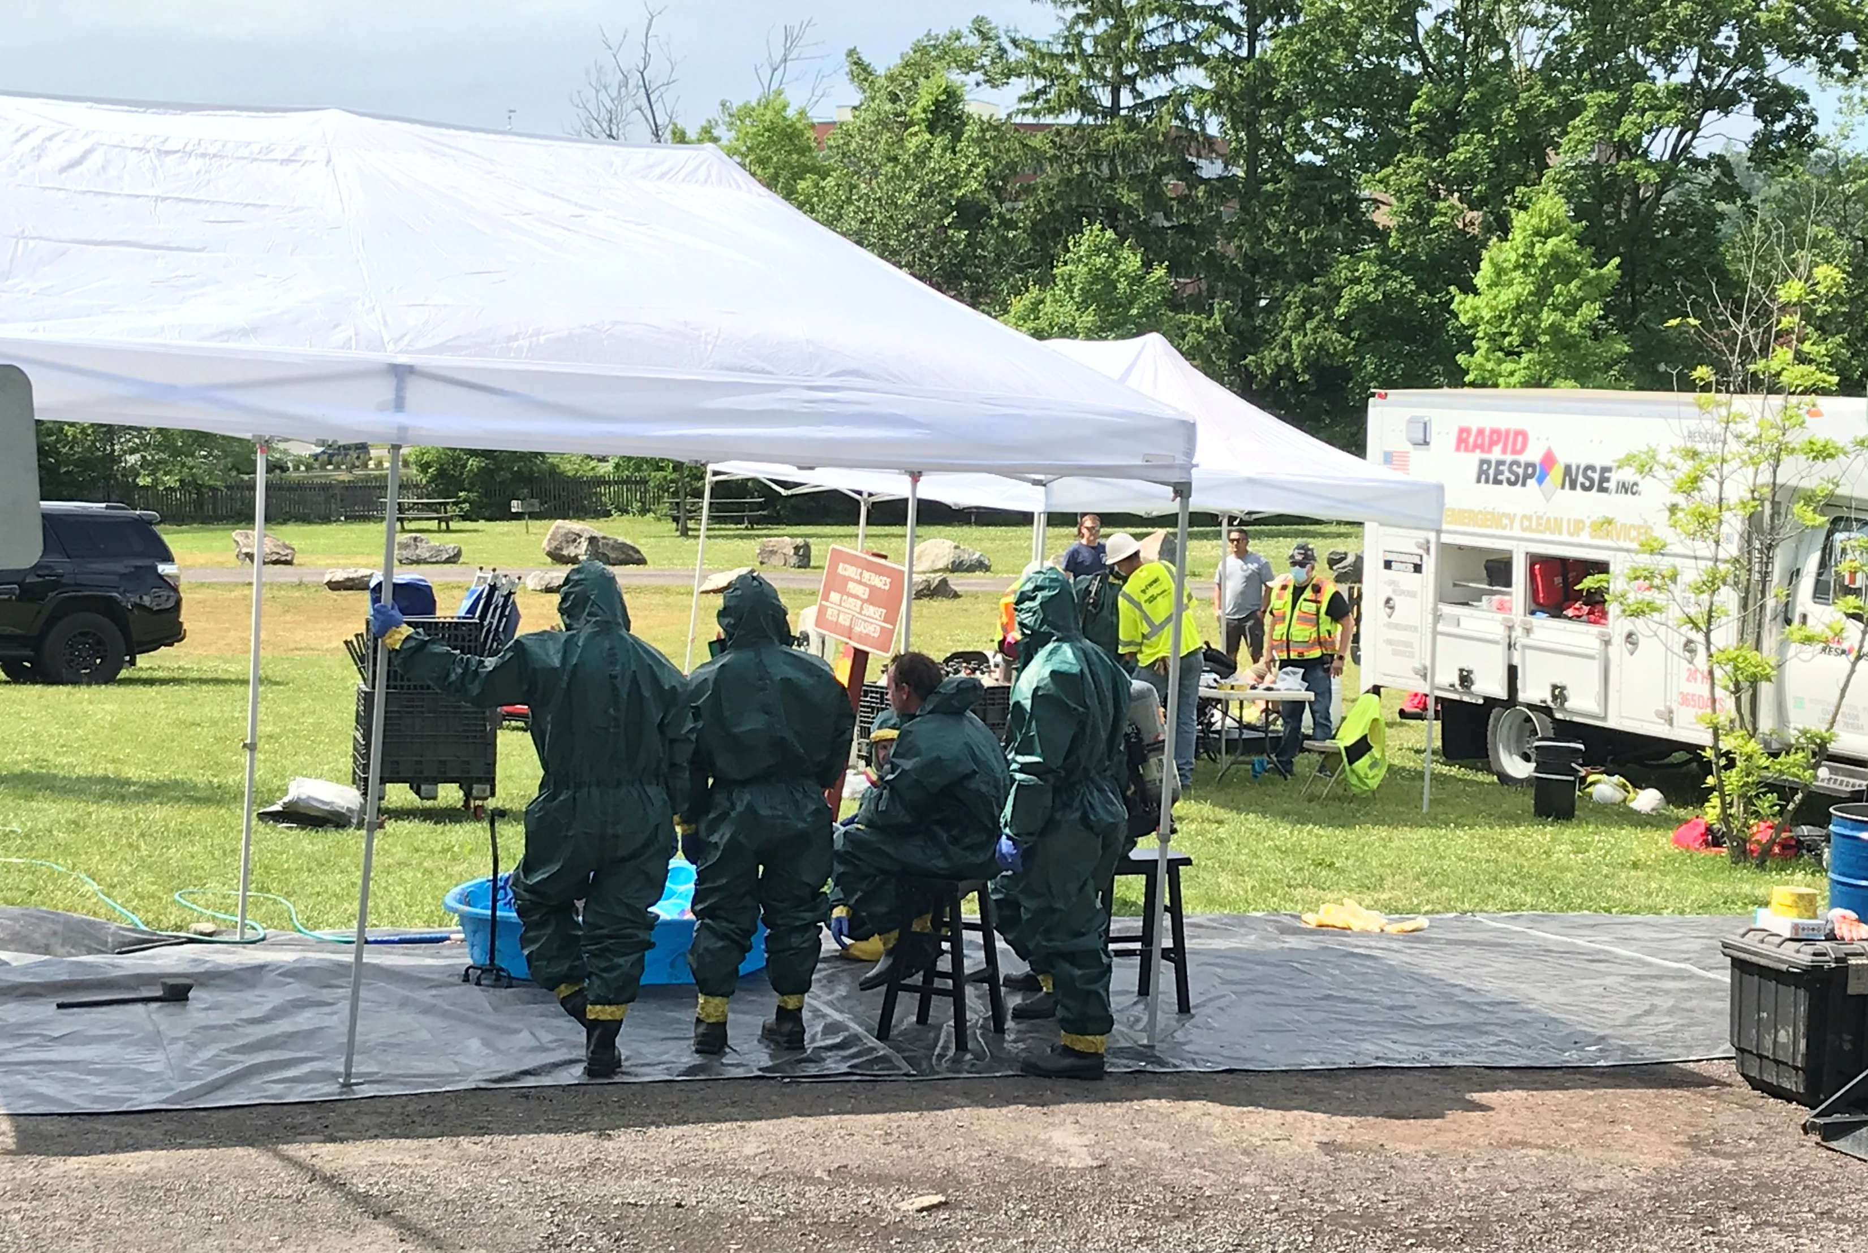
Initial Response Actions by City and County
City contractor made entries into building on June 4 and June 5, 2020.
Approximately 200 containers were inventoried.
Many appeared to contain hazardous substances and were in containers in poor condition.
Several acid containers were overpacked.
Building in poor condition and evidence of squatters.

Slide 19
Initiation of Removal Action
On the afternoon of June 6, City official told EPA that they did not have funding to complete required response actions at the site.
PADEP requested assistance from EPA.
PADEP and EPA agreed that EPA would address threat posed by abandoned containers and PADEP would then assess potential impact to the surrounding environment.
OSC issued a special bulletin on June 8 initiating an emergency removal action.

Slide 20
Initiation of Removal Action
Removal Action would include the following tasks:
Removal of trash and debris from the building as necessary to facilitate safe entry and egress;
Assess condition of containers and inventory containers;
Take actions necessary to secure containers that are in poor condition;
Sample containers to conduct hazardous characterization (HAZCAT) and laboratory analysis as needed;
Organize and store containers based on hazard class;
Conduct transportation and disposal of chemical waste and other site related cleanup waste;

Slide 21
Obtaining Access
Records search indicated that Eastern Plating and Metal Finishing was the owner.
Previous owner of the company was deceased but ownership had passed to son.
City had reported that a County may have taken control of the property due to a tax lien foreclosure.
Initially difficult to locate owner. An investigator with the DEP and PA Bureau of Investigations provided assistance.
Eventually received access from Eastern Plating and Metal Finishing.

Slide 22
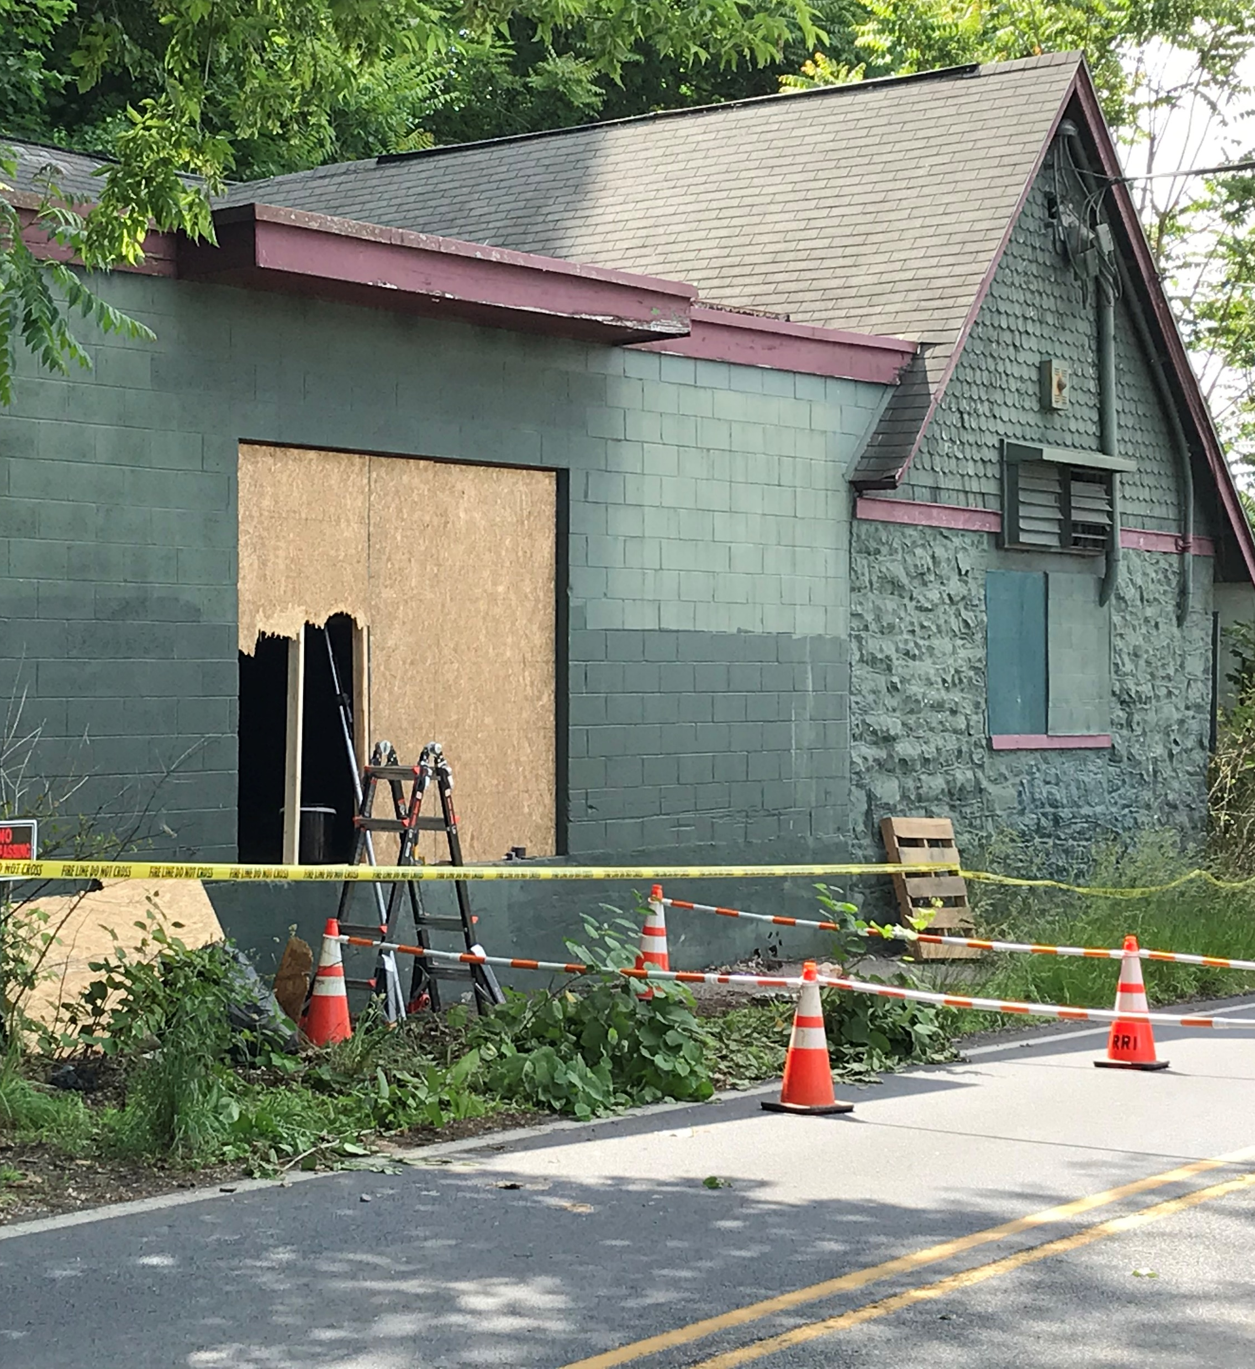
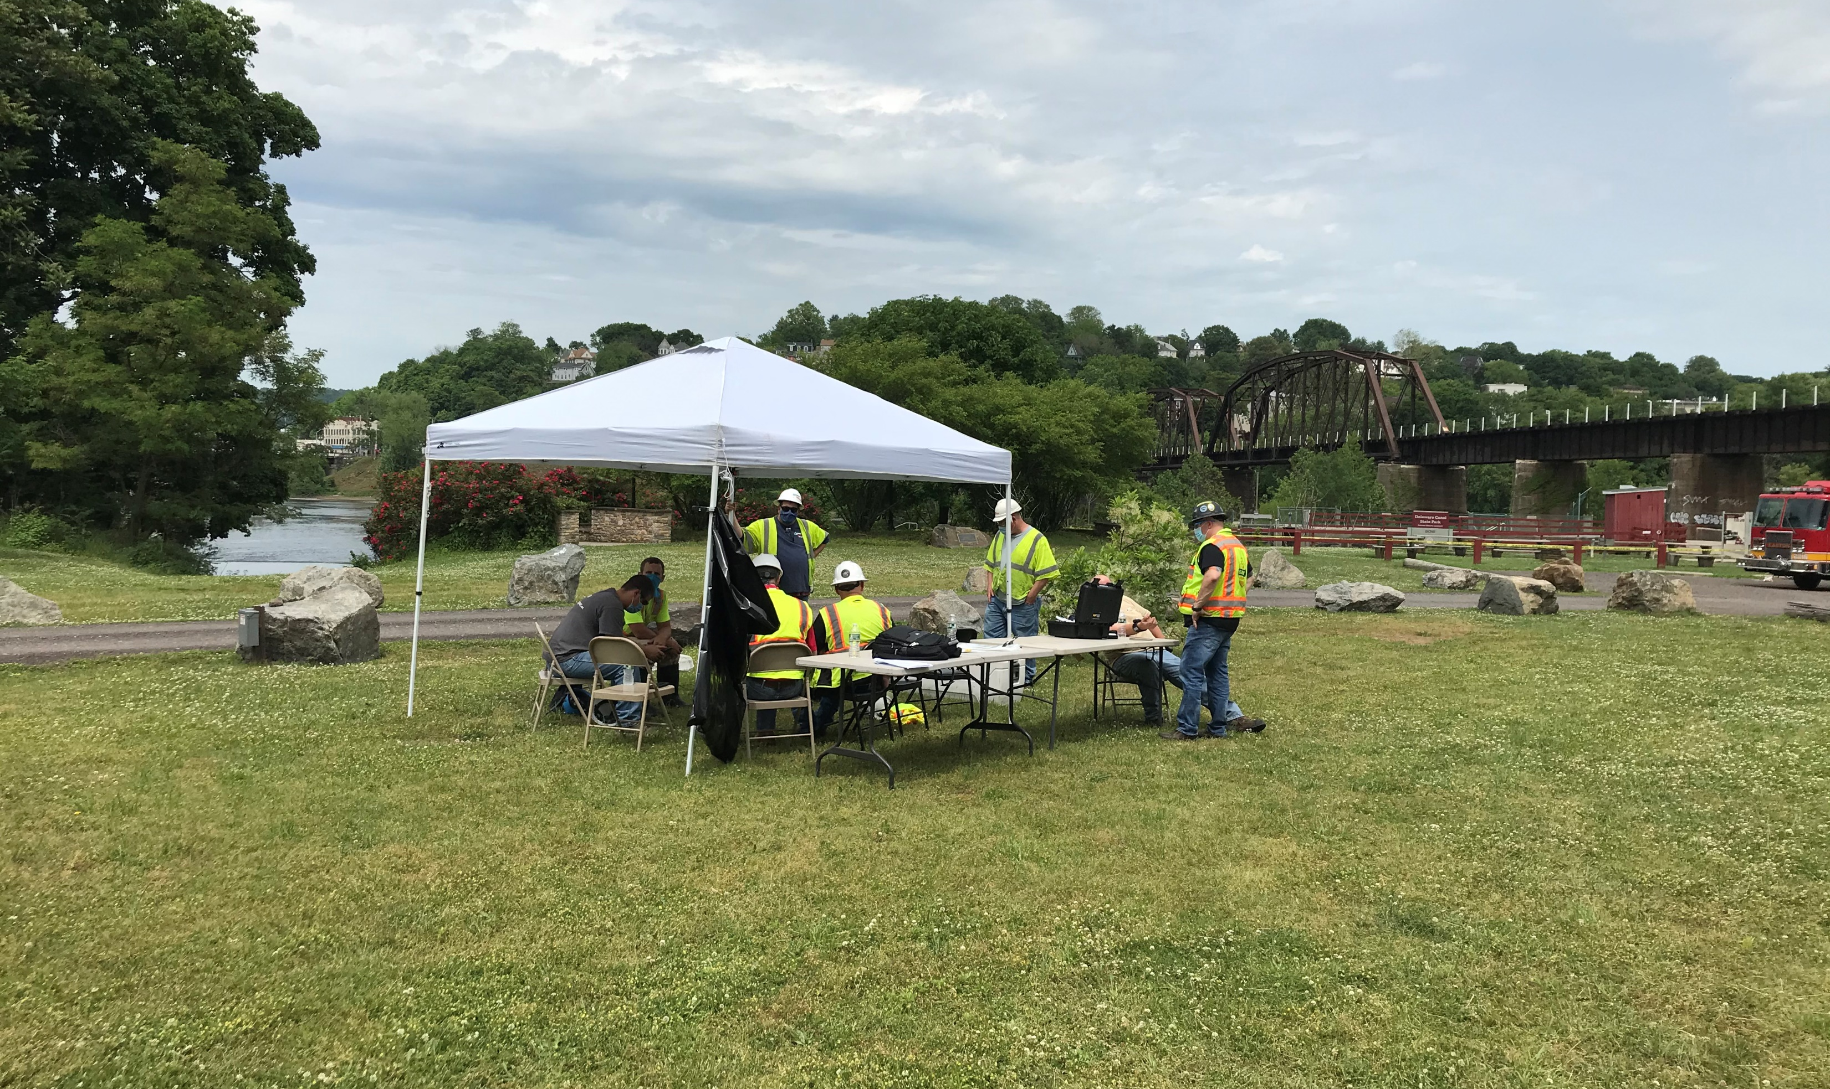
Health and Safety Concerns
Close proximity to road and park.
Need for traffic controls or road closure
Where to conduct HAZCAT?

Slide 23
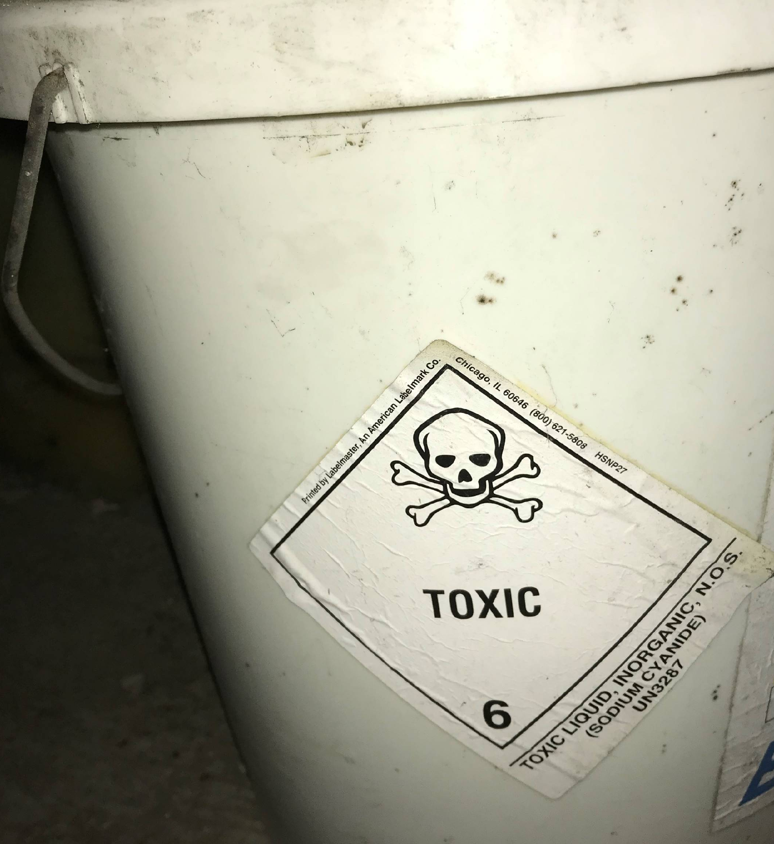
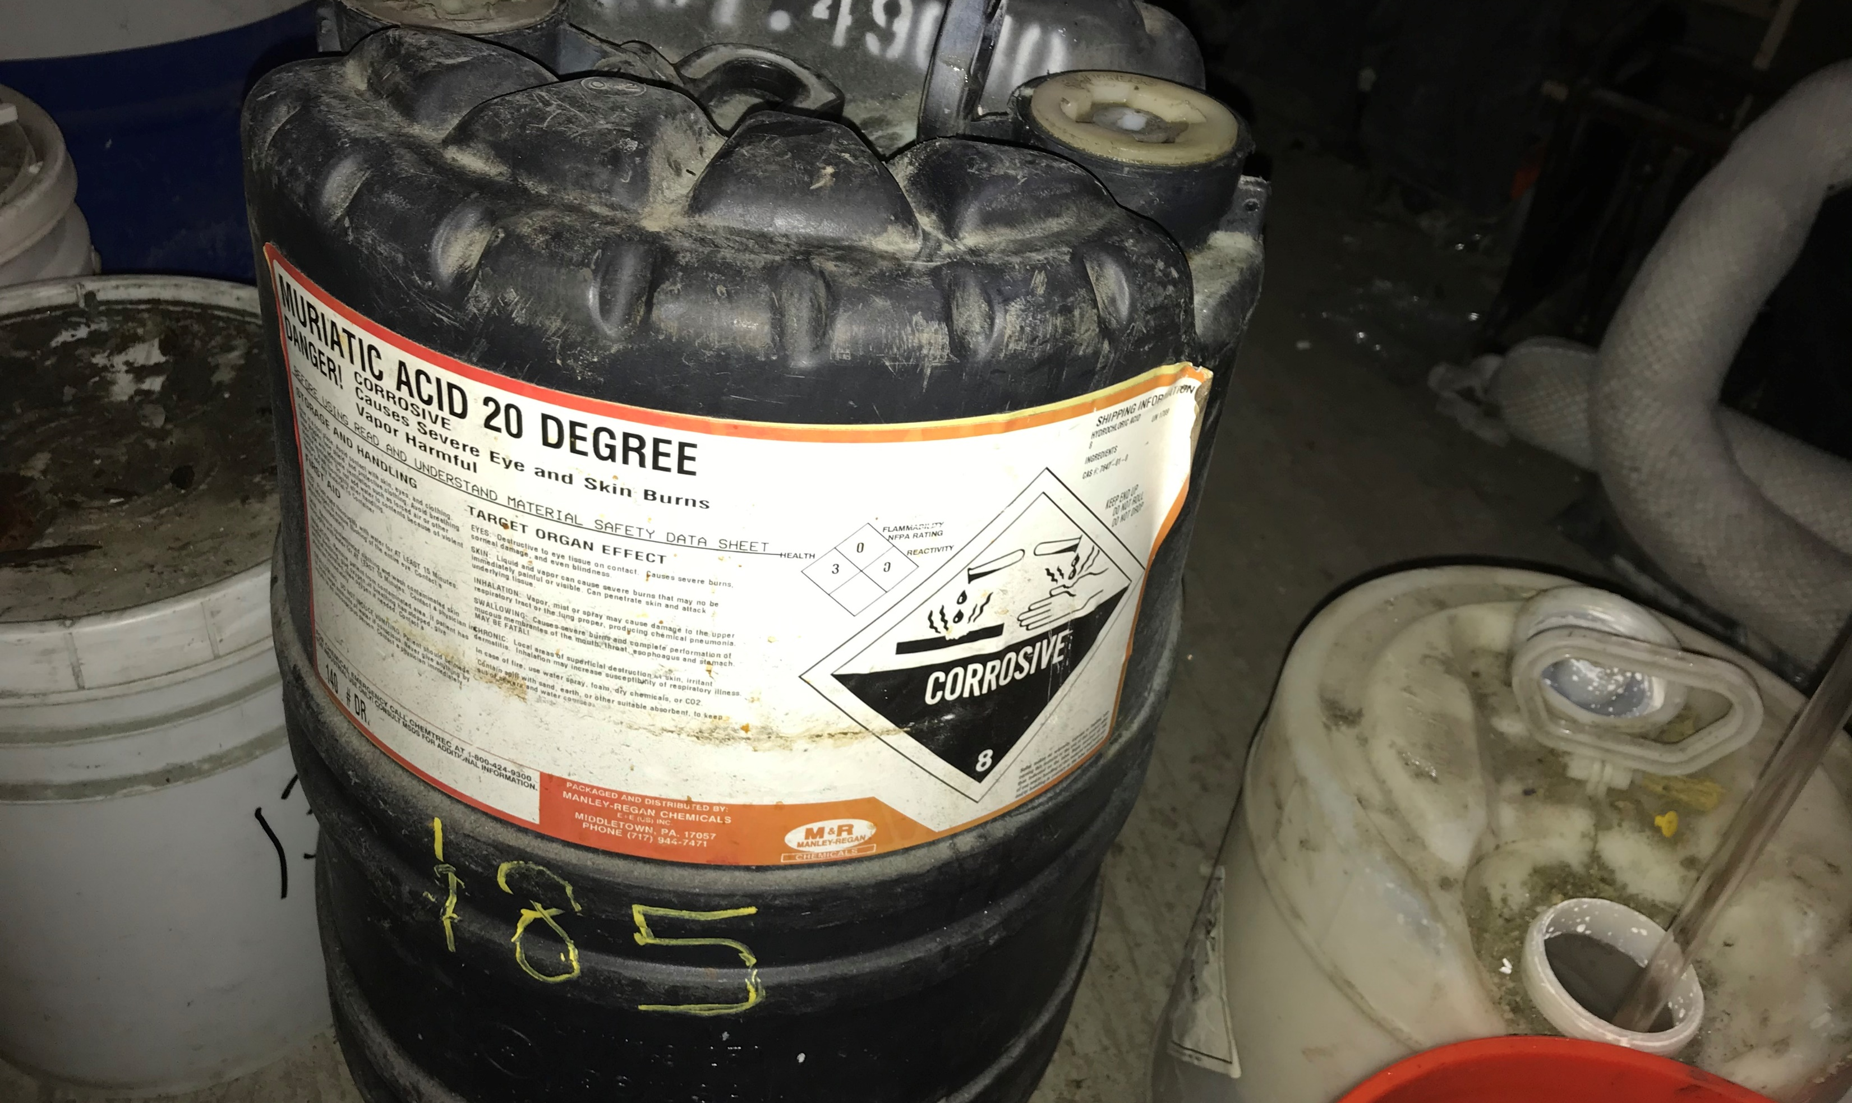
Health and Safety Concerns
Chemical Hazards
Air monitoring was conducted throughout Removal Action.

Slide 24
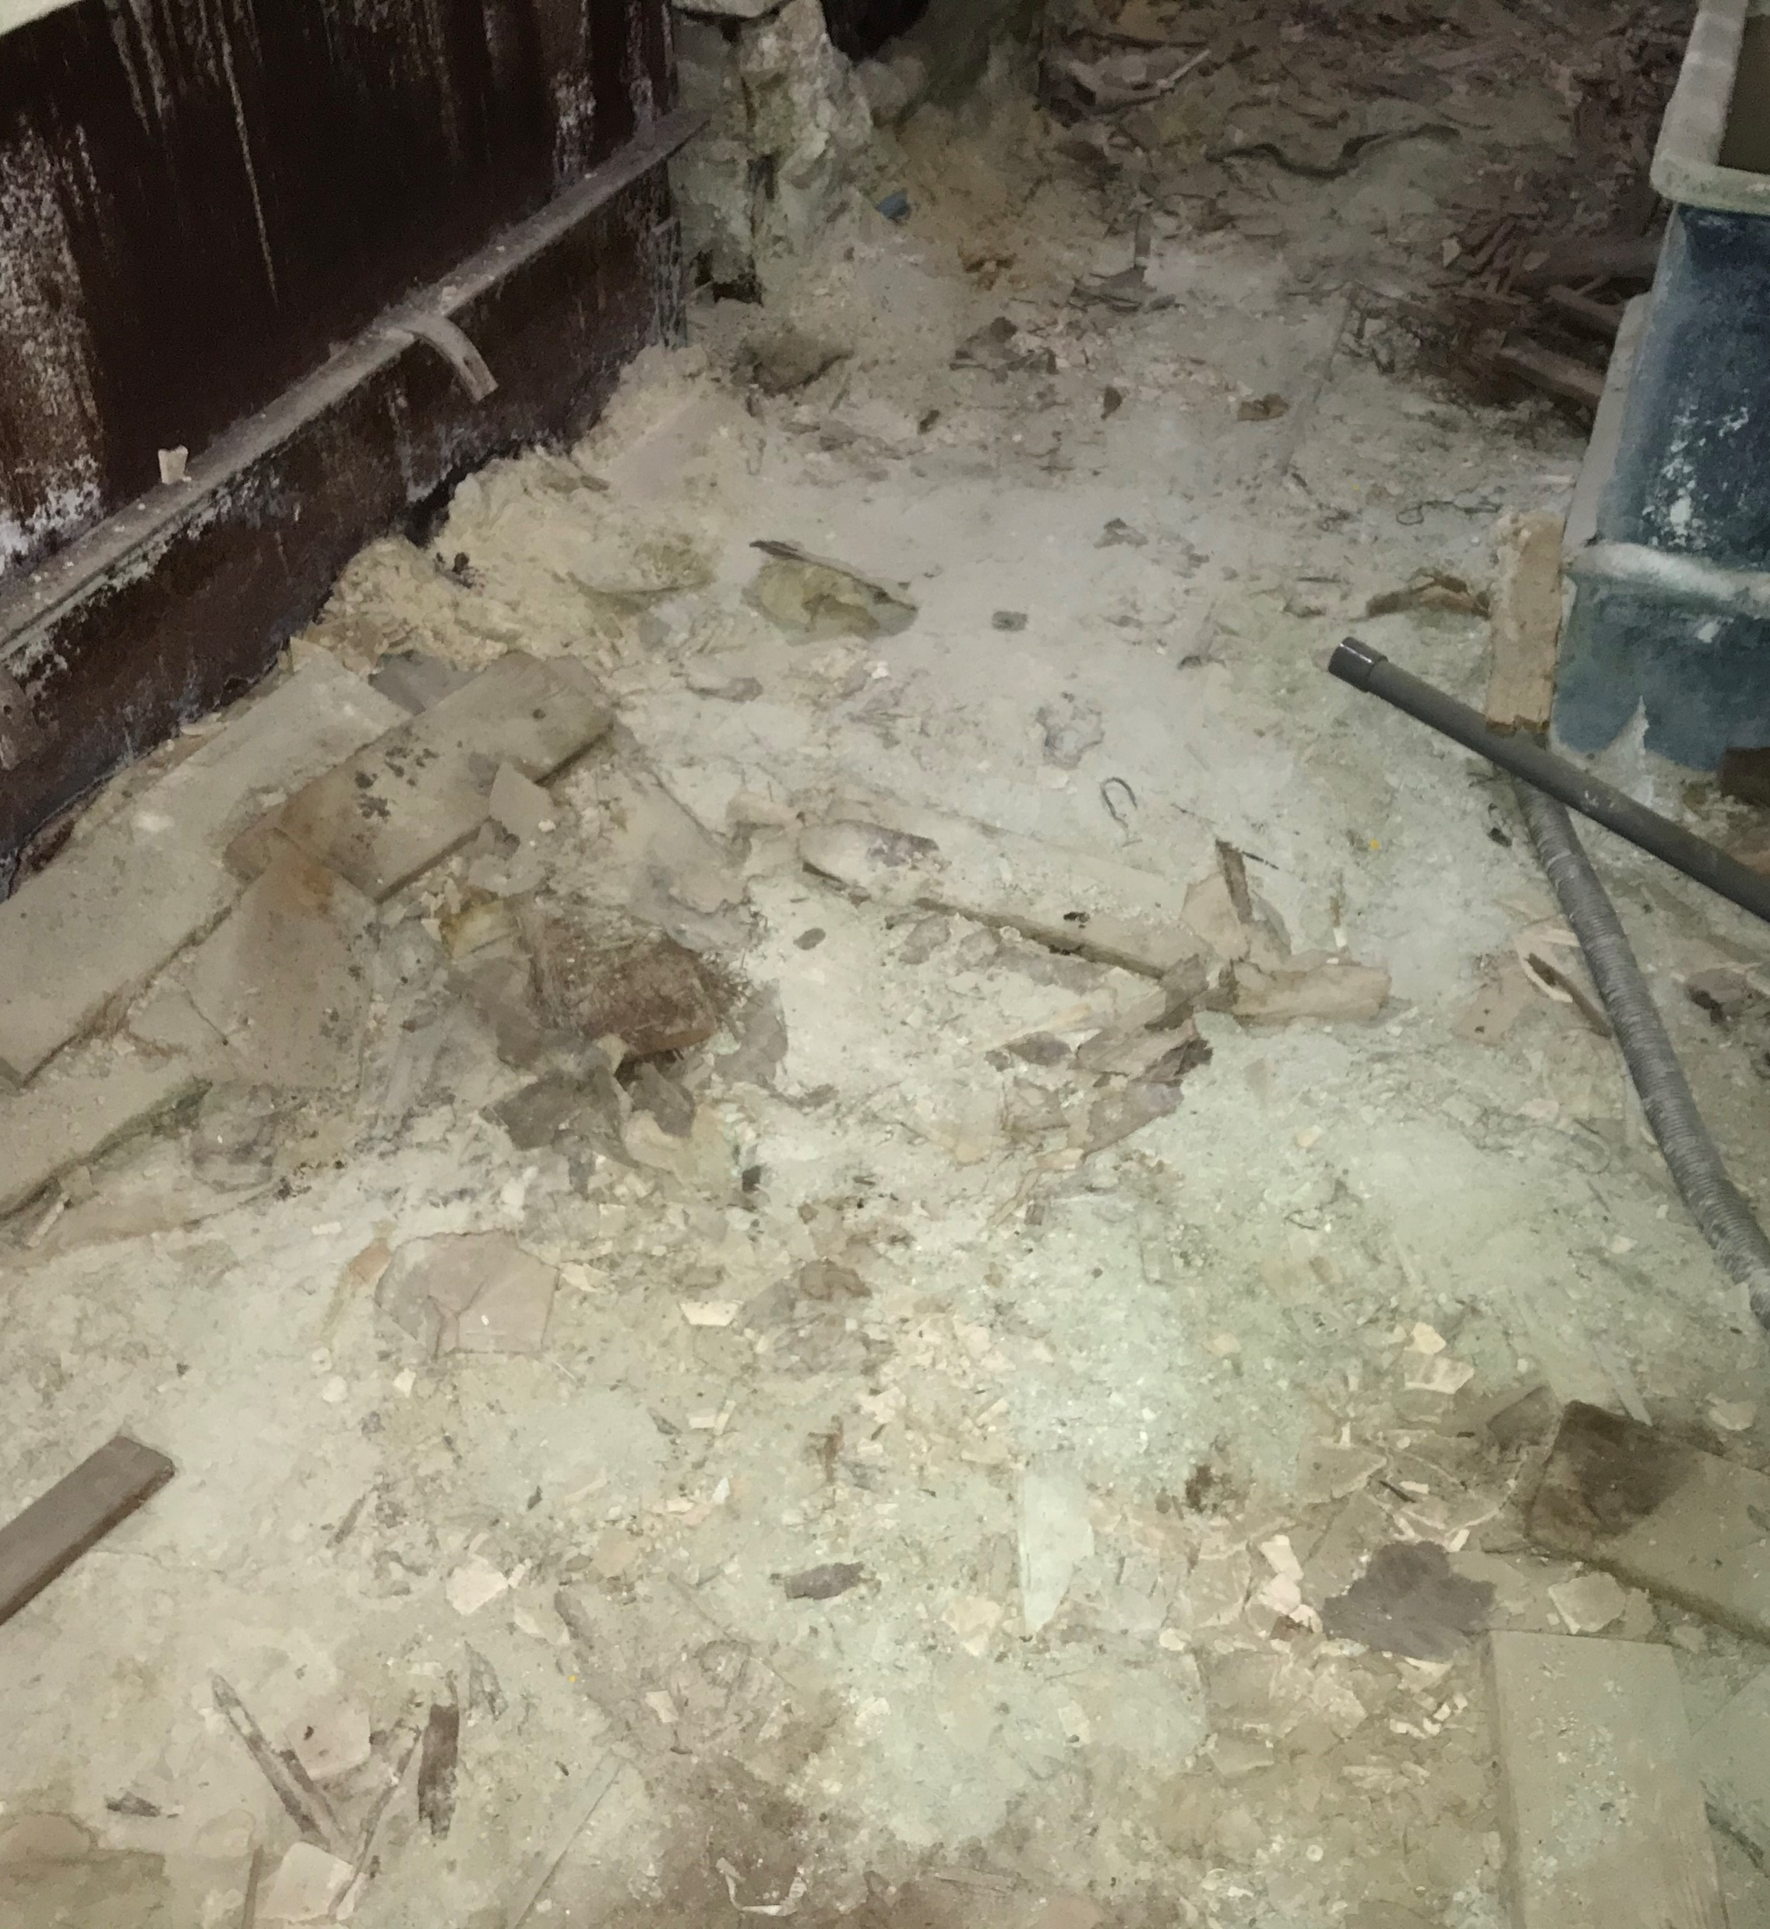
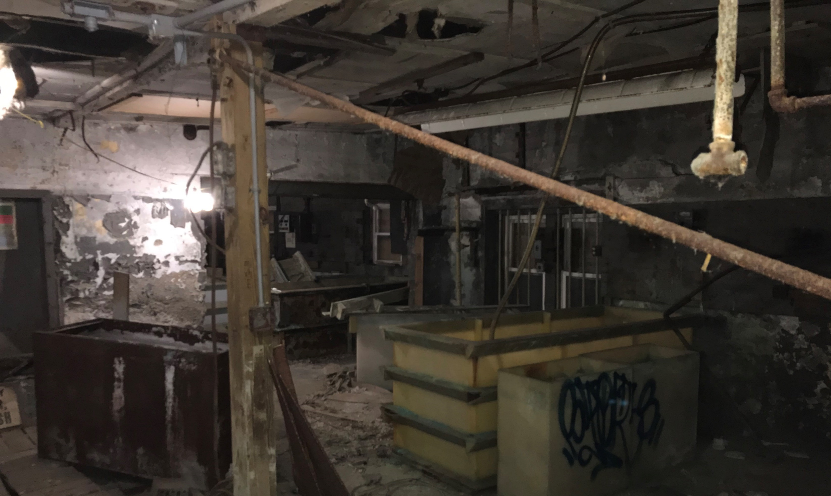
Health and Safety Concerns
Floors throughout building were covered with significant amount of potentially contaminated debris.
Holes in floor
Vats were generally empty but a few contained a minor amount off dry material and trash.

Slide 25
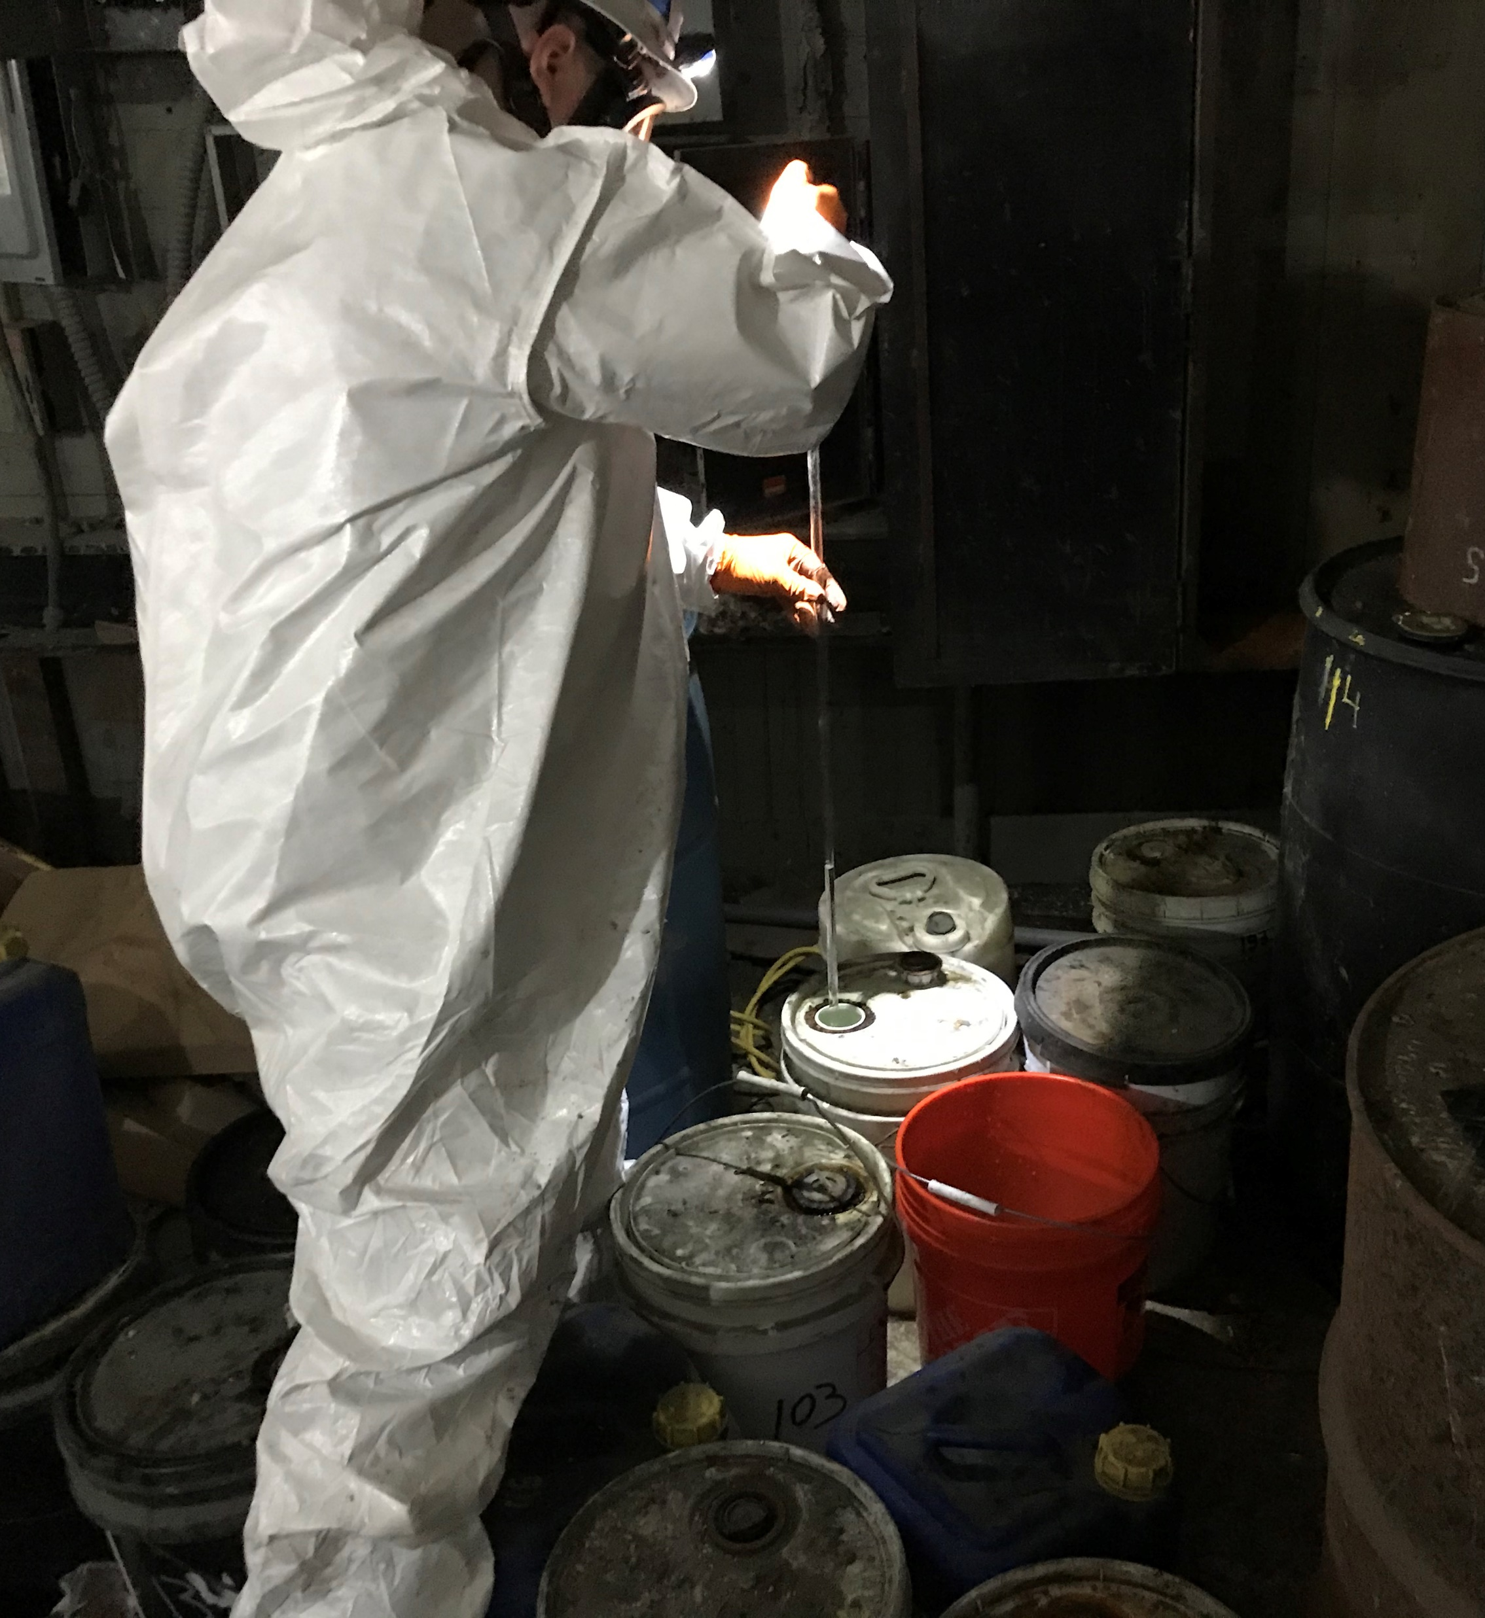
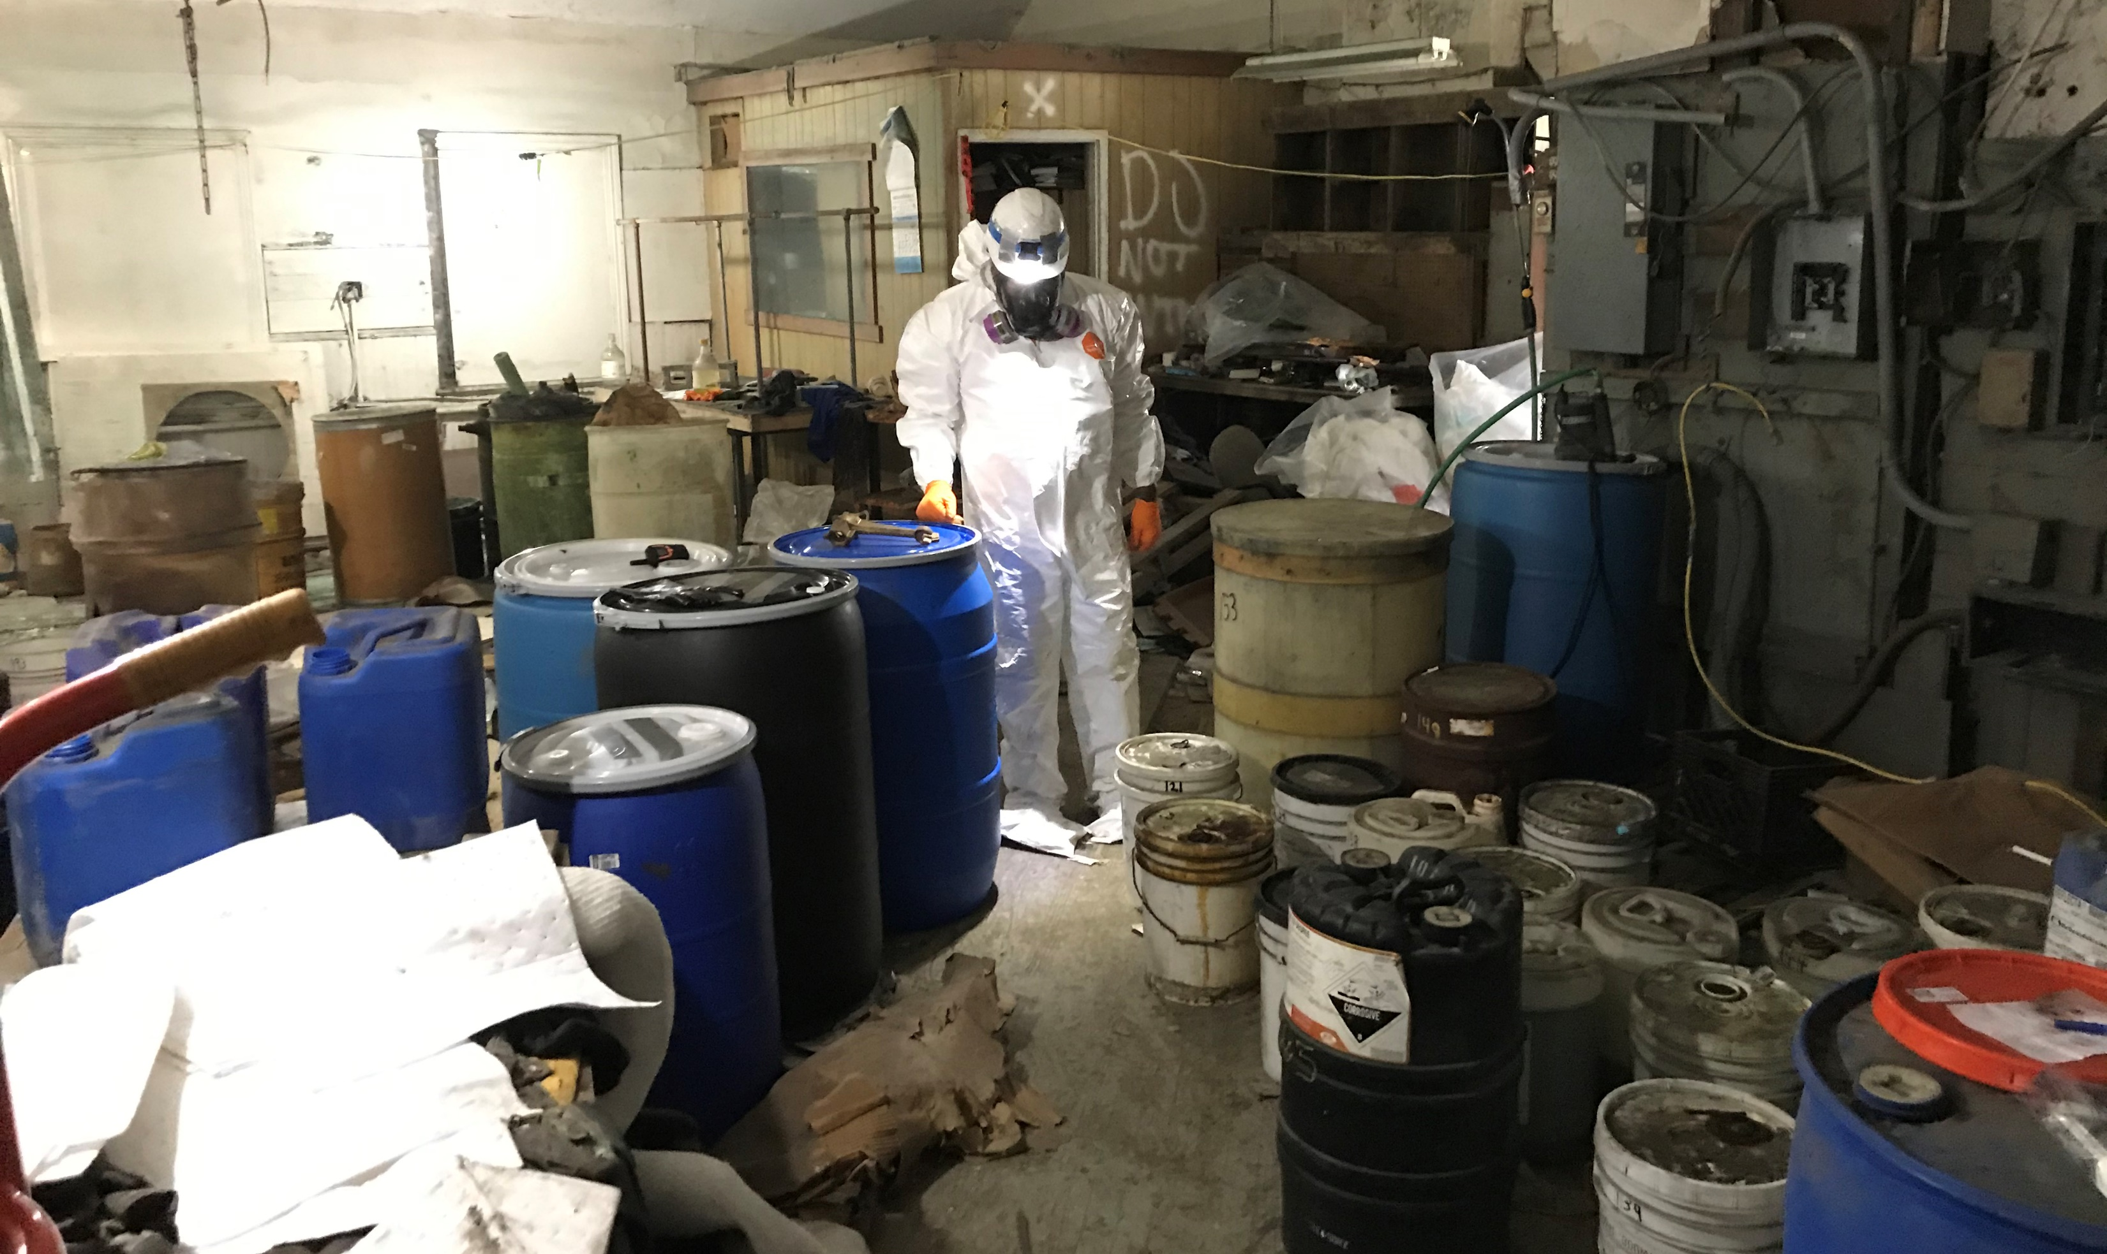
Sampling and HAZCAT
Over 125 samples were collected for HAZCAT
HAZCAT conducted on WWTP property
Samples sent to lab for disposal analysis.

Slide 26
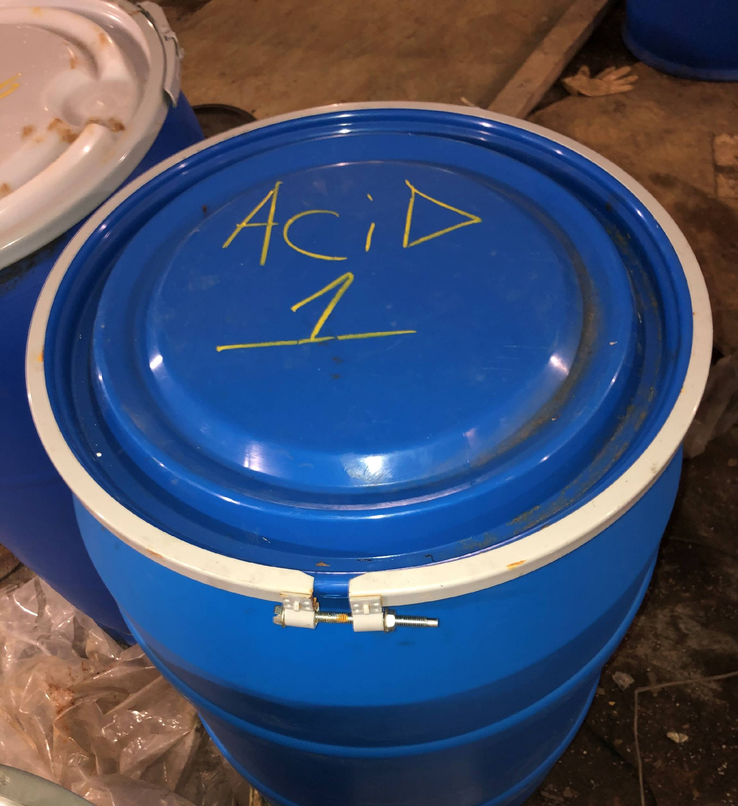
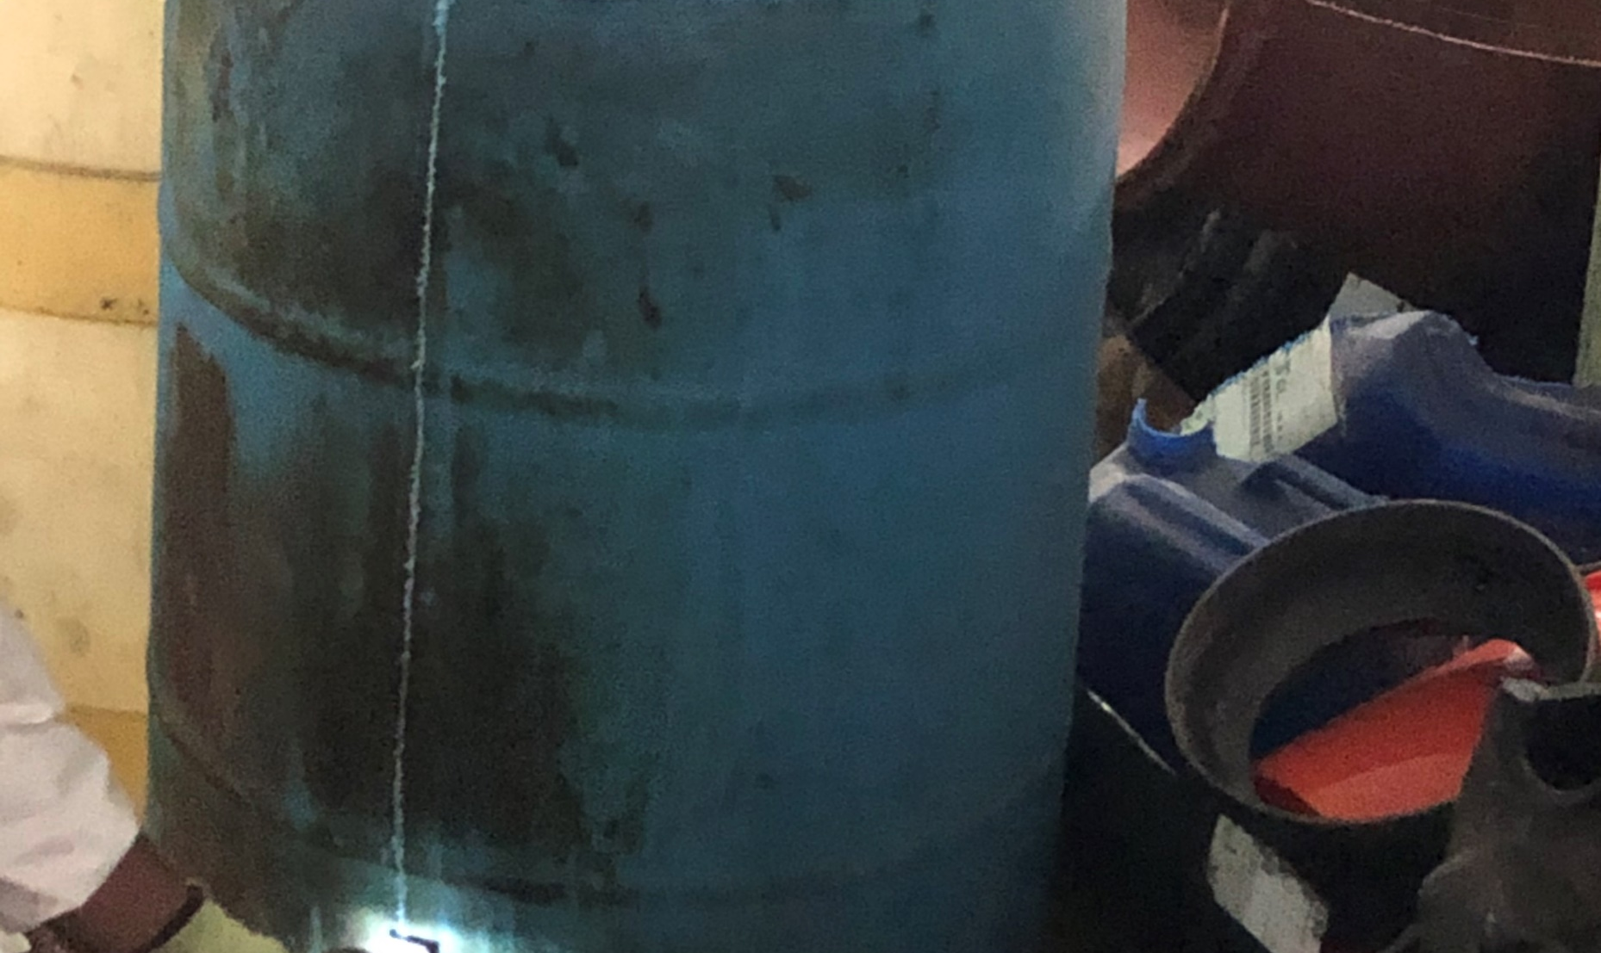
Removal Activities
47 drums of consolidated hazardous and non-hazardous waste were generated.
Drums were stored temporarily according to hazard class until disposal could be arranged.
Empty containers were cut up and disposed of as non-hazardous waste.
All waste transported off site for disposal on August 28, 2020

Slide 27
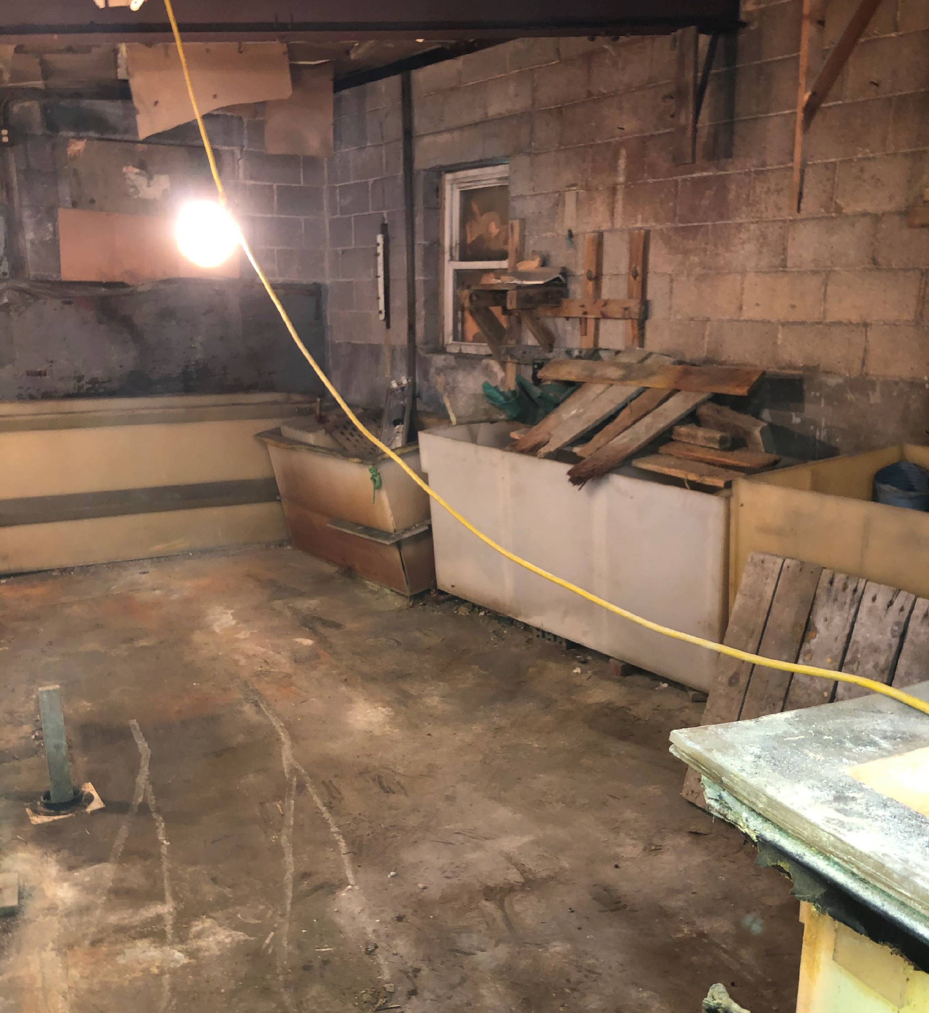
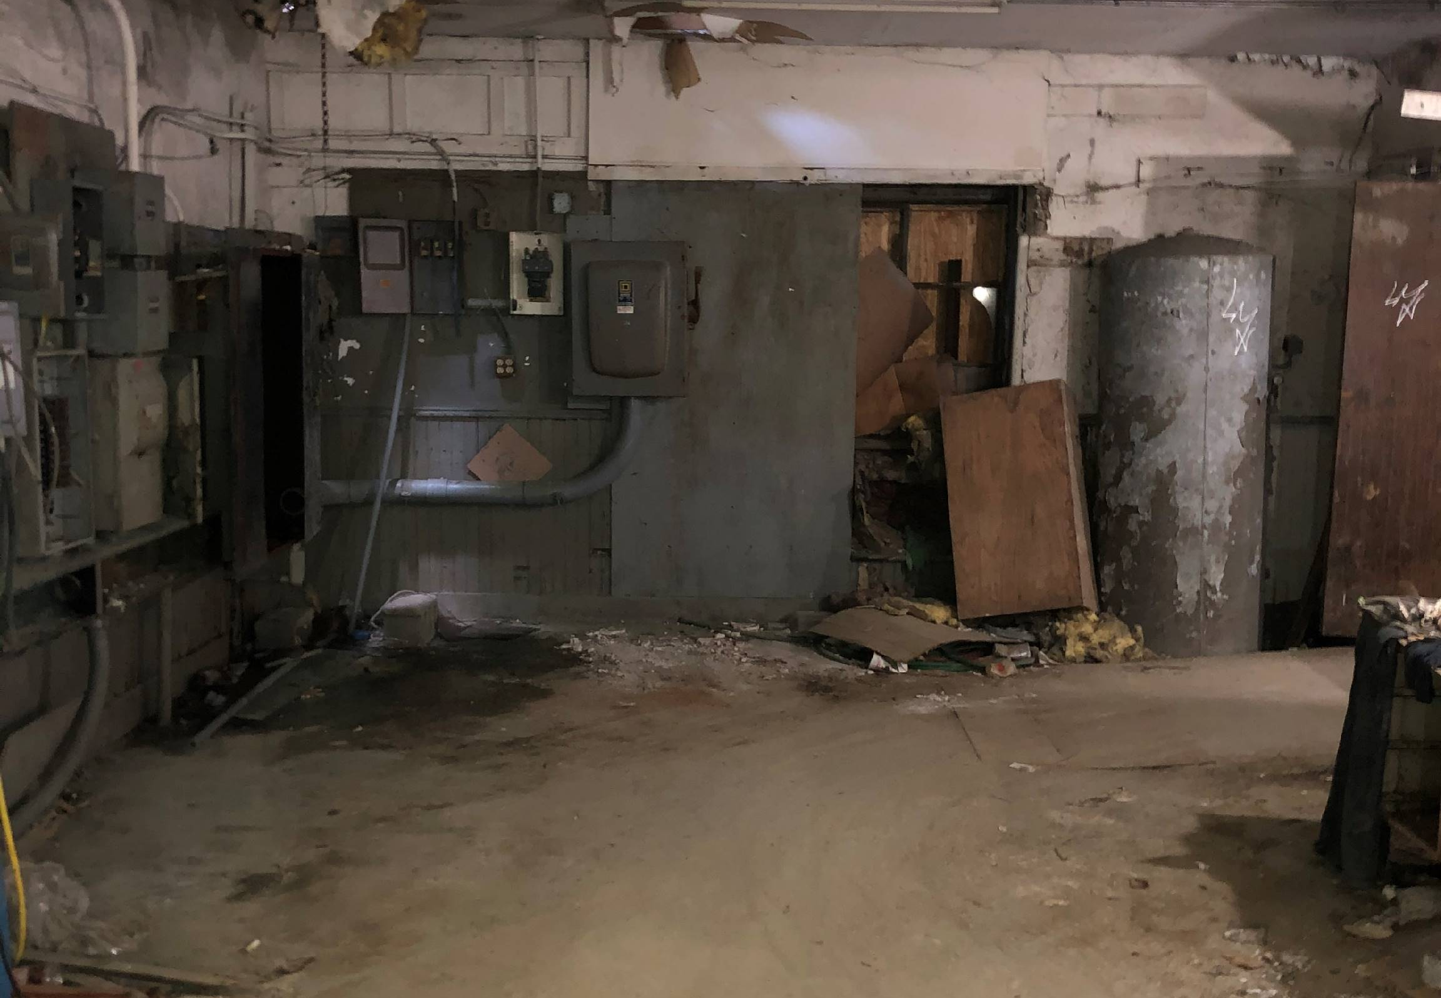
Removal Completion
Completed post removal site walk with City and PADEP HSCA Program on August 28, 2020.
Key Takeaway - Open communication and coordination throughout project between local, state and federal agencies was crucial to ensuring a safe and efficient response action.

Slide 28
QUESTIONS?

