Slide 1



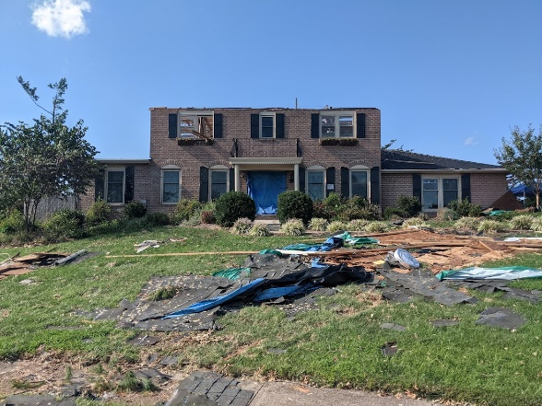
Tropical Storm Ida
FEMA-4618-DR-PA
2021

Slide 2

State Flag
Introduction
Ida made landfall in Louisiana as a Category 4 hurricane 29 August 2021
Commonwealth EOC activated 1 September 2021
Major Disaster Declaration for the Commonwealth of Pennsylvania due to heavy rainfall, severe flash flooding, and tornadoes from tropical depression Ida, with an incident period of August 31, 2021, through September 5, 2021 approved on September 10, 2021.
Designated counties are Bucks, Chester, Delaware, Montgomery, Philadelphia, York, Bedford and Northampton counties for Individual Assistance.
Bedford, Bucks, Chester, Delaware, Dauphin, Fulton, Huntingdon, Luzerne, Montgomery,
Philadelphia, Schuylkill and York counties designated for Public Assistance.
All areas in the Commonwealth of Pennsylvania are eligible for assistance under the Hazard Mitigation Grant Program.

Slide 3
State Flag
FEMA Region 3 Hurricane Planning
Four hurricane scenarios:
  Direct Strike – Hampton Roads
  Direct Strike – Delmarva
  Coastal skirt
  Inland stall
Direct Strike – Similar to Hurricane Floyd in September 1999
  Direct Strike on Delmarva results in significant tidal and storm surge along the Delaware River and tributaries flowing into it.
  Philadelphia and other river-side cities and towns will experience significant urban flooding from this.
  Refineries and storage facilities are at risk.
Coastal Skirt – Similar to Hurricane Irene in August 2011
Inland Stall – Similar to Post-Tropical Storm Lee in September 2011

Slide 4
State Flag
FEMA Region 3 Hurricane Planning
Inland Stall is the most likely tropical storm event in Region
  Ida was a variant of Inland Stall
  Heavy rain results in flash flooding, urban flooding, mudslides, transportation disruptions
  Often tornadoes accompany an event of this nature
  Historically the most impactful events in Pennsylvania
  Flooding may cause hazardous materials incidents
  Power outages may impact refineries chemical/petroleum storage facilities

Slide 5
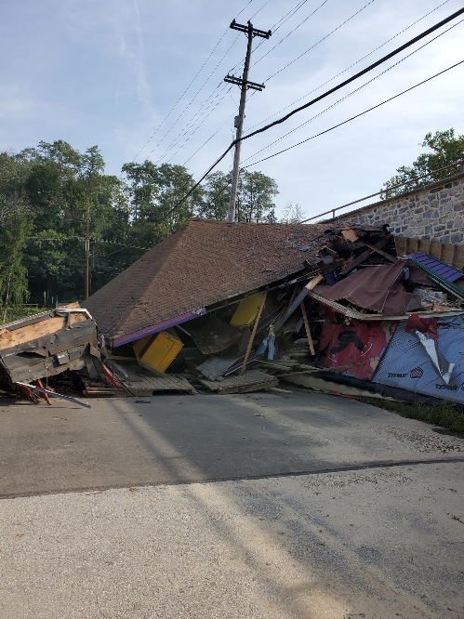
State Flag
Some Ida Impacts
90-unit apartment facility evacuated
Limited stock of affordable housing impacts evacuees who cannot return
Tornadoes accompanied Ida remnants
Home and business flooding created localized hazardous material and petroleum releases

Slide 6
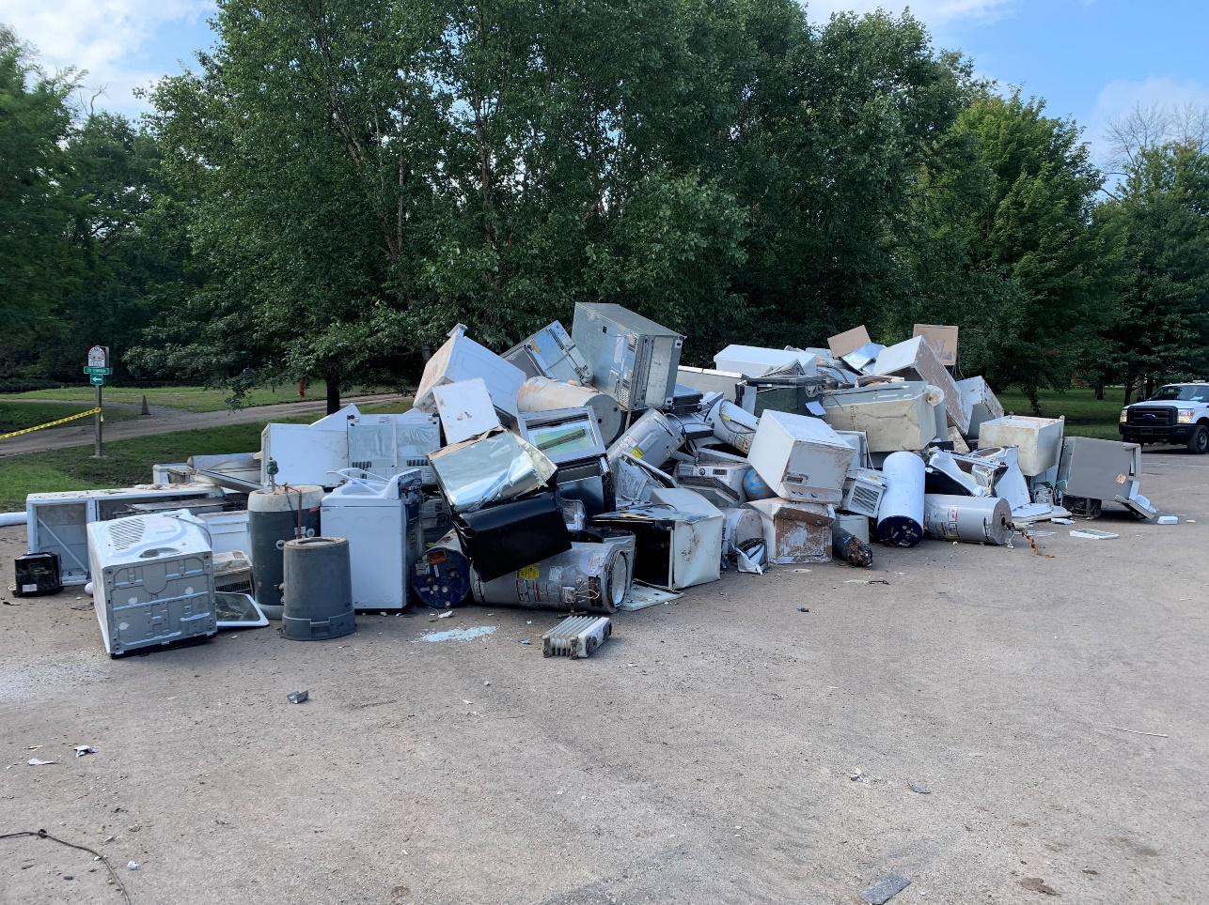
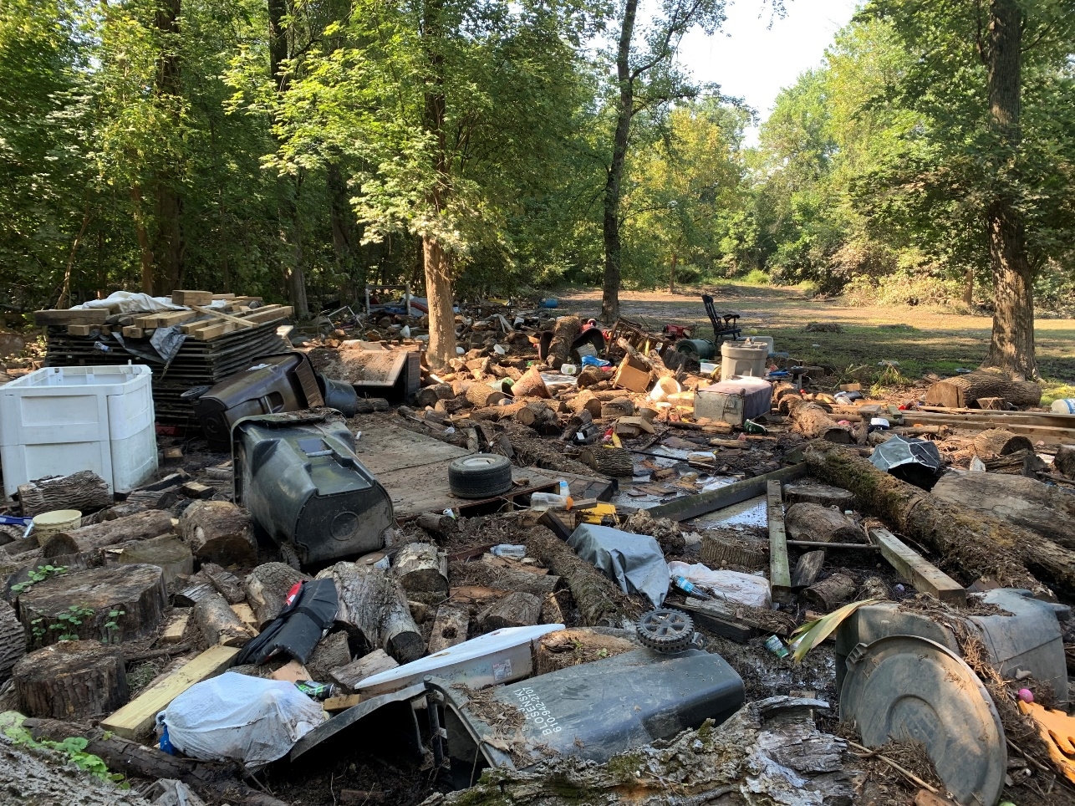
State Flag
Some Ida Impacts
Mont Clare, Upper Providence Twp., Montgomery Co.
  Historic flooding along both Schuylkill River and Perkiomen Creek
  Heating oil, other household chemicals, waste oils from businesses
  Residential, Township Park, County Park Impacts

Slide 7
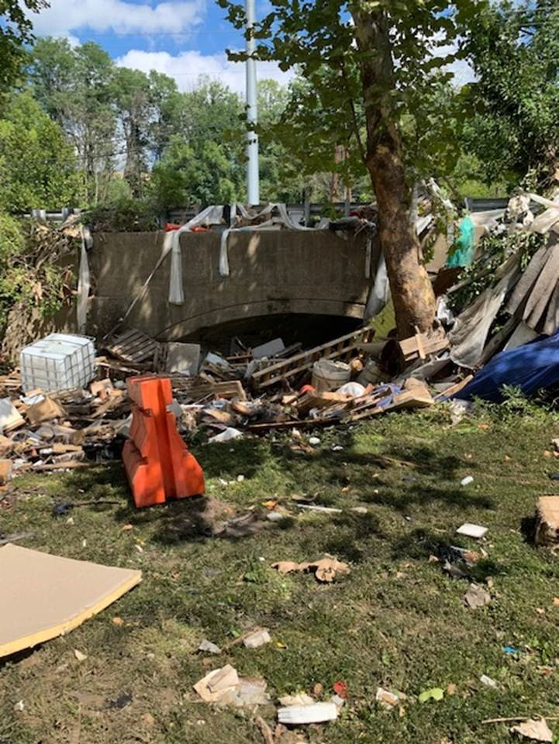
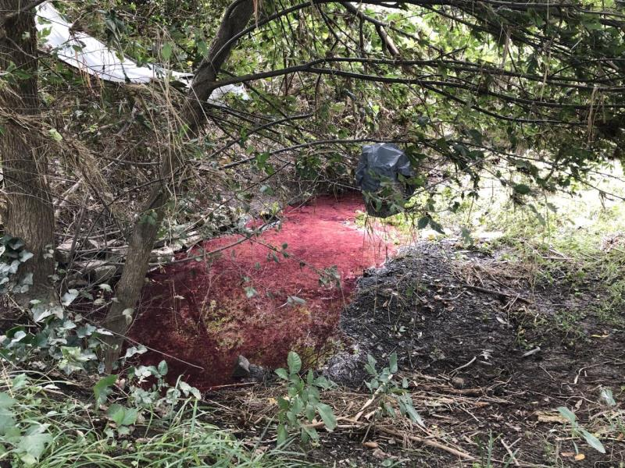
State Flag
Some Ida Impacts
Brandywine Creek Corridor, Chester County
  Historic Flooding
  Residential Heating Oil Releases
  Several Industrial Sites Hit Hard

Slide 8
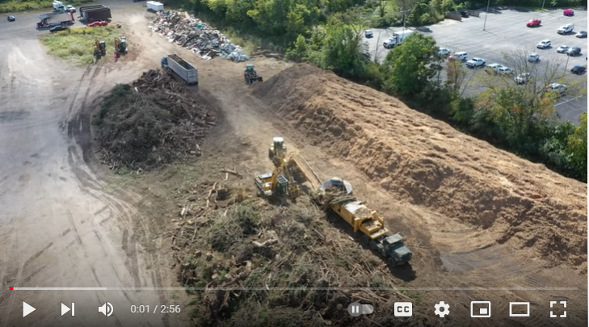
State Flag
Some Ida Impacts
Major debris management operation, Montgomery County
  Tornado damage
  Flood debris
  Operation still ongoing
  https://www.youtube.com/watch?v=v1lS-sRDj8I

Slide 9
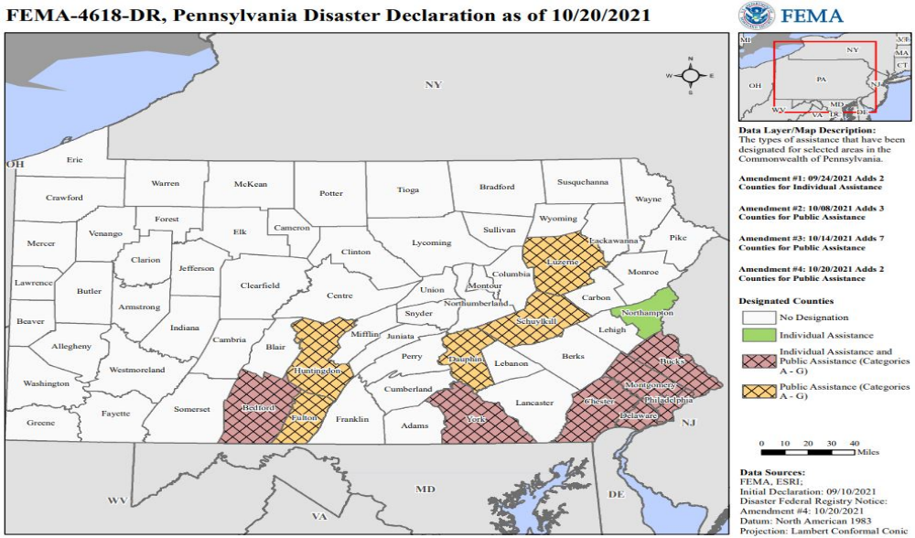
State Flag
County Disaster Declarations

Slide 10
State Flag
Individual Assistance
FEMA's Individuals and Households Program (IHP) provides financial and direct services to eligible individuals and households affected by a disaster, who have uninsured or underinsured necessary expenses and serious needs.
First housing assistance and other needs assistance payments disbursed September 16, 2021

Slide 11
State Flag
Public Assistance
FEMA’s Public Assistance Program provides supplemental grants to Commonwealth and local governments, and certain types of private non-profits so that communities can quickly respond to and recover from major disasters or emergencies.

Slide 12
State Flag
Hazard Mitigation
Hazard mitigation planning reduces loss of life and property by minimizing the impact of disasters. It begins with state, tribal and local governments identifying natural disaster risks and vulnerabilities that are common in their area. After identifying these risks, they develop long-term strategies for protecting people and property from similar events. Mitigation plans are key to breaking the cycle of disaster damage and reconstruction.

Slide 13
State Flag
Issues and Concerns
Ongoing COVID vaccination effort/Social distancing requirements
Afghan partner resettlement support (Philadelphia International Airport/Dulles International Airport
Staff deployed to FEMA Regions 1 & 2 for other hurricane response
Heavy rain October 2021
Some residents unsure regarding how to secure relief measures
Disaster Recovery Centers establishment

