Slide 1
RULET Vessels
Remediation of Underwater Legacy Environmental Threats
By MST3 Alex Leatherman

Slide 2
References
U.S. Coast Guard Marine Environmental Response and Preparedness (MER) Manual, Chap. 10 (COMDTINST M16000.14A)
https://sanctuaries.noaa.gov/protect/ppw/wrecks.html
“Risk Assessment for Potentially Polluting Wrecks in U.S. Waters”, NOAA, Office of National Marine Sanctuaries, Office of Response and Restoration
Mr. Frank Csulak, NOAA SSC, Office of Response and Restoration

Slide 3
Objectives
Understand a general overview of the NOAA RULET Vessel Program
Gain a general awareness of environmental threats from sunken vessels to the USCG Sector VA area of responsibility
Understand the relevance of the RULET program as it pertains to Coast Guard Marine Environmental Response

Slide 4
Background
There are an estimated 20,000 shipwrecks in U.S waters that may contain oil cargo or fuel
Deterioration of the vessels can cause them to leak
Sunken vessels have been the source of mystery spills that impact coastal environments
Notes:
There are concerns about potential environmental impacts from eventual release of cargo and fuel from the 20,000 shipwrecks in U.S. waters. Although a few are well-publicized oil pollution threats, most wrecks are left alone and are largely forgotten until they begin to leak, often becoming the source of "mystery spills" that harm coastal economies and environments.

Slide 5
History
Resources and Undersea Threats (RUST), includes approximately 20,000 shipwrecks in U.S. waters
In 2010, NOAA conducted research to narrow down the potential sites for inclusion into regional and area contingency plans
Remediation of Underwater Legacy Environmental Threats (RULET) narrowed down to 87 vessels within US EEZ by 2015
Notes:
Enter RUST, NOAA’s legacy program of categorizing 20,000 shipwrecks in US waters. RUST is a part of the Sanctuaries Hazardous Incident Emergency Logistics Database System (SHIELDS), a web-based contingency plan tool hosted on a secure intranet, and utilized by NOAA. RUST contains a database of about 30,000 targets. 20,000 of which are shipwrecks.
In time, there was a realization that these shipwrecks needed to be prioritized and monitored based upon their environmental and operational impacts. Thus, in 2010 NOAA began to narrow down these legacy threats, and ended up with a grand total of 87 targeted shipwrecks by 2015.

Slide 6
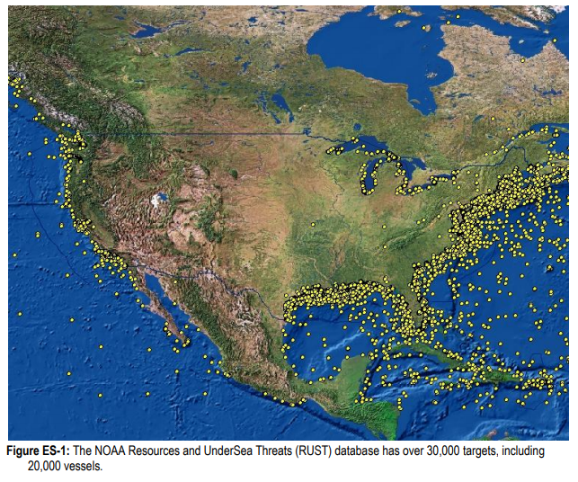
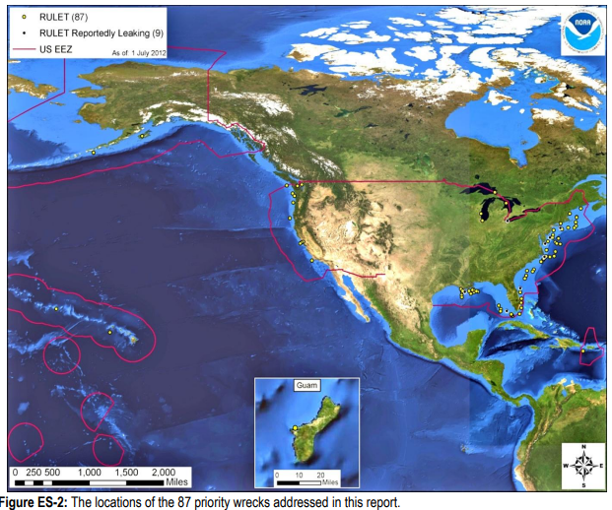
RUST vs. RULET
Rust Capture of the Lower 48
Entire RULET Database
Notes:
This is to illustrate the effect of pairing down the RUST database.
To the left is a picture of the lower 48 and the targets therein, under the RUST database.
To the right is a picture of the entire RULET database and it’s 87 targets.

Slide 7
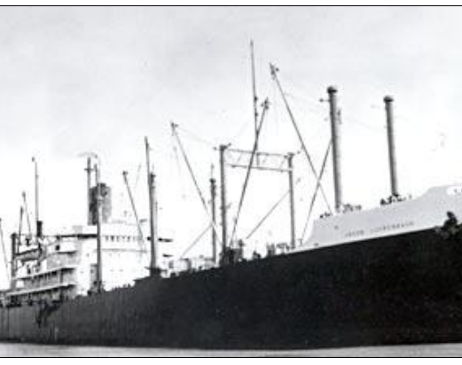
Before RULET:
Jacob Luckenbach
Collided with its sister ship and sank off the Farallon Islands on July 14, 1953
Loaded with 457,000 gallons of bunker fuel
Hull shifted during violent storms, releasing oil
Cost $19 million to pump out tanks
Cost $22.7 million for 14 different shoreline restoration Projects
Notes:
Sunk after a collision in 1953. Fifty years later, researchers found that the ship rocked from side to side on the seabed every time there was a heavy storm, releasing oil. NOAA and the US Coast Guard decided it would be best to remove the oil, so in 2003 salvors bored holes in the ship’s tanks and heated the oil with steam lances to lower its viscosity, then pumped it out. This technology for removing oil, known as hot tapping, is well established but it can be expensive, depending on the state of the wreck. Emptying the Jacob Luckenbach cost $19 million. It also cost another $22.7 million dollars for coastal clean-up efforts prior to hot tapping.

Slide 8
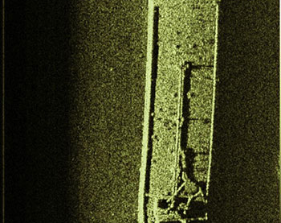
After RULET:
Argo
Oil tank barge, sank in Lake Erie in 1937
Sank with 4,800 barrels of oil
Identified as an imminent threat by the RULET program in 2013
Successful monitoring lead to identification of leaking oil in September 2015
Oil product removal completion December 1, 2015
Notes:
The important distinction between the two vessels is the timeliness of response. A sheen from the Argo triggered a clean-up project, which prevented the need for shoreline restoration projects.

Slide 9
What does this all mean for USCG MER?
RULET vessels fall under the definition of abandoned vessels in the USCG MER Manual
    “FOSCs should incorporate information about known abandoned vessels and vessels captured in the RULET program into their area planning process”
Guidance in the USCG MER Manual states that there are no programmatic expectations
    FOSC should evaluate RULET threat assessments with local area committees to determine if any are deemed a “substantial threat.”
Notes:
Area planning, as directed by the MER manual, states a preference for the consideration of RULET vessels as abandoned or derelict vessels, during the planning process.
There is no current expectation to add these vessels into planning documents unless deemed a substantial threat by local area committees.
There is currently no know entry of RULET vessels in the ACP for Sector Virginia.

Slide 10
Pollution Potential Factors
1) Total oil volume potentially onboard as cargo and bunker fuels
2) Oil type
3) If the wreck was reported to have been cleared as a hazard to navigation or demolished
4) If significant amount of oil was lost during the casualty
5) The nature of the casualty
Notes:
These are the potential pollution factors used when categorizing the potential discharge risk posed by the RULET vessels.

Slide 11
Potential Operations Impact Factors
1) Wreck orientation on the seafloor
2) Water depth
3) Visual or remote sensing confirmation of the site conditions
4) If other hazardous materials were onboard
5) If munitions were onboard
6) If the wreck is of historic significance and will require appropriate actions to be taken under the National Historic Preservation Act and the Sunken Military Craft Act
Notes:
These are the potential operations impacting factors used when categorizing the potential hazards posed by the RULET vessels.

Slide 12
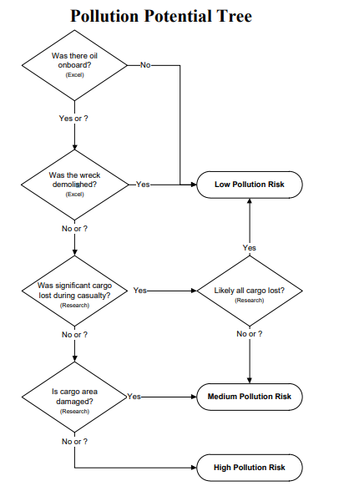
SERT Analysis
Notes:
Flow chart used in conjunction with NOAA research to determine the low, medium, high designation of RULET vessels. Flow chart and analysis were conducted by USCG Salvage Engineering and Response Team (SERT) (Low, Medium, High Designation are reflected in the green, amber, red coloring on the chart in the following slides.)

Slide 13
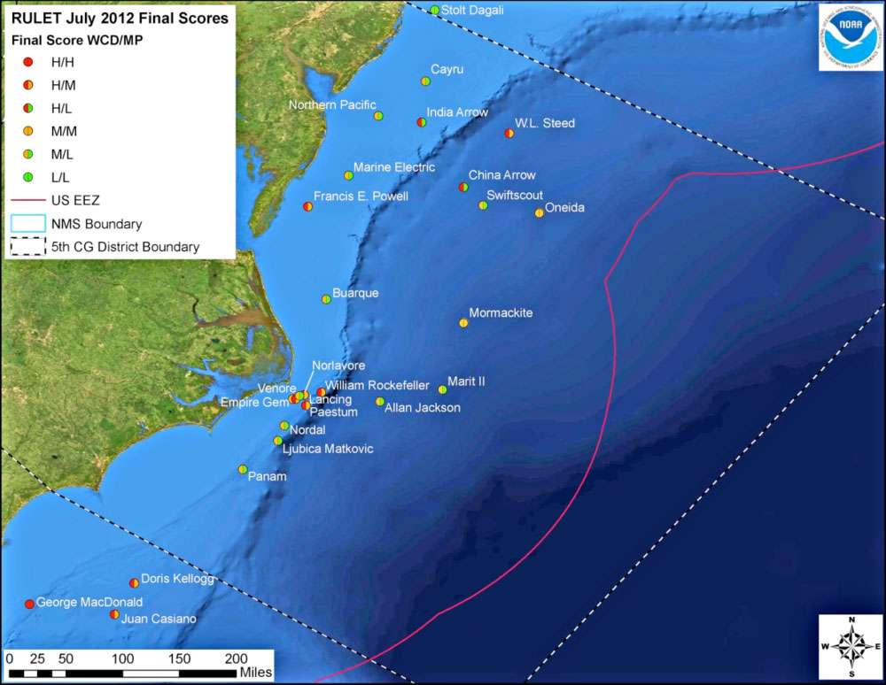
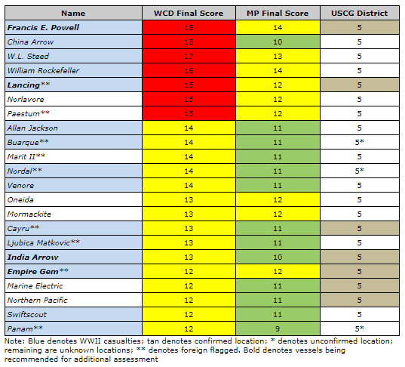
RULET Vessels in USCG District 5
Notes:
There are 22 total RULET vessels currently listed in D5. The accompanying chart lays out the max potential (MP), and worst case discharge (WCD) probability based on the previously discussed Pollution Potential factors and Operational impact Factors. The calculation and categorization were done through the research and development of the RULET program along with the USCG Salvage Engineering Response Team (SERT)

Slide 14
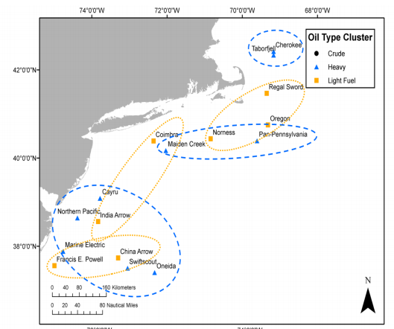
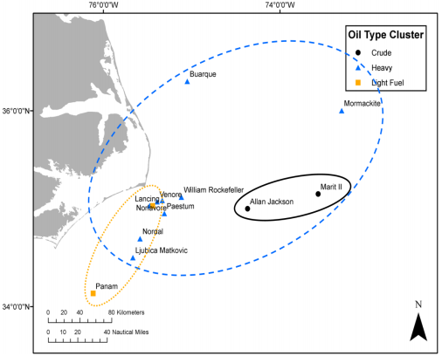
Geographic Clusters
Notes:
Geographic clusters of vessels carrying the same grade of oil can increase the difficulty of locating the source of discharge. The diagrams show the areas that could potentially be affected and the vessel clusters which may be priority targets, depending on the location of a mystery spill.
Note: There are no known models showing shoreline impact to the Sector VA AOR by RULET vessels under normal wind and sea conditions.

Slide 15
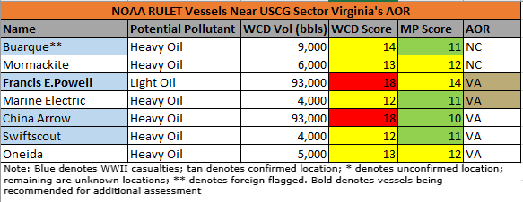
RULET Vessels in USCG Sector VA AOR
Notes:
There are five RULET vessels within the Sector VA AOR China Arrow and Francis E. Powell being the two “high risk” vessels in the AOR for Sector Virginia. Five other RULET vessels that reside within the Sector Virginia AOR are:, Marine Electric, Swiftscout, and Oneida. The vessels Buarque and Mormackite reside in the Sector NC AOR, but the locations are near the Sector VA southern border.
The following slides detail each of these vessels.
Important to note:
-WCD volume is reported in barrels (bbls). Each barrel is equivalent to 42 US gallons
-Of the seven vessels, only the Francis E. Powell has been reported leaking
-The Francis E. Powell and China Arrow have the highest risk for Worst case discharge, and are also the only two vessels reported to have a light fuel oil onboard
-The Oneida is the only vessel reported to have gone down with munitions.

Slide 16
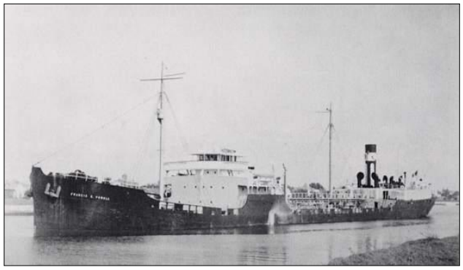
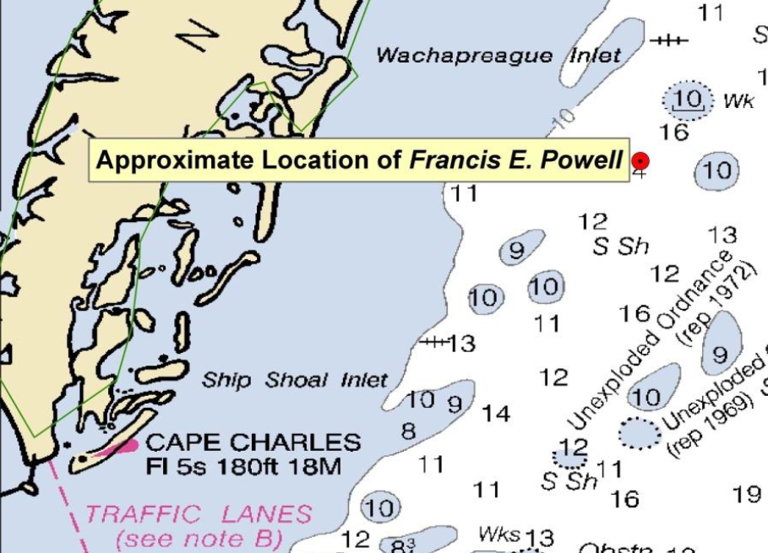
Francis E. Powell
Tanker
Lost on 27JAN1942
Location: Confirmed
Nearest Point of Land: 20NM
Approximate Water Depth: 95ft
WWII Torpedo Casualty
09 cargo tanks
Cargo: 81,000 bbls Furnace Oil & Gasoline
Probable Potential Remaining: <9,074 bbls
Reported Leaking: Yes

Slide 17
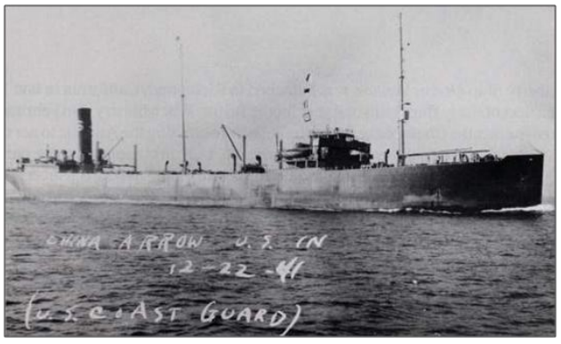
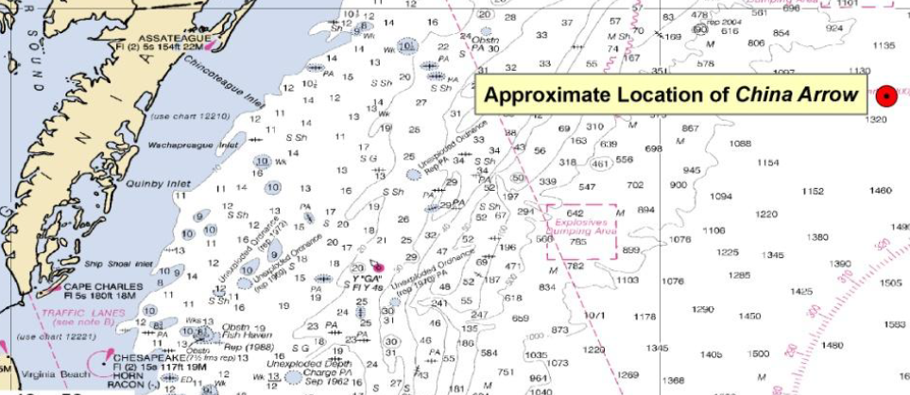
China Arrow
Tanker
Lost on 05FEB1942
Location: Not Confirmed
Nearest Point of Land: 90NM
Approximate Water Depth: 6,500ft
WWII Torpedo Casualty
10 cargo tanks
Cargo: 81,773 bbls Fuel Oil
Probable Potential Remaining: ≤10,870 bbls
Reported Leaking: No

Slide 18
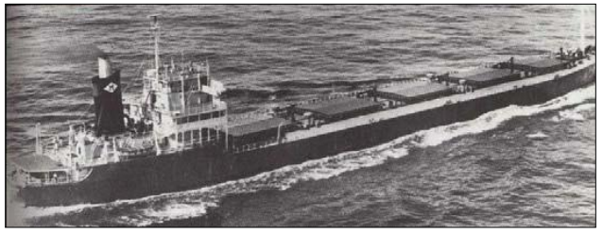
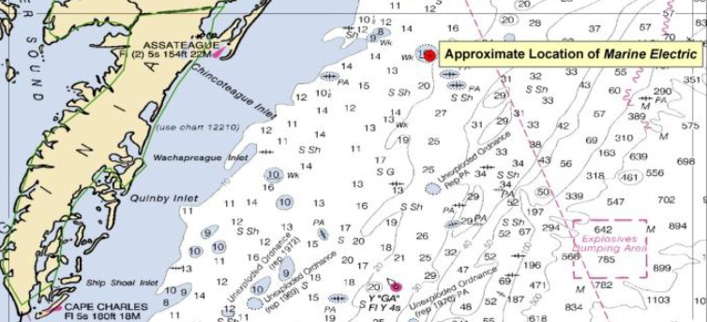
Marine Electric
US Flag Dry Bulk Carrier
Lost on 10FEB1983
Location: Confirmed
Nearest Point of Land: 23NM
Approximate Water Depth: 125ft
Heavy Weather and Hull Integrity
10 dry cargo holds
Fuel Oil: 3,600 bbls
Probable Potential Remaining: 3,600 bbls
Reported Leaking: No

Slide 19
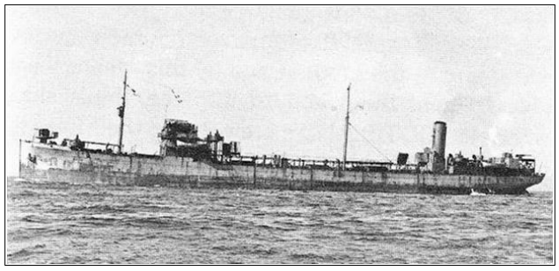
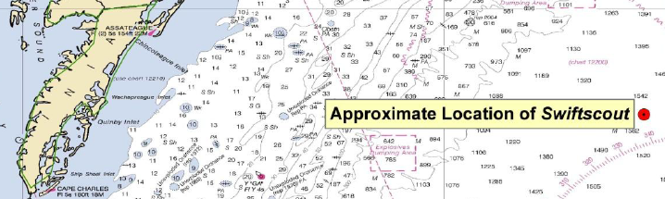
Swiftscout
Munitions Freighter & Fuel Tanker
Lost on 16APR1945
Location: Not Confirmed
Nearest Point of Land: 132NM
Approximate Water Depth: 9,350ft
WWII Torpedo Casualty
Cargo: ≤3,941 bbls Fuel Oil
Probable Potential Remaining: ≤3,941 bbls Fuel Oil
Reported Leaking: No

Slide 20
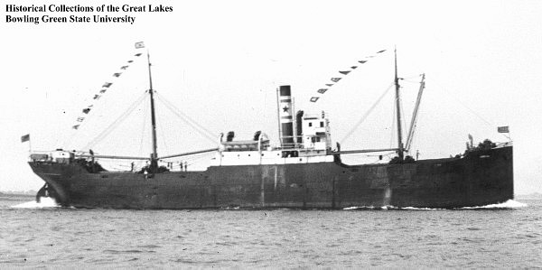
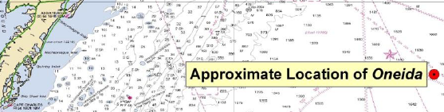
Oneida
Munitions Freighter, Troop Transport & Fuel Tanker
Lost on 04MAY1943
Location: Not Confirmed
Nearest Point of Land: 171NM
Approximate Water Depth: 10,647ft
Loss due to Foundering
Cargo: 48 Tons of TNT, 1800 Tons Castor Oil, & ≤18,068 bbls Fuel Oil
Probable Potential Remaining: ≤4,928 bbls Fuel Oil
Reported Leaking: No

Slide 21
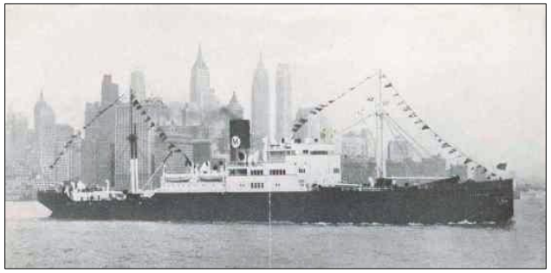
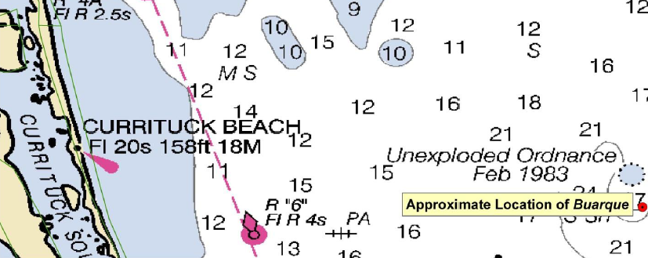
Buarque
Freighter
Lost on 16JAN1942
Location: Not Confirmed*
Nearest Point of Land: 40NM
Approximate Water Depth: 250ft
WWII Torpedo Casualty
Dry Bulk Carrier
Fuel: ≤8,900 bbls
Probable Potential Remaining: ≤8,900 bbls
Reported Leaking: No
Notes:
*Wreck is at location, but has not been positively identified

Slide 22
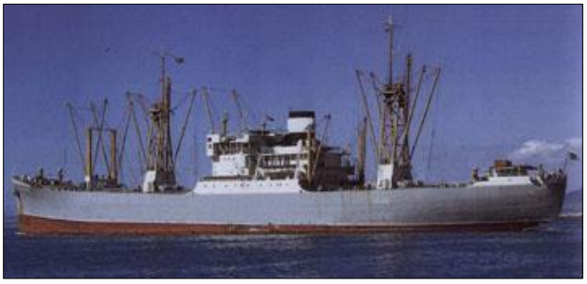
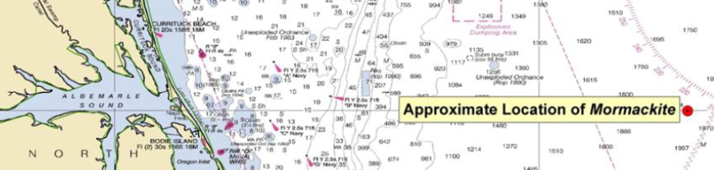
Mormackite
Freighter
Lost on 05FEB1942
Location: Not Confirmed
Nearest Point of Land: 132NM
Approximate Water Depth: 11,890ft
WWII Torpedo Casualty
Dry Bulk Cargo
Fuel Oil: ≤5,145 bbls
Probable Potential Remaining: ≤5,145 bbls
Reported Leaking: No

Slide 23
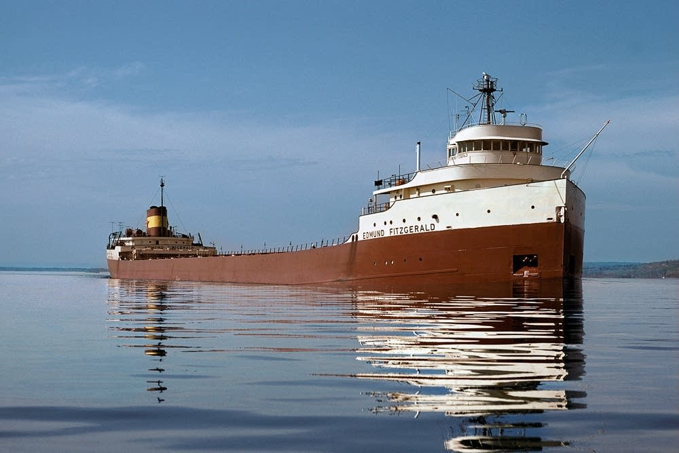
Questions?

