Slide 1
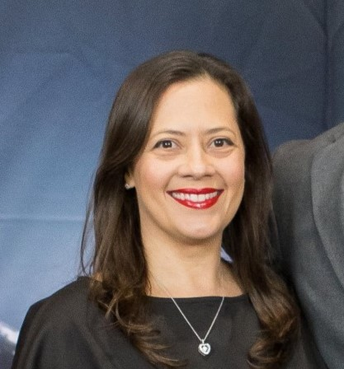
Thank You
Cindy!

Slide 2
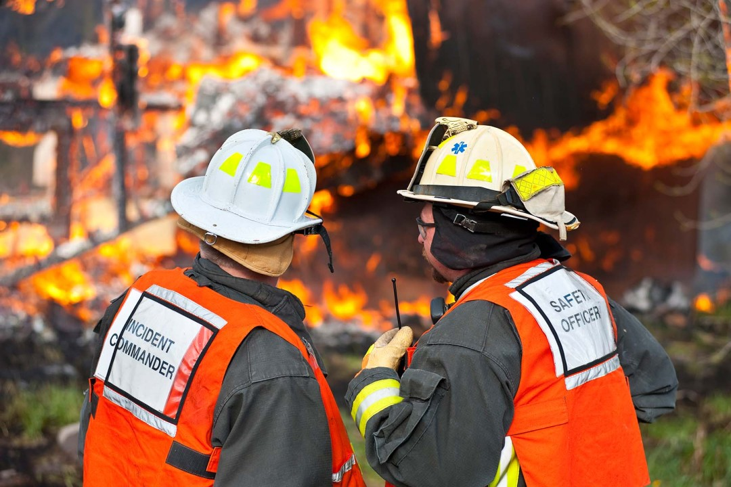
RRT III
Coordinator’s Report
Sabina Bastias
RRT3 Coordinator
December 11, 2024

Slide 3
RRT Meetings
RRT Meeting
Locations
RRT Meeting
Locations
RRT Meeting
Dates
RRT Meeting
Dates
RRT 1
TBD | TBD
Dec 18 & 19, 2024 | Norrie Point, NY
TBD | TBD
April 30 – May1, 2025 | Chincoteague, VA
May 29-30, 2025 | Tentative: Gautier, MS
April 15-16, 2025 | Columbus, OH
April 2-3, 2025 Nov 5-6, 2025 | Lenexa, KS (Joint w/ R7) Addison, TX
RRT 7
April 2-3, 2025 Aug 2025 | Lenexa, KS (Joint w/ R6) Lenexa, KS
April 16-17, 2025 Oct 15-16, 2025 | Denver, CO Denver, CO
February 5-6, 2025 | TBD – Southern CA
March 11, 2025 Sept 25, 2025 | TBD – Puget Sound Area TBD
TBD | TBD
TBD | TBD
RRT 2
RRT 8
CRRT
RRT 9
RRT 3
RRT 10
RRT 4
Alaska
RRT 5
Oceania
RRT 6

Slide 4
Other Events:

Slide 5

The Gulf-Alaska Knowledge Exchange Workshop series will hold the final of three workshops in Washington, D.C. on March 25th & 26th, 2025. The workshop will have an overarching goal of learning from and applying past oil spill experiences to future spills. Speakers representing community organizations, agencies, industry, academia, and indigenous communities will provide context for the rich discussion by all participants in the workshop. Participation is open to all interested parties, and there will be a virtual attendance option. Following brief panel discussions by invited speakers, all interested parties are welcome to participate in breakout group discussions.
https://www.nationalacademies.org/our-work/gulf-alaska-knowledge-exchange-a-workshop-series

Slide 6
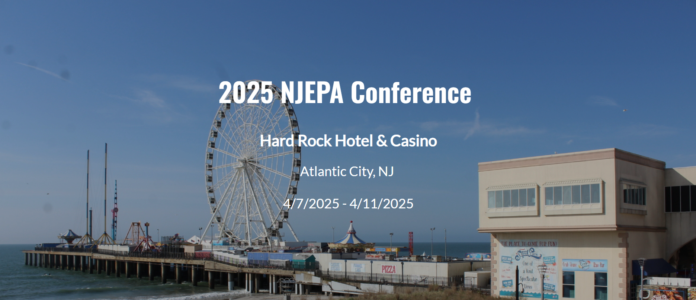
NJ Emergency Preparedness Association
https://www.njepa.org/website/73427/

Slide 7

The International Oil Spill Conference (IOSC)
New Orleans, LA
April 8 – 10, 2025
https://www.iosc.org/

Slide 8

https://www.interspill.org/2025/exhibition/overview/

Slide 9

Hilton Baltimore - Baltimore, MD
June 12 - 15, 2025
https://www.iafc.org/events/event/2025/06/12/default-calendar/international-hazardous-materials-response-teams-conference-2025

Slide 10

https://www.cleanwaterwaysevent.org/

Slide 11
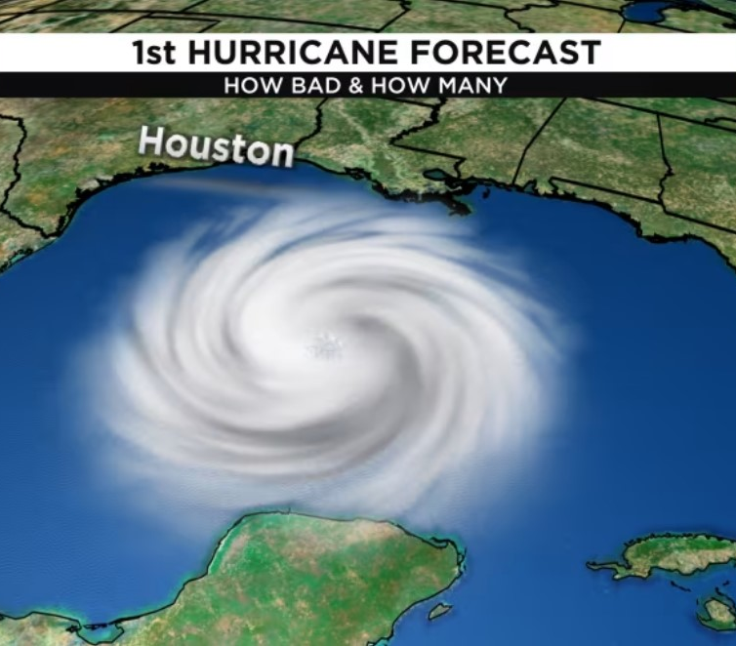
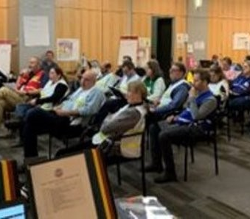
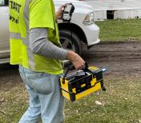
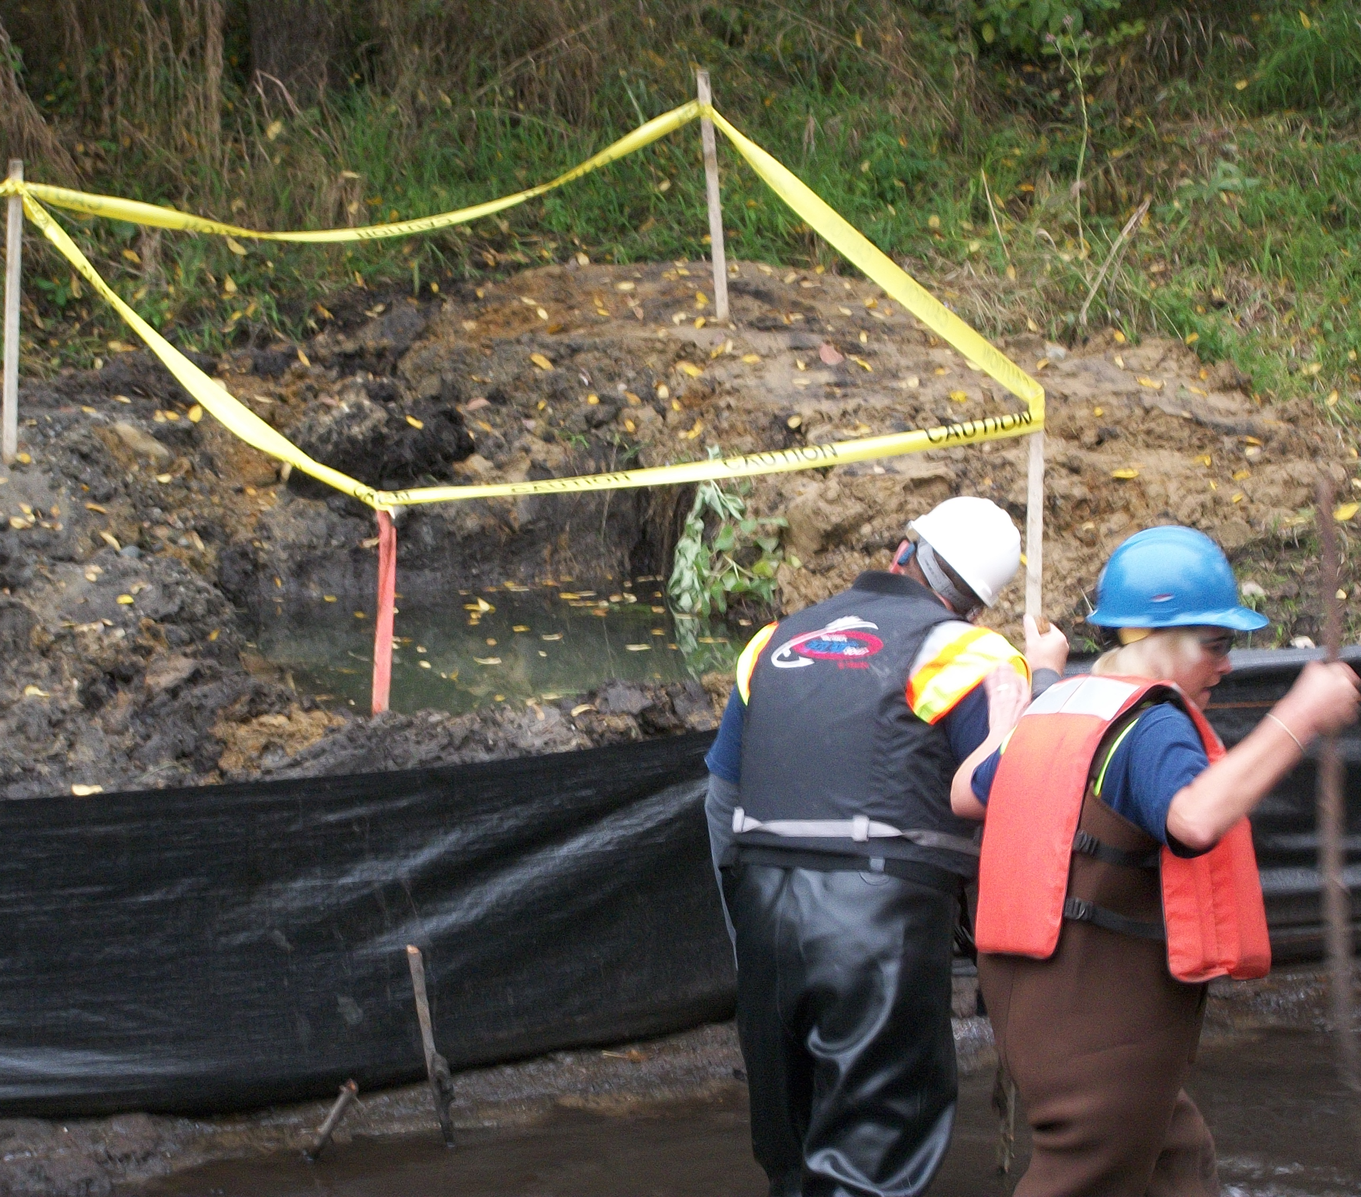
  Please share information with us:
  New entry forms and dashboards coming to nrt.org/RRT3!
    Conferences
    Meetings
    Workshops
    Exercises
    Training
    Other Events that we can share in your area,
    region, nationally and internationally
Notes:
Mention new entry forms and dashboards coming to website. An email will be sent when ready to be used.

