Slide 1
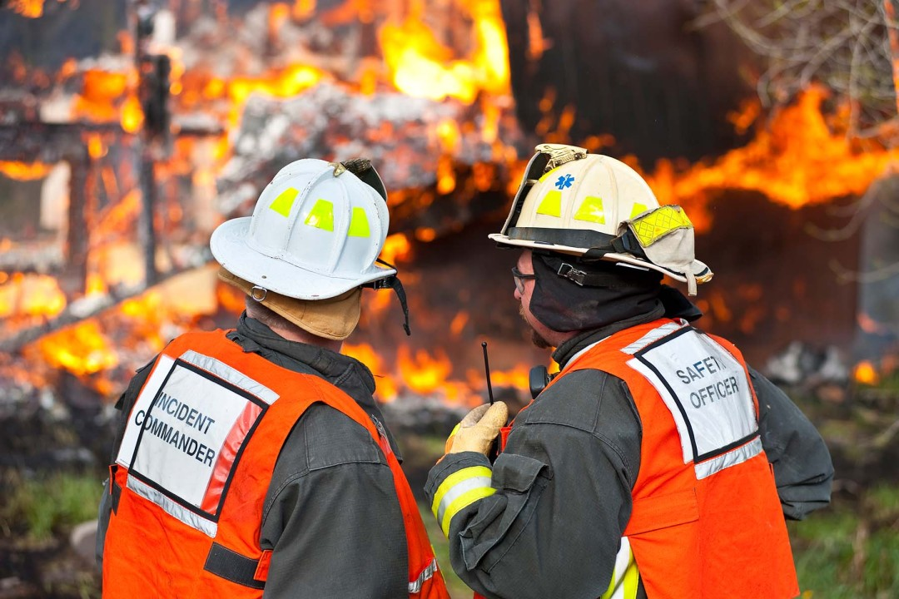
RRT III
Coordinator’s Report
Cindy E. Santiago
RRT3 Coordinator
May 8, 2024

Slide 2
RRT Meetings
RRT Meeting
Locations
RRT Meeting
Locations
RRT Meeting
Dates
RRT Meeting
Dates
RRT 1
June 4, 2024 Dec 2024 | Boston, MA TBD
TBD | TBD
TBD | TBD
Dec 3-5, 2024 TBD | Shepherdstown, WV (tentative)
May 29-30, 2024 | Gautier, MS
April 30 – May 1 Next TBD | St. Paul, MN TBD
May 8-9, 2024 | Addison, TX
RRT 7
Aug 14-15, 2024 | Lenexa, KS
May 1-2, 2024 | Denver, CO
July 24-25, 2024 | Carson City, NV
June 12th September 25th | Idaho Falls, ID Florence, Oregon
Sept 10-12, 2024 | TBD
December 12 | Virtual
RRT 2
RRT 8
CRRT
RRT 9
RRT 3
RRT 10
RRT 4
Alaska
RRT 5
Oceania
RRT 6

Slide 3
Other Events:

Slide 4

The Gulf Research Program (GRP) will host a workshop series to bring together representatives from Alaska and the Gulf of Mexico region to share experiences, knowledge, strategies, and best practices to help prepare for and recover from potential future spills. This effort is in accordance with GRP’s settlement agreement language which refers to reducing risk of future harm to people, the environment, and the economy due to oil spills as a “national priority."
https://www.nationalacademies.org/our-work/gulf-alaska-knowledge-exchange-a-workshop-series

Slide 5
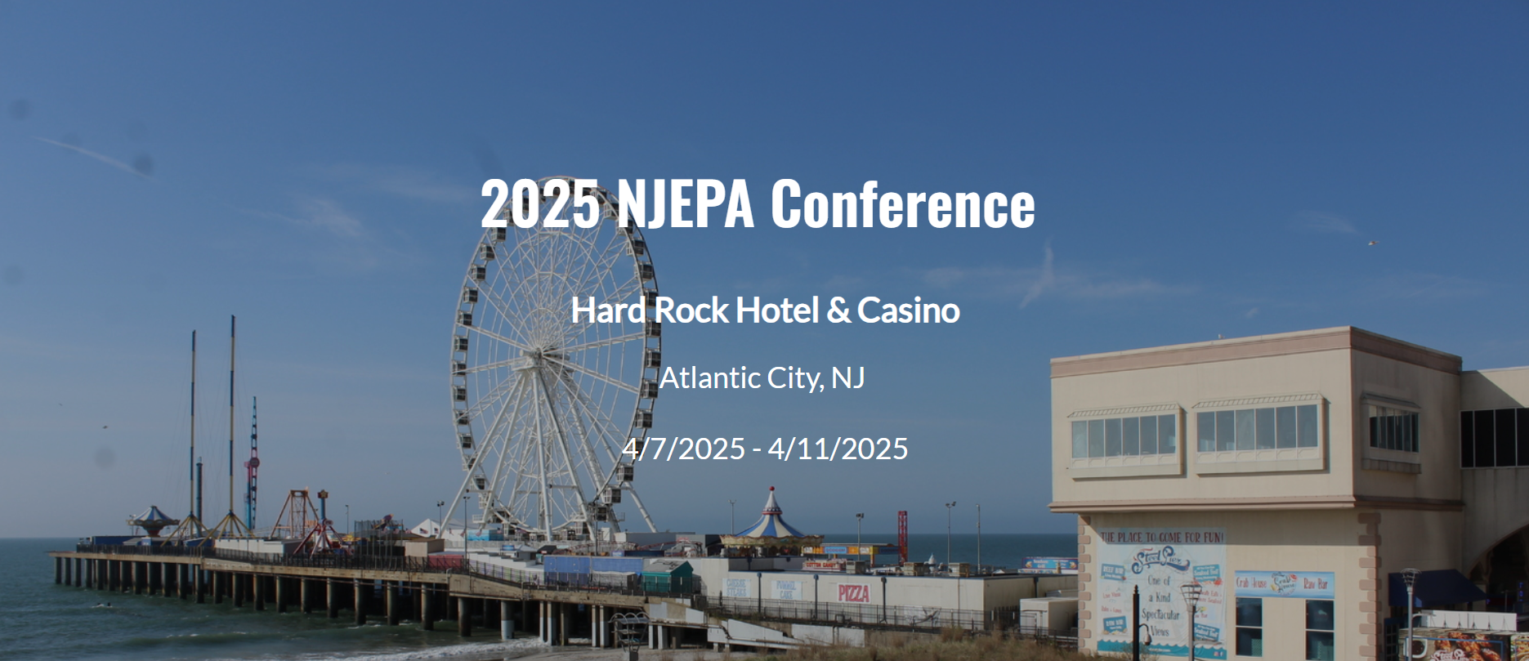
NJ Emergency Preparedness Association
https://www.njepa.org/website/73427/

Slide 6

The International Oil Spill Conference (IOSC)
New Orleans, LA
May 13-16, 2024
https://www.iosc2021.org/

Slide 7

https://www.interspill.org/2025/exhibition/overview/

Slide 8

Hilton Baltimore - Baltimore, MD
June 5-9, 2024
https://www.iafc.org/events/event/2024/06/05/default-calendar/international-hazardous-materials-response-teams-conference-2024

Slide 9

https://www.cleangulf.org/

Slide 10

https://www.cleanwaterwaysevent.org/

Slide 11
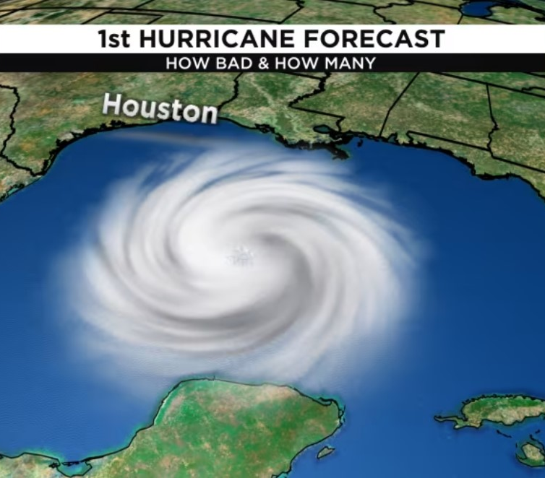
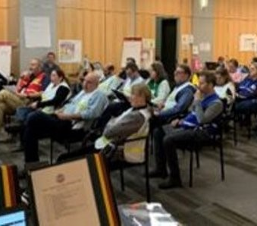
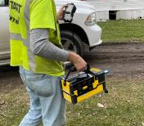
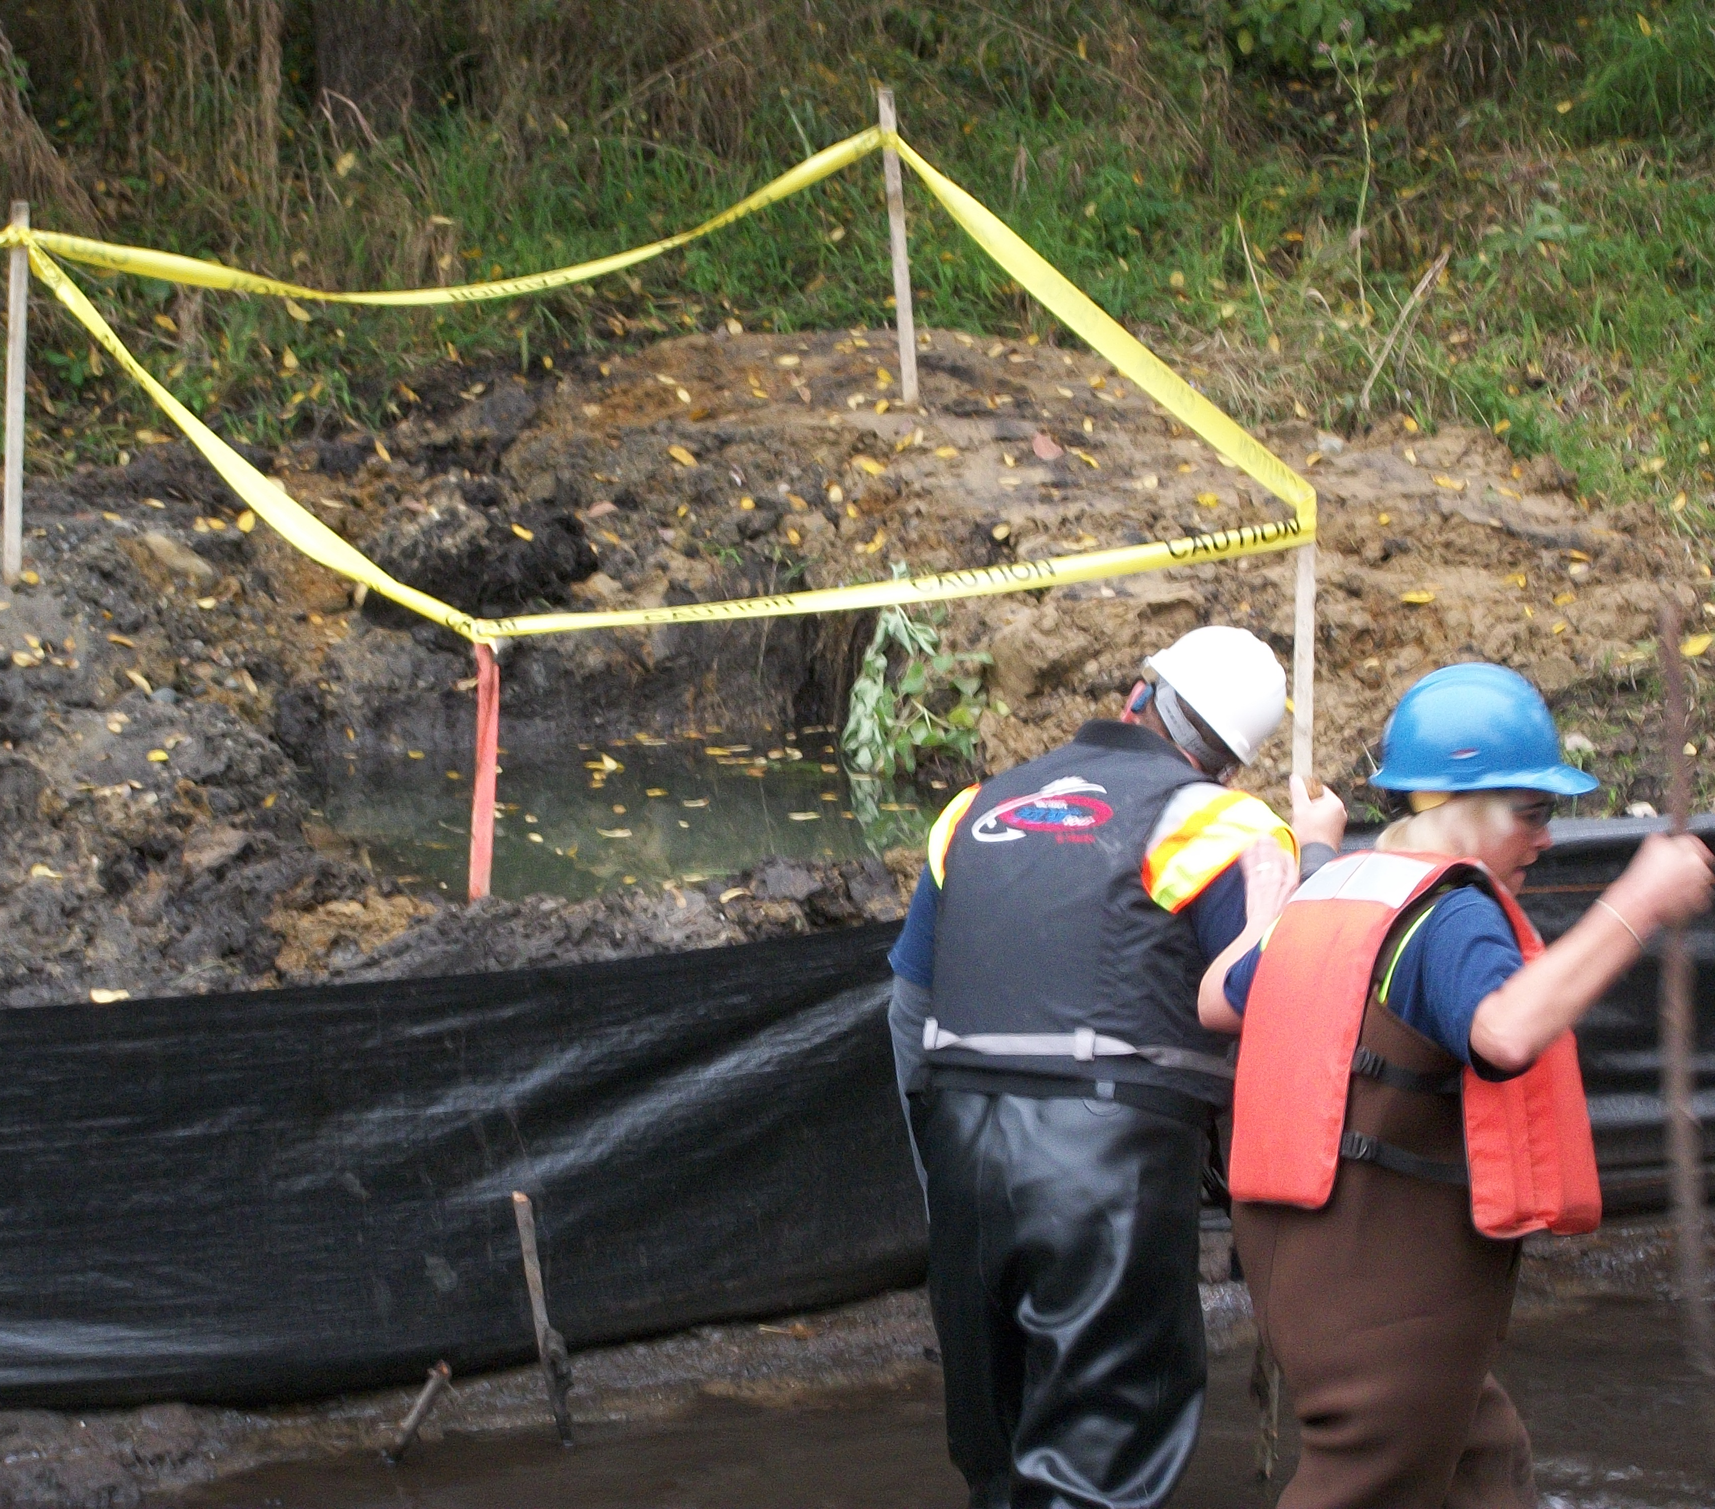
  Please share information with us:
    Conferences
    Meetings
    Workshops
    Exercises
    Training
    Other Events that we can share in your area,
    region, nationally and internationally
    Retirements

Slide 12

Thank You
John Giese

