Slide 1
May 2024

Slide 2

Department of Interior Report – May 2024
Bureau of Safety & Environmental Enforcement (BSEE) - Oil Spill Preparedness Division (OSPD) - Response Research Branch (RRB):
  Development of a Remotely Operated Surface Vehicle: Under BSEE project (contract 140E0119P0019), Tactical Electronics has developed a Remotely Operated Surface Vehicle (ROSV) built from a commercial off-the-shelf jet ski that provides a platform for rapid and long-term remote sensing. A prototype ROSV is being developed with the capabilities for an integrated oil slick thickness detection system, flexible system to mount and deploy instruments above or below water and VOC sensing system.
FWS
  Sarah Scheaffer – Delaware and Southeastern Pennsylvania (Delaware River Watershed)
  Jo Ann Banda – Maryland, Virginia, West Virginia, District of Columbia, and remainder of Pennsylvania

Slide 3
DOI Report – May 2024
Key Bridge Collapse - Coordinating with USCG, NOAA, MD SHPO, FWS, etc. Resources at risk and providing input into protection strategies and plans.
PRFA Guidance - DOI/OEPC is working on revising internal Pollution Removal Funding Authorizations guidance; process for setting up reimbursable agreements between DOI bureaus and OSC when DOI expertise is requested on a response.
Tribal Training – DOI is working to assemble a Tribal Outreach Plan. Identified need to provide Tribes with training and preparedness activities associated with oil spills. Identify Tribal training needs and barriers associated with attending trainings.
Unanticipated Discovery Plan – RRT workgroup drafted template plan that can be used in ACPs; additional material including field guide and MOA for data sharing are also being considered; distributing for review and comment. MD and PA SHPO; EPA
Inland Oil Spill Preparedness Project – DOI recently accepted preproposals for FY25 projects.
Partners in Response – Training with Colonial Pipeline scheduled for May 21 & 22 in Williamsburg, VA
ACP Architecture - ACP Updates; Sector Delaware Bay

Slide 4
General Services Administration Report – May 2024
GSA is scheduling a training session on GSA Acquisition tools (e.g., GSA Advantage, eLibrary and Emergency Acquisition Basic Ordering Agreements) within the next 6 weeks. Contact Kathy or Dave if interested in attending.
FEMA, GSA and DLA held a Logistics Partnering Session on 4/3/24, with a focus on support to Non Stafford Act events. The Planning Committee will begin meeting again soon to plan its next session.
GSA RRT III Representatives from the Office of Mission Assurance (OMA) Philadelphia:
Kathleen Peek, Regional Emergency Coordinator, kathleen.peek@gsa.gov
David Sanders, Emergency Management Specialist, david.sanders@gsa.gov
OMA Philadelphia currently has one vacancy, which we hope to fill by July 2024
Current GSA R3 Regional Administrator – Tom Lyman, Acting
GSA Federal Acquisition Service (FAS) Reorganization – Devolved regional structures to business and customer centric model. FAS support requests will be sent to: fas.emergency@gsa.gov.

Slide 5
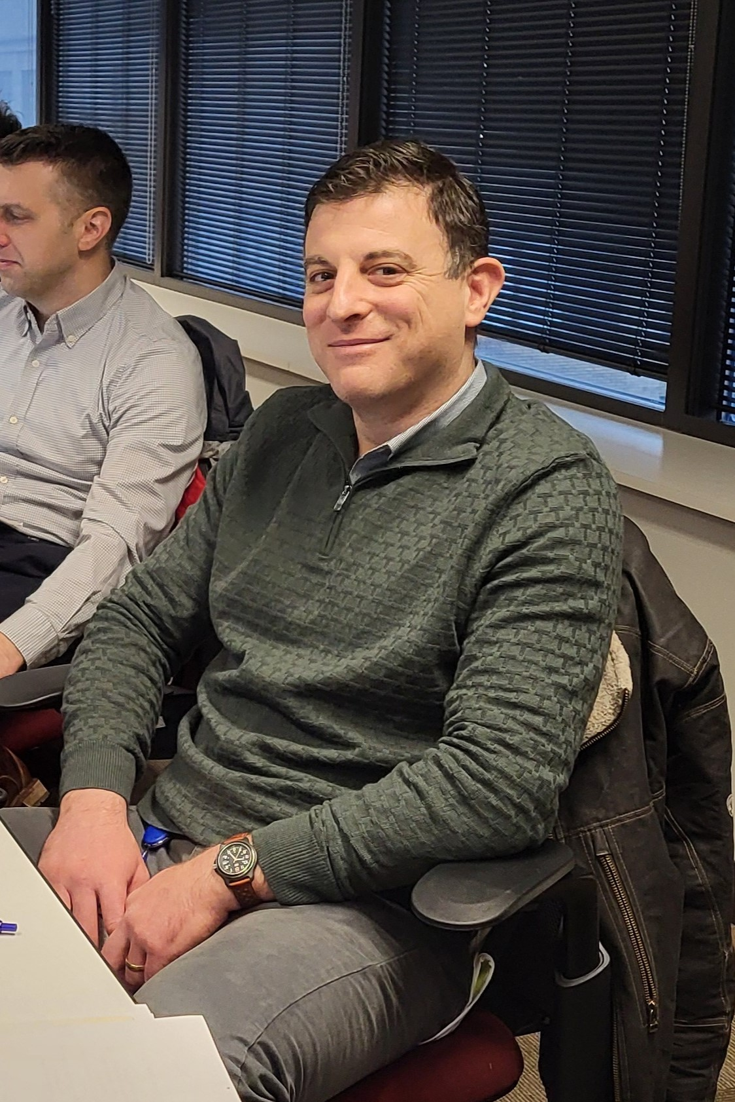

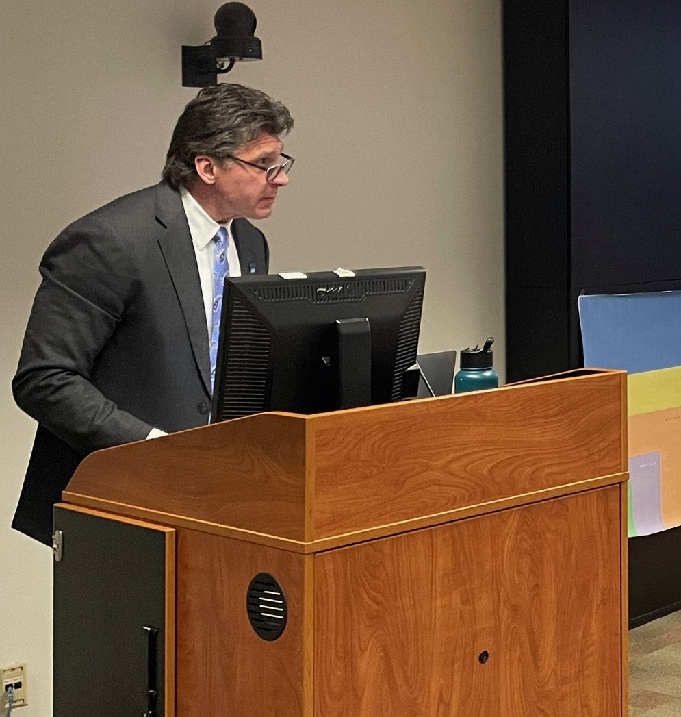
General Services Administration Report – May 2024
Logistics Partnering Session – 4/3/24

Slide 6
FEMA Report – May 2024
Examples include involvement in major responses, lessons learned, challenges, exercises, training events, etc.
Developing Operations Concept of Resource Support
Continued focus on ESF Engagement (meetings, training opportunities)
Published first Regional Air Operations Response Plan
  Assisting in state plan development, as requested
Held 2nd annual State Operations and Logistics (SOL) Symposium
Planning for FIFA 2026
Planning for Nation’s 250th Events (2026)
Recently held Hurricane Senior Leader TTX
Policy changes or updates, organizational changes, new / departing personnel, etc.
Dick Polley - Retired

Slide 7
NOAA SSC Report – May 2024
Examples include involvement in major responses, lessons learned, challenges, exercises, training events, etc.
Training
  SCAT Course, April 22-25,Assateague, VA
  Sector CHS PREP, June 11-13, Charleston, SC
  Sector New York PREP, July 22-23, Albany, NY
  Responses
    26 responses since 1 Oct 2023
    Right Whale carcass
    Humpback Whale carcass
    Key Bridge Collapse
      On-scene support
      Trajectories
      Resources at risk
      Coordinated with the EU, OSRO
      Arranged NWS support
    FV SUSAN ROSE
Policy changes or updates, organizational changes, new / departing personnel, etc.
USEPA Region II RRT/CRRT – Steve Touw retiring as of 31 May 2024

Slide 8


Role | RRT Member | Agency | Contact Info
Primary | Travis Haas | USDA Forest Service | Phone: 414-533-7385 Email: travis.j.haas@usda.gov
Alternate |  |  | Phone Email
Primary |  |  | Phone Email
Alternate |  |  | Phone Email

Slide 9
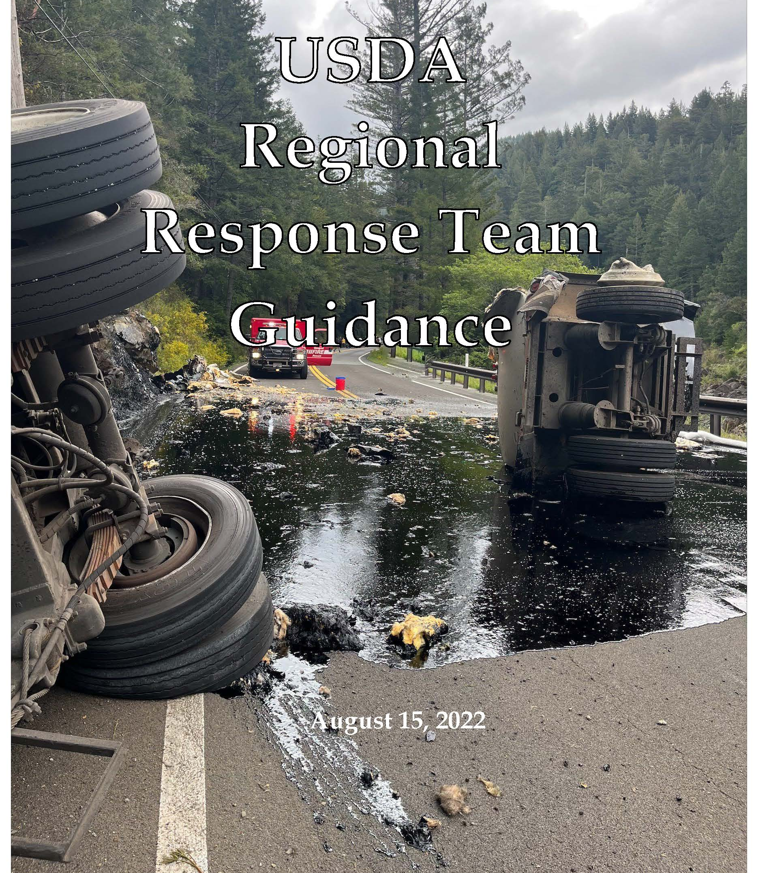
USDA RRT internal Guidance Document
Notes:
Shaken Fury 3-7 June 2019

Slide 10

Recently Developed Tribal Resources
    Tribal Relations Action Plan
    Tribal Connections – GIS Map
    Forest Service Tribal Relations App
Notes:
Shaken Fury 3-7 June 2019

