Slide 1
December 2024

Slide 2
USACE North Atlantic Division Report – May 2024
Hurricanes Helene/Milton
  Currently 40 pax
Support to VA by the Baltimore Debris PRT
  76% debris removed
Washington Aqueduct
  Ongoing preparation for the American Water Infrastructure Act inspection scheduled on or about FEB 2025
LTG William Graham
  New 56th Chief of Engineers - August 2024
Consequent Management coordination and support to the JTF-NCR to the Presidential election, certification, and inauguration

Slide 3
ATSDR Report – May 2024
No significant updates
New Region 3 Director – Michael C Byrns, PhD, ab79@cdc.gov, (267) 760-0304

Slide 4
FEMA Report – December 2024
Examples include involvement in major responses, lessons learned, challenges, exercises, training events, etc.
  Virginia Hurricane Helene Response
  NSSE Inauguration Preparations
  FIFA World Cup 2026 support planning on-going
Policy changes or updates, organizational changes, new / departing personnel, etc.
  Lillian Hutchinson – New Deputy Regional Administrator
  Air Operations Appendix Published
  Concept of Resource Support Published, Continuing to be developed

Slide 5
NOAA Report Out - December 2024
Regulatory Updates for 2024 Released in CAMEO Data Manager and Tier2 Submit
• The National Oceanic and Atmospheric Administration (NOAA) and the Environmental Protection Agency (EPA) jointly released their annual updates for CAMEO Data Manager and Tier2 Submit™, two programs that aid users in meeting regulatory filing and emergency response planning efforts under the Emergency Planning and Community Right-to-Know Act (EPCRA).
•The latest versions, CAMEO Data Manager 4.4.0 and Tier2 Submit 2024, were released on November 4, 2024. These versions have many enhancements, including:
•State-specific data fields updated for regulatory report year 2024 for several states.
•Improvements to the Contact record interface so that the initial data fields display dynamically based on the chosen Contact Type(s). This will lead to better data quality and eliminate a potential area of confusion for some users.
•Updates to both the pre-populated county lists and the county-based latitude/longitude verification tool with the latest county names and boundaries from the U.S. Census Bureau which allows users to compare features and do advanced quality assurance checks. This feature is particularly useful for state-level data collectors who use Tier2 Submit to view (and validate) Tier II forms submitted by users throughout their state.
New National Incident Management System (NIMS) resource types from the Federal Emergency Management Agency (FEMA), which help responders and planners categorize and discuss resources with a shared understanding on what each resource includes and its response capabilities.
Changes to the advanced options for PDF reports in CAMEO Data Manager to allow Contacts to be optional, so that they can be excluded in cases of privacy concerns.
Added ability to run the newest version of the program side-by-side with an older version, which allows users to compare features and do advanced quality assurance checks. This feature is particularly useful for state-level data collectors who use Tier2 Submit to view (and validate) Tier II forms submitted by users throughout their state.
Both programs are part of the CAMEO® software suite, a set of tools to help emergency planners and responders with hazardous chemical releases. Annually, the suite has over eight million page views online and more than 500,000 downloads of the desktop and mobile app programs.
The CAMEO software suite has been jointly developed by the NOAA Office of Response and Restoration and the EPA Office of Emergency Management for more than 35 years. Programs within the suite are vital components of many emergency responder and planner toolkits. All of the programs in the suite are available to users at no cost. For more details and to subscribe to future updates, see the official CAMEO Data Manager and Tier2 Submit release announcement(link is external).

Slide 6
NOAA Report Out - December 2024
What’s New in ERMA®: Enhanced Data Accessibility, New Sensitivity Mapping Data, and more.
This fall, the NOAA Office of Response and Restoration released a new version of the Environmental Response Management Application (ERMA®). ERMA is a web-based mapping application used by environmental responders and natural resource decision-makers. It serves as the Common Operational Picture, or COP, for NOAA and the U.S. Coast Guard, as well as other state and federal agencies, during environmental disaster response and cleanup. Highlighted key enhancements in the recent release, include a host of new features and optimizations.
Dashboards Enhancements
A photo carousel now offers a visually engaging way to browse images, while tab cards provide an organized, at-a-glance view of key data points. Button placements within ERMA have been updated for a more intuitive layout, and users now have added abilities to display percentage values alongside raw data and apply new sort options to streamline data analysis.
View Data Export
Users can also now export data directly from the View Data table, making data sharing and analysis more accessible than ever before. To find the View Data option, find a layer, hover over, and right click on the layer. Users can also find this option by clicking on the vertical ellipsis.
From the View Data table, users can apply additional filters before data export. In the upper right-hand corner is a menu where the Export Layer Data option lives. Accessing this option prompts terms of use that must be agreed upon before proceeding, as well as the different formats data can be exported in.
ESI Tool Updates and New Data Atlases
The latest ERMA update also includes a number of Environmental Sensitivity Index (ESI) changes. In partnership with the Bureau of Safety and Environmental Enforcement (BSEE), ERMA has expanded its coverage by publishing offshore ESI data atlases for the Gulf of Mexico, Southern California, and Alaska. The new offshore atlases contain the same ESI data but for offshore areas in these regions. This data can be queried in ERMA along with the shore-based ESI atlases. ESI source data, metadata, reports, maps, and links to ERMA and ArcGIS online are all available from the OR&R website.
Additional ESI improvements included enhancements to the ESI report, which introduces the ability to create a Resources at Risk (RAR) Summary (ICS-232) Report. ICS-232 is one of the U.S. Coast Guard Incident Command System (ICS) Authorized forms(link is external) used during an incident or in drills. The ERMA ESI Query tool will provide a preliminary report on threatened, endangered and species of special concerns, shoreline classification, managed resource areas, and socioeconomic information. Unique layers within the table of contents have been created for all ESI atlases that represent the extent of data for threatened and endangered species. This allows for more precise mapping and analysis providing valuable data for these sensitive marine areas.
Users can go to the Query Tool Menu and draw a polygon of the area they would like to generate an ESI report. The months are preselected for a timeframe of a month before and after the current date. Select additional months, if necessary, and the biological and other information desired for viewing, then click Run Query. The ESI RAR report page is generated. On the right hand side above the inset map is the option to “Download ICS232 PDF” form. The Environmental Unit Lead (EUL) with the resource trustees would fill in the additional information. A three-page report of the ICS-232 fillable form with the ESI information prefilled will be generated based on the polygon area drawn.

Slide 7
NOAA Report Out - December 2024
2
NOAA 2025 Training
Science of Chemical Releases (SOCR) classes are designed to help spill responders and planners increase their understanding of chemical spill (release0 science when preparing for and analyzing chemical spills, and making risk-based decisions to protect public health, safety, and the environment. SOCR classes follow a similar framework and level of content as NOAA’s Science of Oil Spills (SOS) classes, but are centered on chemical releases rather than oil. SOCR classes are designed to offer a broad, science-based approach to understanding the framework for chemical release response for the purpose of:
•increasing awareness and preparedness, and
•reducing uncertainty and risk associated with this type of incident.
The classes are primarily intended for new and mid-level spill responders, planners, and stakeholders from government and public agencies. Upon completion of the class, students will be able to demonstrate increased awareness and preparedness by employing science-based decision-making in planning for and responding to chemical incidents.
The following SOCR classes have been scheduled:
Mobile, Alabama, March 10-14, 2025: The application period will be October 17 - December 13, 2024.
Seattle, Washington, June 23-27, 2025: The application period will be December 16, 2024 - February 16, 2025.
Response.restoration.noaa.gov/Oil and Chemical Spills/Training

Slide 8
NOAA Report Out - December 2024
2
NOAA 2025 Training
Science of Oil Spills (SOS) classes help spill responders increase their understanding of oil spill science when analyzing spills and making risk-based decisions. They are designed for new and mid-level spill responders.
•These multi-day trainings cover topics including:
•Fate and behavior of oil spilled in the environment.
•An introduction to oil chemistry and toxicity.
•A review of basic spill response options for open water and shorelines.
•Spill case studies.
•Principles of ecological risk assessment.
•A field trip.
•An introduction to damage assessment techniques.
•Determining cleanup endpoints.
•The following SOS classes are currently scheduled:
Houston, Texas, March 17-21, 2025: The application period will be October 17 - December 13, 2024.
Key West, Florida, May 5-9, 2025: The application period will be November 22, 2024 - January 24, 2025.
Seattle, Washington, June 9-13, 2025: The application period will be December 16, 2024 - February 16, 2025.
Online Application: The online application form will be available during the application period for each scheduled SOS class.
https://response.restoration.noaa.gov/training-and-education/training/workshops/science-oil-spills-classes

Slide 9
NOAA Report Out - December 2024
2
NOAA 2025 Training
•Shoreline Clean-Up Assessment Technique Team (SCAT)
USCG District 5 and NOAA co-hosting SCAT Team Member Training
Dates: 15-17 April 2025
Location: U.S. Fish and Wildlife Service
Chincoteague National Wildlife Refuge
8231 Beach Road
Chincoteague, VA 23336
David Pugh, USCG D5, will be sending out course announcement late January, early February. 2025

Slide 10
NOAA Report Out - December 2024
NOAA USCG District 5 Responses
FV SUSAN Rose Grounding and Sinking - 17 Nov 2023, Point Pleasant Beach, NJ
Key Bridge Major Marine Casualty - 26 March 2024, Baltimore, MD
Delaware City Refinery Oil Spill - 29 May 2024, Delaware City, DE
Stepan Chemical Co Chemical Spill - 18 June 2024, Fieldsboro, NJ
Buckeye Terminal Oil Spill - 12 September 2024, Wilmington, DE
Marine Debris Wash-Up - 16 September 2024, DE, MD, VA
MV DEFIANT Oil Spill - 27 September 2024, Baltimore, MD

Slide 11
NOAA Report Out - December 2024
NOAA Personnel Changes
John Tarpley
Chief, Emergency Response Division
NOAA Office of Response and Restoration
Seattle, WA
Jay Coady
Spatial Data Branch Chief
Assessment and Restoration Division
NOAA's Office of Response and Restoration
Charleston, SC

Slide 12
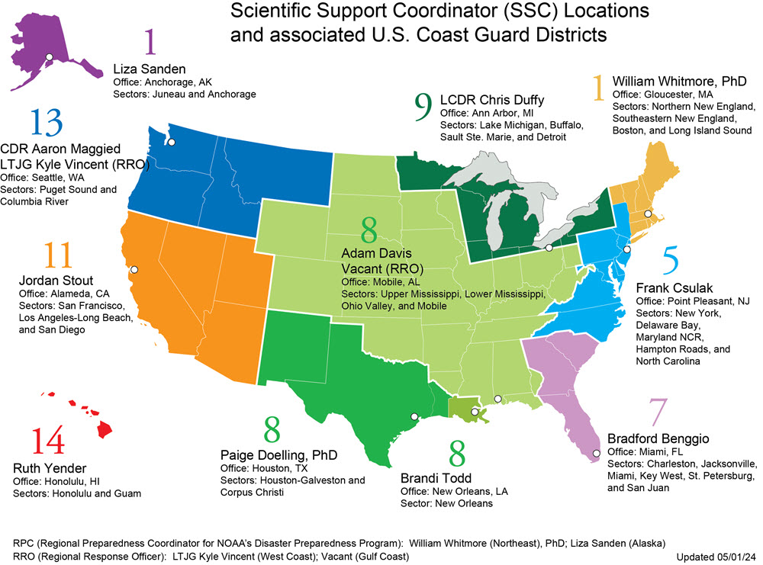
NOAA Report Out - December 2024

Slide 13

NOAA Report Out - December 2024
Frank Csulak
Scientific Support Coordinator
Emergency Response Division
Office of Response and Restoration
National Ocean Service
cell - 732-371-1005
frank.csulak@noaa.gov

Slide 14
[Dept of Navy] Report – May 2024
Examples include involvement in major responses, lessons learned, challenges, exercises, training events, etc.
March 28, 2024: Spill of 10K gallons of oily waste water at Naval Station Norfolk. Spill created a large sheen on the Elizabeth River but bulk of spill remained on-station. Navy resources and an OSRO (HEPACO) responded and contained the spill. Recovery lasted two days. A failed check valve in the system was determined to be the cause.
Policy changes or updates, organizational changes, new / departing personnel, etc.
None

Slide 15
DOI Report – December 2024
Miyoshi Stith from OEPC HQ departed – Division Lead for Environmental Response and Recovery. Hoping to fill vacancy soon.
Biological Evaluation with USCG District 9 being submitted (include RRT3 portion of PA near Lake Erie).
Work continues drafting Unanticipated Discovery Plan template for inclusion in RCP.
Working with States/Tribes to investigate expansion of categorical exclusions listed on the 97 Programmatic Agreement.
Delaware City Refinery Spill – FWS involvement and USCG coordination with DE SHPO.
BSEE released report: Technology Evaluation: Mechanical Recovery, Dielectric Fluids
DOI effort to develop spill training with a focus on Tribal audience
  Currently working on survey for Tribes to identify areas of need for the training
DOI Inland Oil Spill Response Training scheduled for March 10-14, 2025 in Shepherdstown, WV

Slide 16
USFWS Report – December 2024
Erie National Wildlife Refuge Spill – small spill with issues getting it cleaned up.
Franklin, PA Allegheny River Mystery Spill – federally listed mussel observed within the boom. Will likely do water sampling.
M/V SSI Defiant - provided AMMs related to migratory birds.
Medical waste Chincoteague NWR & Assateague Island National Seashore – unable to identify RP
South Hill Warehouse Fire – potentially listed mussels, but lacking surveys in this area.
Putting together spill kits for field offices – considering putting them together for NWRs.
Plan to do some training/exercises with NWRs.

Slide 17
DOL Report – May 2024
(Examples include involvement in major responses, lessons learned, challenges, exercises, training events, etc.)
Hanover Foods Corporation, Centre Hall, PA: Complaint alleging the employer has had ammonia releases that are not investigated, loss quantities are minimized on paper to circumvent reporting. Referred to EPA.
  PSM Standard: 8 serious citations, 4 serious-repeat citations, 2 other- than serious citations issued. Total Penalty $250,000
  Safety: 11 serious Citations, 4 serious-repeat citations, 1 repeat-other citation, 5 other-than-serious citations. Penalty: $215,000
  Health: 5 serious citations, 4 other-than-serious citations. Penalty 37,534
  Total Penalty: $502, 534 – Employer accepted all citations for a reduced penalty of $412,534 – paid in full.
Spray Products, Plymouth Meeting, PA: Incident involving a flashover event. Worked with EPA RMP-AOC
  PSM 11 serious citations, 2 serious-repeat citations. Penalty $205,332.00.
  Safety: 4 serious citations, 1 other-than-serious citation. Penalty $58,072.00
  Total Penalty: $263,404.00 – All citations have been contested.
Sink Hole – awaiting on information.
(Policy changes or updates, organizational changes, new / departing personnel, etc.)
Mark Stelmack, ARA, is retiring. Tracy Townsend, OSHA, will be filling in at meetings.

Slide 18
General Services Administration – December 2024
GSA Tools are available at gsa.gov to include:
  GSA Advantage!’s Disaster Relief and Pandemic Products Program aisle includes a wide range of products, including temporary housing, medical supplies, communication tools, and infrastructure repair materials.
  GSA Emergency Acquisition Basic Ordering Agreement site
  Fleet Management Training
GSA is planning to schedule and conduct training with FEMA RIII on disaster leasing as a result of our lessons learned from the Tropical Storm Helene response.
GSA RRT III Representatives from the Office of Mission Assurance (OMA) Philadelphia:
  Kathleen Peek, Regional Emergency Coordinator, kathleen.peek@gsa.gov
  David Sanders, Emergency Management Specialist, david.sanders@gsa.gov
  Bee Umar, Emergency Management Specialist,
  bee.umar@gsa.gov
Current GSA R3 Regional Administrator – Tom Lyman, Acting

Slide 19
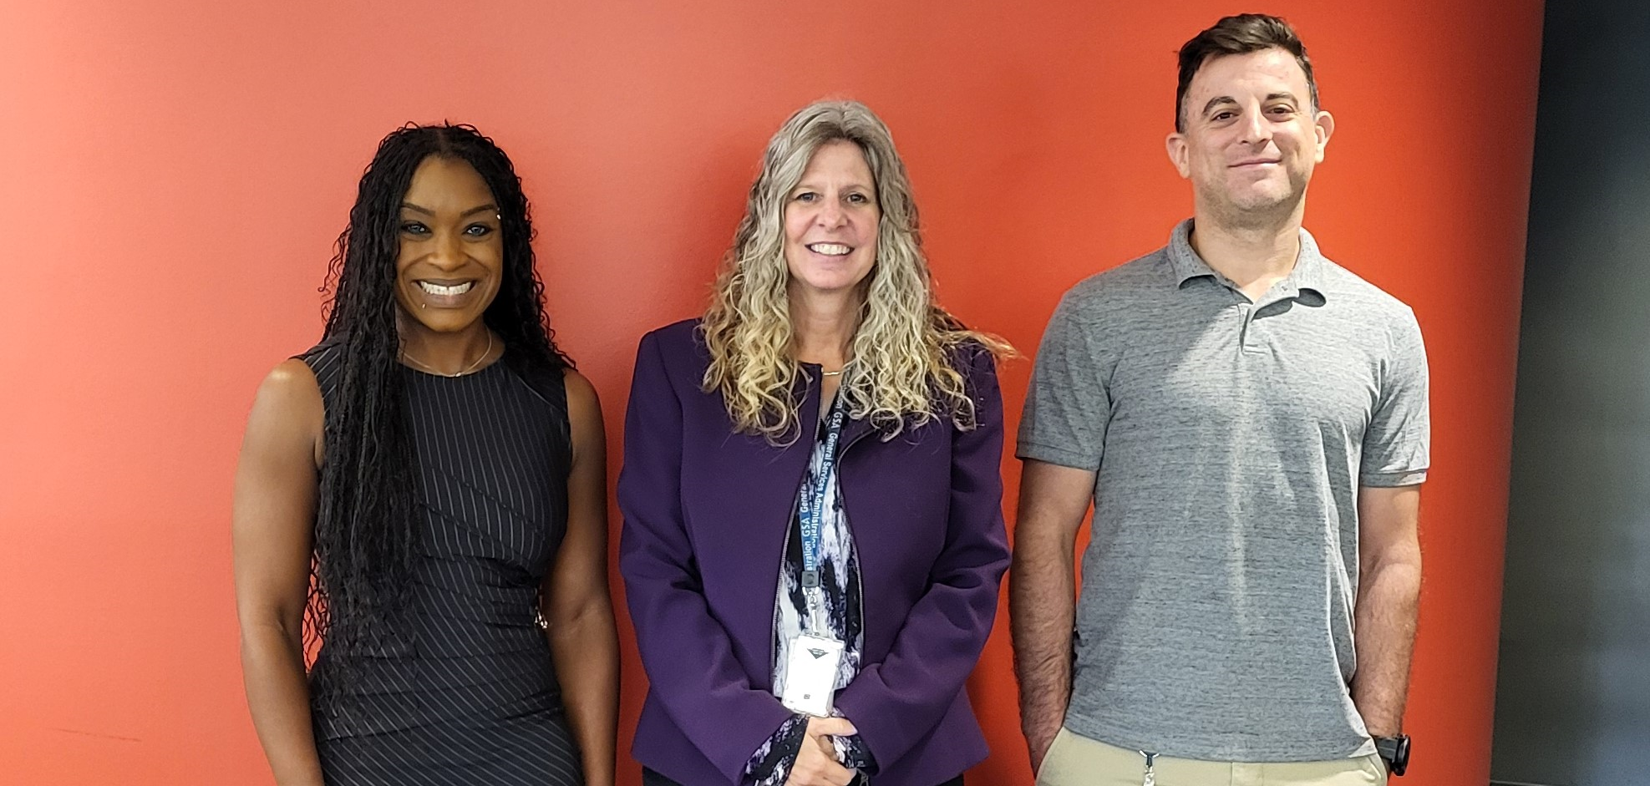
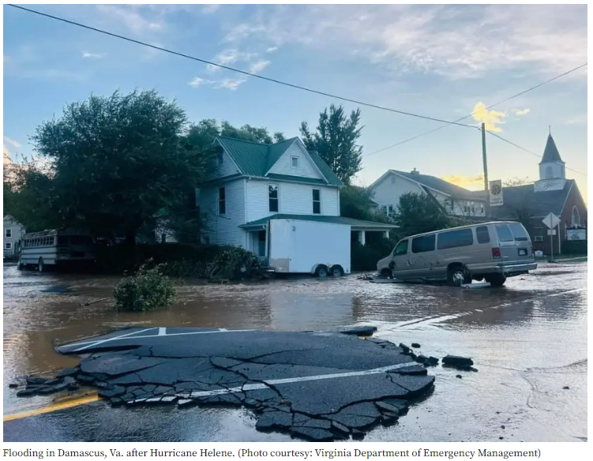
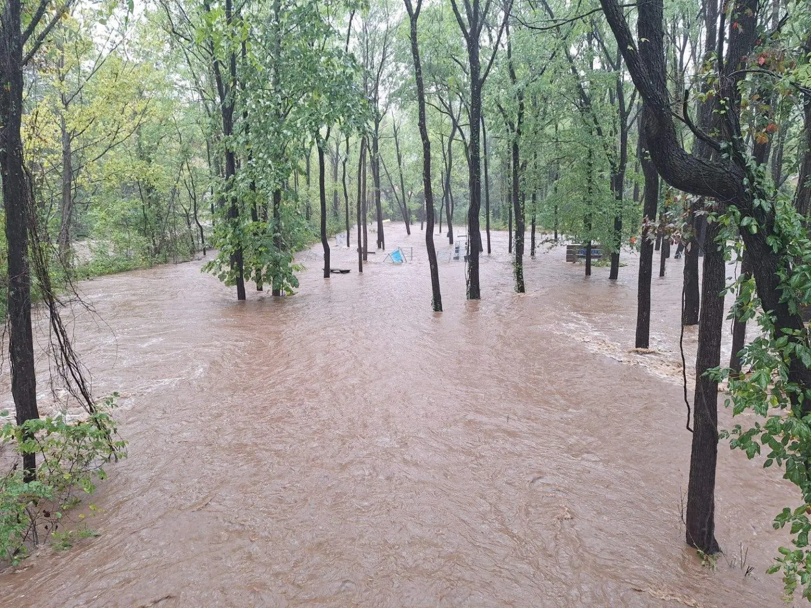
General Services Administration – December 2024

Slide 20
[USDA] Report – May 2024
Michael Yandrich, USDA-FS will be the new RRT3 representative for USDA, and Travis Haas, USDA-FS is the alternate.
Michael Yandrich
  michael.yandrich@usda.gov
  970-792-5468
Travis Hass
  travis.j.haas@usda.gov
  414-533-7385
Kane Fields Site, Allegheny National Forest
We’re working closely with EPA R3 and the State of PA to respond to a former oil and gas production facility on the Allegheny NF in Pennsylvania encompassing roughly 10,000 acres.
EPA responded to clean up some leaking tanks and containers in the summer of 2024 and the Forest Service is now taking over the non-emergency response and managing the site within its CERCLA and site clean-up program.
The Forest Service plans to do a time-critical removal to empty what remains in the tanks and conduct a PA/SI in FY25.

Slide 21
[ORSANCO] Report – DEC 2024
ORSANCO received 219 NRC reports since May
  113 were spills to water
  ORSANCO made 90 notifications to other agencies and partners
No major spill events led to on-site involvement by ORSANCO during this period
Meeting with USCG Sector Ohio Valley
  Discuss loss of US Coast Guard boats and crews
  Agency partners provided list of resources and capabilities during an event on the Ohio River
Exercises/Training:
  Local LEPC Functional Exercise involving a train derailment
  Boom deployment demonstration on the Ohio River
  Tabletop exercise in Huntington, WV involving the release of an above ground storage tank
Sam Dinkins named the new Executive Director of ORSANCO as of November 1st.
Replacement for his previous position (Emergency Response Manager) is yet to be decided.

Slide 22

Tri-State Bird Rescue Report – December 2024
Examples include involvement in major responses, lessons learned, challenges, exercises, training events, etc.
Vane Brothers response – Wilmington DE, September 2024
  14 Laughing Gulls, 1 Common Snapping Turtle
Delaware City Refinery - June 2024
  Put on standby, no wildlife impacted
Agency/industry workshop on Oct 17th
  Thank you to all who came!
Policy changes or updates, organizational changes, new / departing personnel, etc.
Tri-State is planning the 2025 Effects of Oil on Wildlife Conference
  Will be held in Cape Town, South Africa from October 13-17, 2025
  Oiled Wildlife Hotline: 1 800 261 0980
  Oil Programs Email: Oilprograms@tristatebird.org

Slide 23
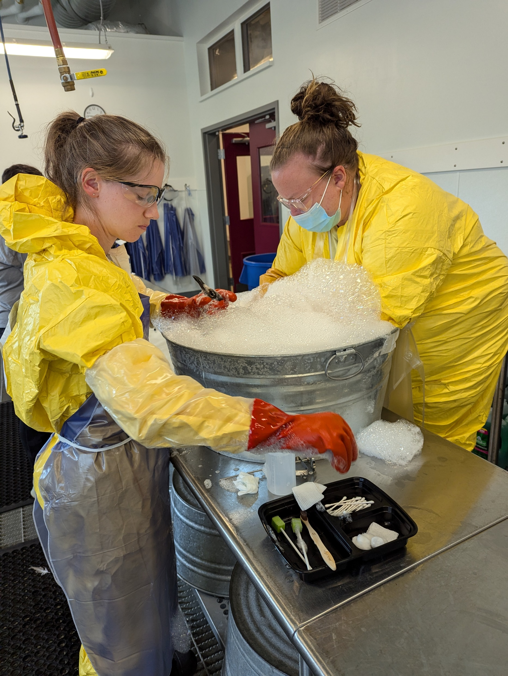

Tri-State Bird Rescue Report – December 2024
Vane Brothers Response – Laughing gull wash and common snapping turtle wash

