Slide 1
Regional Contingency Plan Workgroup Update
Workgroup Chairs
Kelly Thorkilson – USCG
Kevin Gaynor - EPA

Slide 2
Outline
Background
Goals
Plan
Timeline
Requested Participation
Review Process

Slide 3
Background
40 CFR § 300.115 - Regional Response Teams – Outlines the requirements for the RRT and 300.115 (i) highlights the need for the Regional Contingency Plan (RCP) and to update the RCP as needed.
RRTIII has decided that the review and update period for the RCP will be every 5 years, with the next update planned to be finalized by 2025.
The RCP Workgroup works with the members of the RRT to review and update all components of the RCP to ensure that it remains an effective plan for federal response to discharges and releases, and provide technical assistance for preparedness to the response community.
The current version of the RCP contains a main body document made up of 7 Sections and 11 Appendices (containing 64 individual documents).

Slide 4
Goals
At the beginning of this process the RCP Workgroup had three goals for the new version of the Regional Contingency Plan:
Review: Comb through the current plan to see areas that need to be addressed or updated. With the update of the RRT website, see if any pieces of the plan can become fixtures on the website.
Update: Working with the RRT Workgroups and Members, discuss the changes for the Plan and prepare to present the draft changes planned for the 2025 deadline.
Accessible: Working with the Information Management Workgroup and RRT Coordinators make finding information in the RCP on the updated website more straightforward.

Slide 5
Plan
The plan to review and update the RCP will be broken down into five phases, Preliminary Review, Workgroup and Member Review, Consolidation, Comments, Publish.
Preliminary Review: The RCP Workgroup has done a preliminary review of the entire plan and has some recommended changes to the Main Body of the plan and designated which sections need to be reviewed by the Workgroups and Members. This draft version of the RCP will be the working document for the review process
Workgroup and Member Review: The RCP Workgroup will work with the standing RRT Workgroups and Members to review and recommend changes to the relevant parts of the RCP.
Consolidation: The RCP Workgroup will collect the recommended changes and comments from the review by the Workgroups and Members, and create a final draft RCP.
Final Comments: The RCP Workgroup will send out the final draft RCP to the Members, Partners, and Stakeholders of the RRT for final comments.
Publish: After a review of the final comments and approval by the RRT Chairs, the RCP Workgroup will publish the final RCP in print and on the updated RRT website.

Slide 6
Suggested Timeline
December 2023: RCP Workgroup Chairs selected and begin the update process.
Winter-Spring 2024: RCP Workgroup completes a preliminary review of the RCP.
May 2024: RCP Workgroup present the RCP Update Plan to the RRT and requests participation in the review process from the Workgroups and Members.
Summer-Fall 2024: Workgroup and Member Review of current/working documents.
October 2024: All documents under review must be submitted to RCP Workgroup.
December 2024: RCP Workgroup will present consolidated draft RCP, and present changes to the RCP, and request final comments from RRT Members, Partners, and Stakeholders.
March 2025: Final comments must be submitted to RCP Workgroup.
Spring 2025: RCP Workgroup addresses final comments and send final draft to RRT Chairs for approval.
May 2025: RRT Chairs approve/disapprove of Updated RCP at RRT Meeting.
Summer-Fall 2025: RCP Workgroup publishes Updated RCP in print and on updated RRT website.
December 2025: RCP Workgroup presents new location of RCP on RRT Website.

Slide 7
Recommended Participation
Reviewing Body | Documents to Review
RCP Workgroup | All Documents
Executive Committee | Main Body (All sections)
RRT Coordinators | Main Body (All sections)
 | Appendix 1
 | Appendix 11
Inland Area | Main Body (Sections 2, 3, 4, 5, 6)
 | Appendix 3-B1 & B2
 | Appendix 4 (All Documents)
 | Appendix 5
Coastal Area/USCG | Main Body (Sections2, 3, 4, 5, 6)
 | Appendix 4 (All Documents)
 | Appendix 5
 | Appendix 7-L1, L3, & L6
Cultural, Natural Resource, and Damage Assessment | Main Body (Sections 2, 3, 4, 5)
 | Appendix 3-C
 | Appendix 7-L2
 | Appendix 9 (All Documents)
 | Appendix 10
Spill Response Countermeasure | Main Body (Sections 2, 3, 4, 5)
 | Appendix 6 (All Documents)
 | Appendix 7-A1, A2, B, C, D, E, F, G, H, I, J, K, L3, L5
 | Appendix 8 (All Documents)
Information Management | Main Body (Sections 2, 3, 4, 5)
 | Appendix 7-L8
 | Appendix 8-A & D
Federal Agencies | Main Body (All sections)
State Agencies | Main Body (All sections)
Federally Recognized Tribes | Main Body (All sections)
 | Appendix 9-D

Slide 8
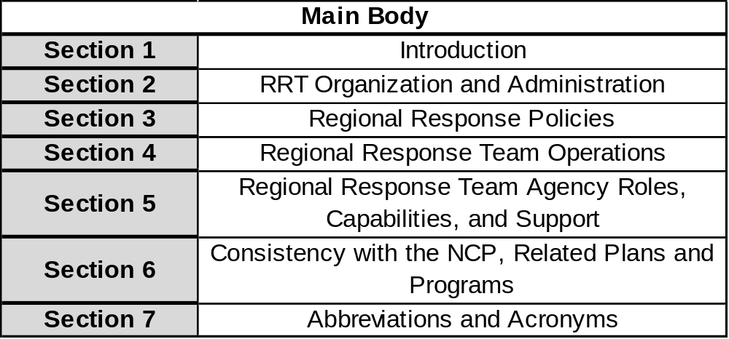
RCP Components
Main Body

Slide 9
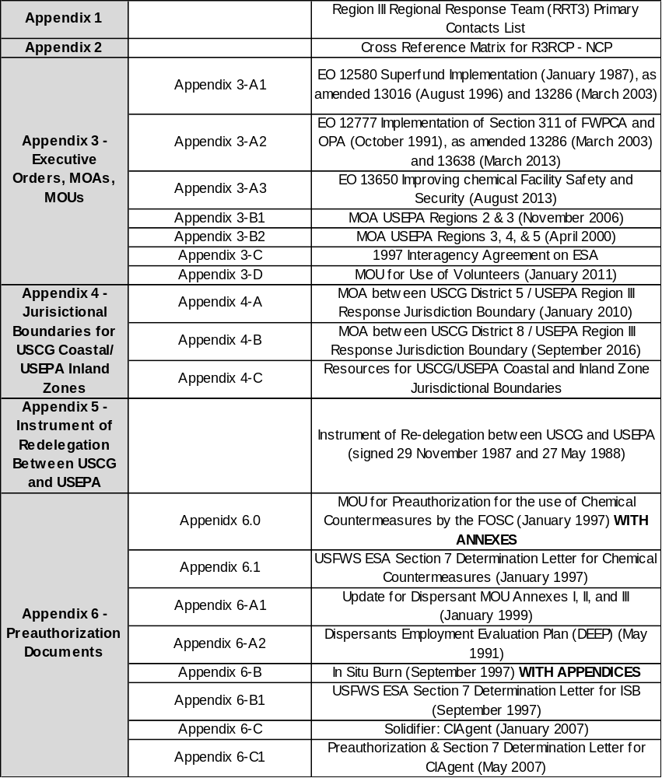
RCP Components
Appendices 1-6

Slide 10
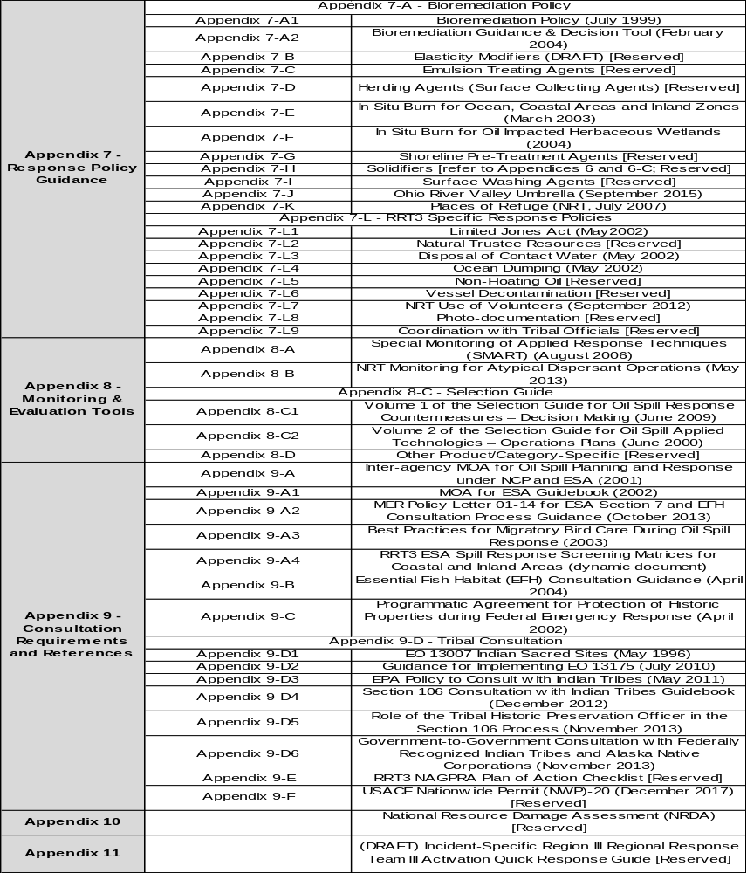
RCP Components
Appendices 7-11

Slide 11
Review Process
Following the May 2024 RRT Meeting, the RCP Workgroup will reach out to the requested participants needed for review providing additional information on the review process.
The RCP Workgroup can participate in review discussions among Workgroups and Members, and if additional support is needed please reach out.
The RCP Workgroup Website working space is still being set up and when ready, members of the designated review groups can use that as a file sharing space. When final drafts and comments are ready they can be posted there.
This process is still being set up, please be patient, but for quicker responses please reach out via email to Kevin Gaynor (gaynor.kevin@epa.gov) or Kelly Thorkilson (Kelly.A.Thorkilson2@uscg.mil)

Slide 12

Questions?

