Slide 1
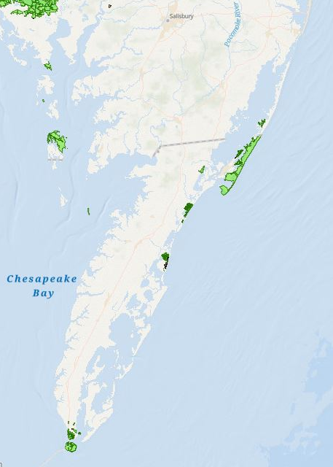
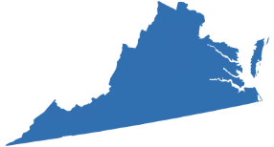

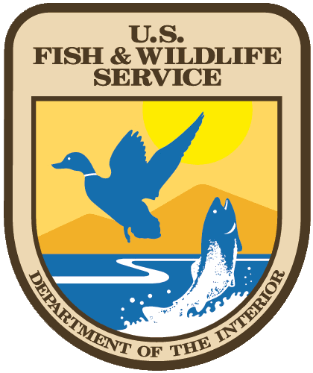
Virginia
Welcome to
Chincoteague
National Wildlife Refuge Complex!
Region III Area Committee Meeting
May 7, 2025
Chincoteague NWR &
Wallops Island NWR
Eastern Shore of Virginia NWR &
Fisherman Island NWR

Slide 2
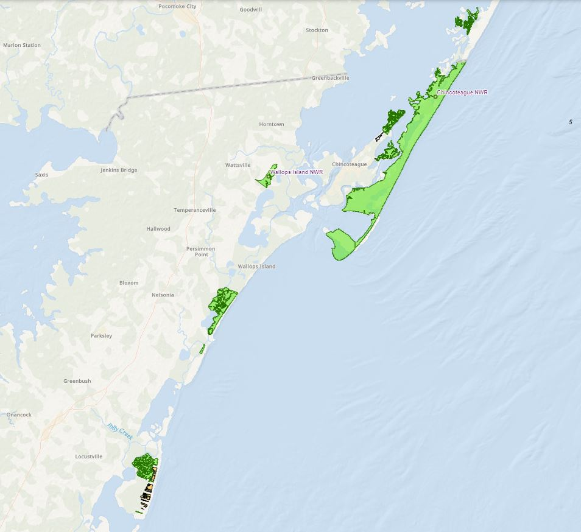
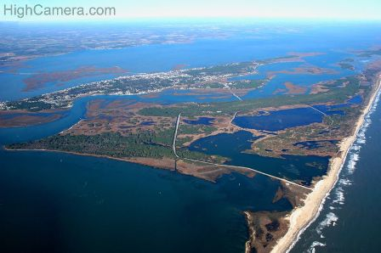
Chincoteague & Wallops Island NWRs
Accomack County, Virginia and
Worcester County, MD
Wildcat Marsh Unit
Chincoteague – Est. 1943 = 14,032 ac
Wallops Island – Est. 1971 = 373 ac
Morris Island Unit
Wallops Island NWR
Assateague Island Unit
Assawoman Island Unit
Metompkin Island Unit
Cedar Island Unit
Highcamera.com
Notes:
Chincoteague Refuge is made up of 14,000 acres of coastal barrier island, beach, dune, marsh and forest habitats, with Assateague Island being the main unit of the Refuge, combined with Wildcat Marsh, and Morris, Assawoman, Metompkin and Cedar Islands. Most of Chincoteague is in Accomack County, Virginia but a small portion lies in Worcester County Maryland. Wallops Refuge, at 373 acres, is across from Assateague on the peninsula.

Slide 3
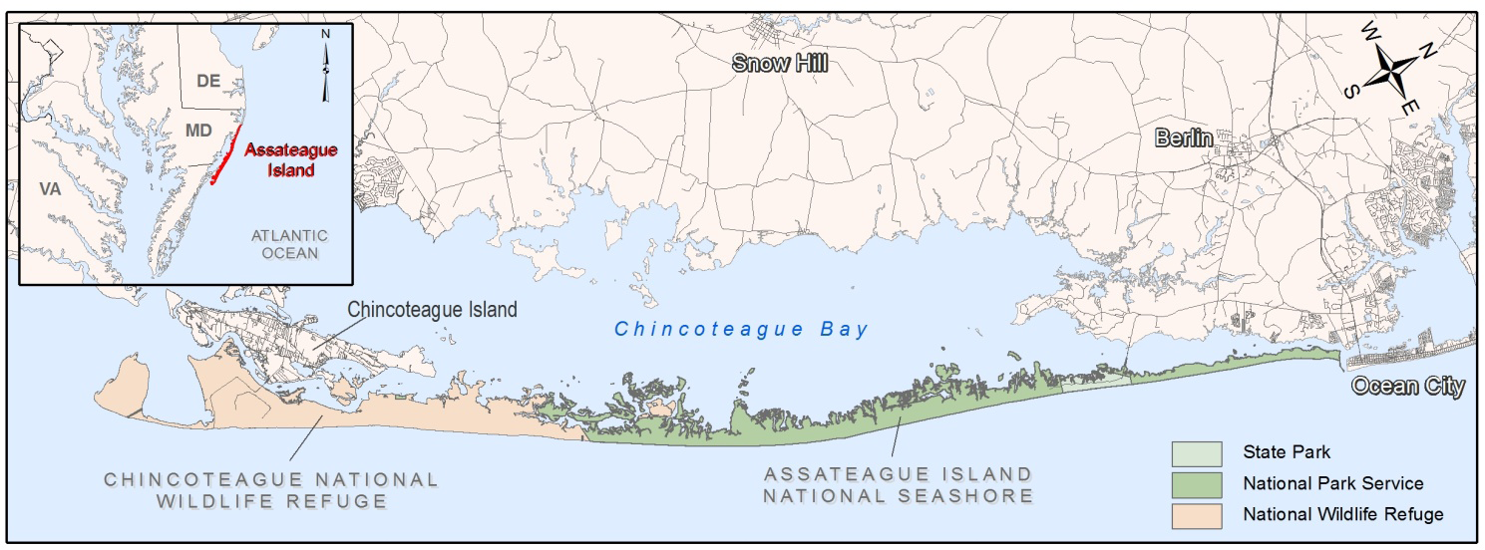


Assateague Island Land Management Agencies
Chincoteague National Wildlife Refuge, USFWS (1943) - 9,021 ac
Assateague State Park, MDNR (1956) - 630 ac
Assateague Island National Seashore, NPS (1965) - 8,983 ac on Assateague and Mainland & ~22,393 ac Ocean/Bay
Notes:
Having been here all of three months, its clear that Chincoteague and the surrounding lands and waters are managed under a unique arrangement. In 1965, Congress created the Assateague Island National Seashore, giving the National Park Service authority to manage the waters and beaches below mean low water that surround the Assateague Island unit of the Refuge. Consequently, while still a National Wildlife Refuge with a wildlife first mission like all refuges, The National Park Service is a key partner and inextricably linked to our management and success.

Slide 4
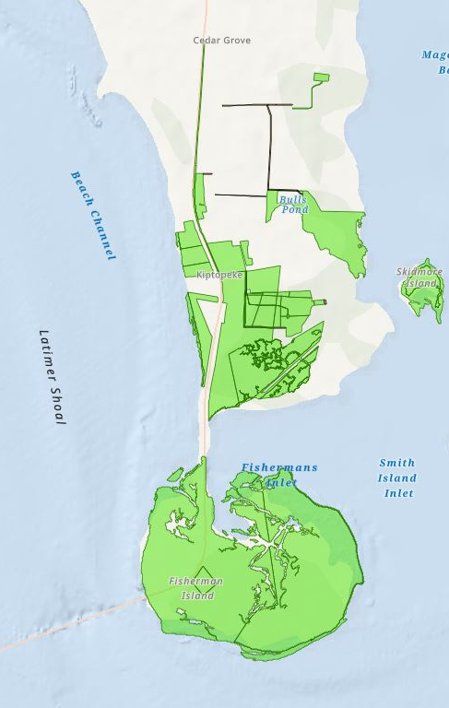
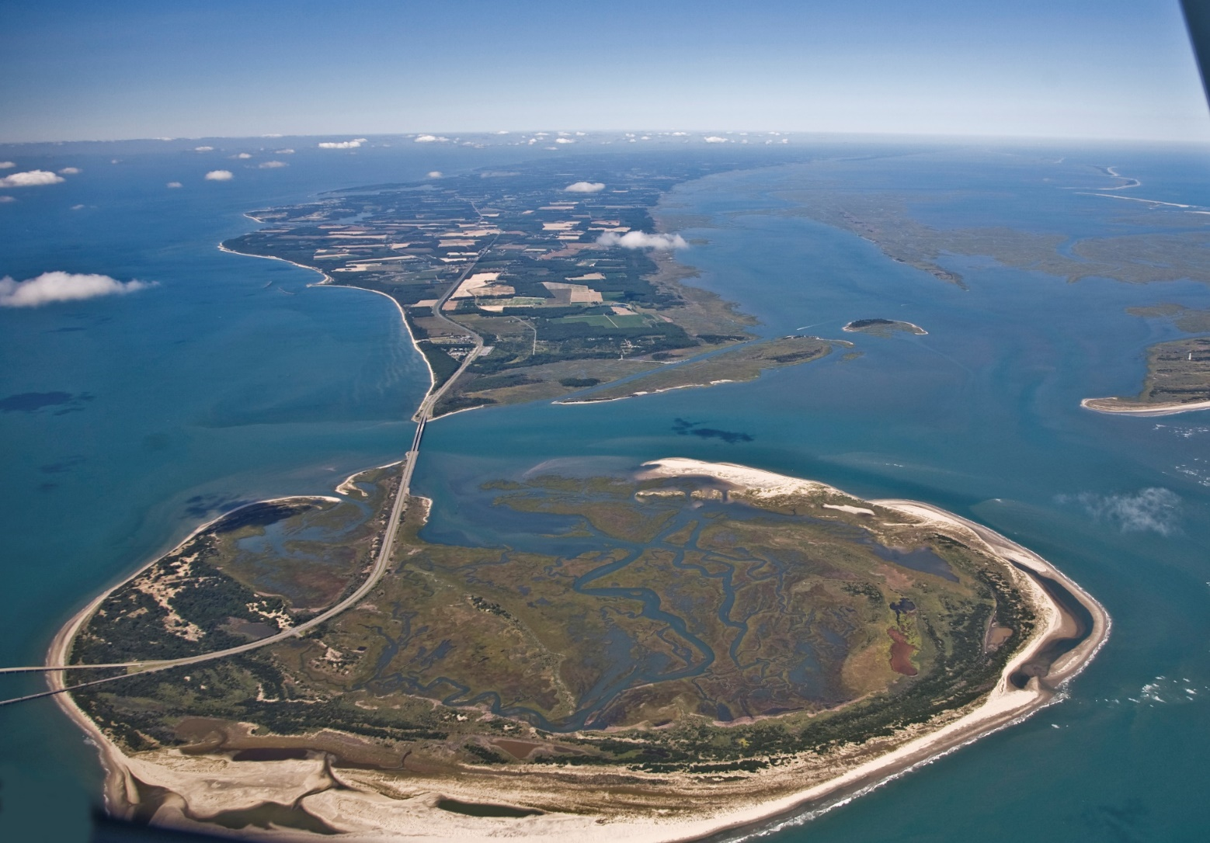
Eastern Shore of Virginia & Fisherman Island NWRs
Northampton County, Virginia
Eastern Shore of VA – Est. 1984
Fisherman Island – Est. 1969 (1973 sole ownership)
Eastern Shore
of Virginia NWR
Fisherman
Island NWR

Slide 5
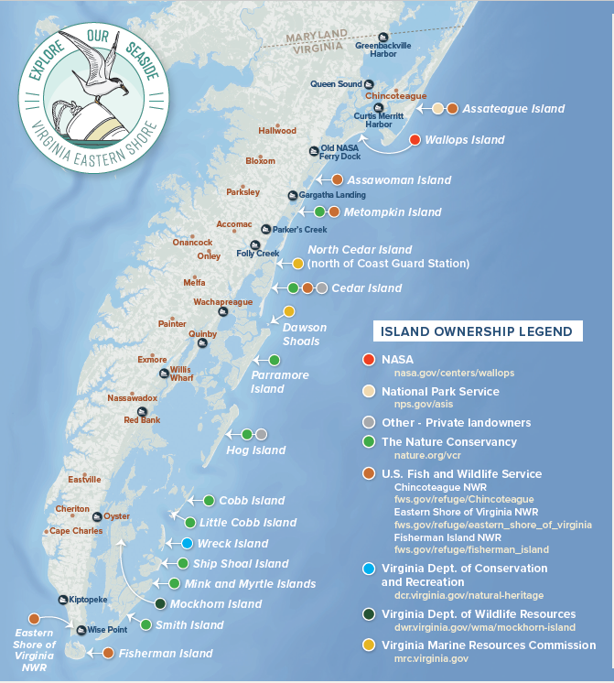


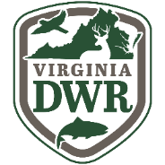


Barrier Island System
Under Protective Ownership
“…partners share a common goal of protecting natural resources, while balancing sustainable recreation and economic use of the seaside.”

Slide 6
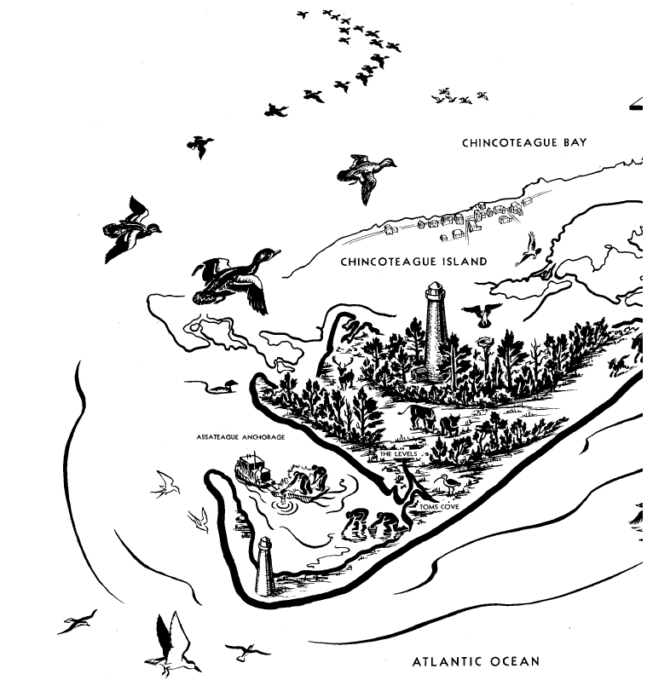
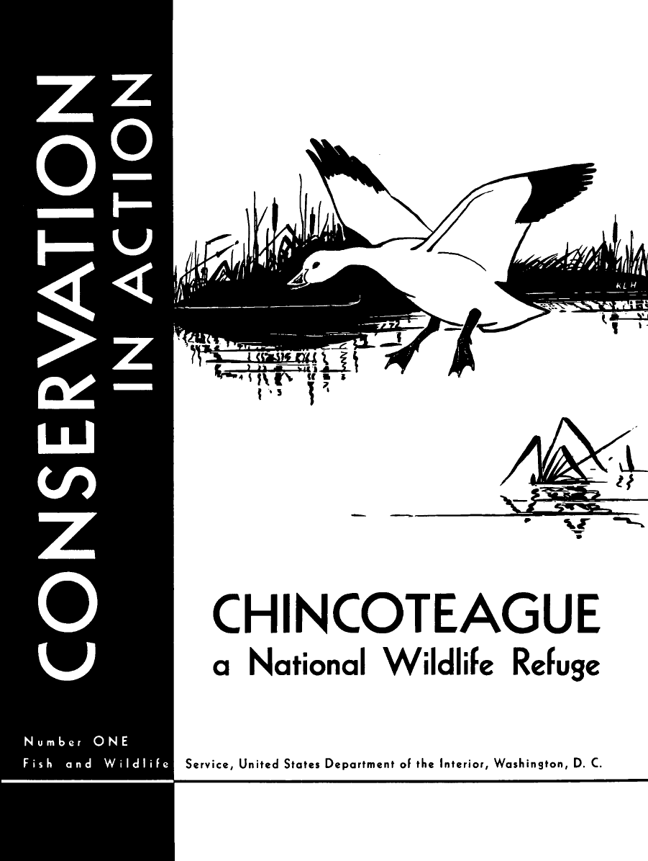

Chincoteague National Wildlife Refuge
“If we are to preserve the remaining waterfowl, and the sports and recreation which depend on them, we must set apart for the birds, refuges like Chincoteague, where they may find these simple and necessary creature requirements: food, rest, security.”
- Rachel Carson (1947)

Slide 7
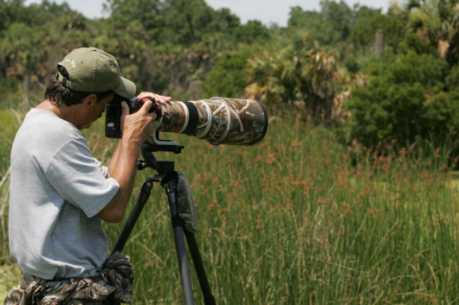
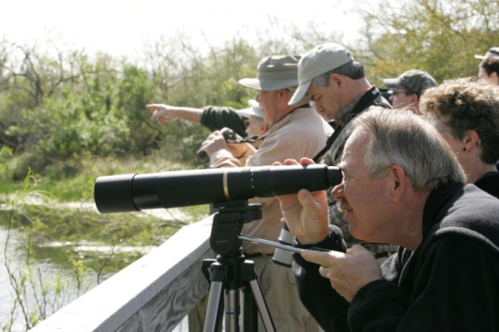
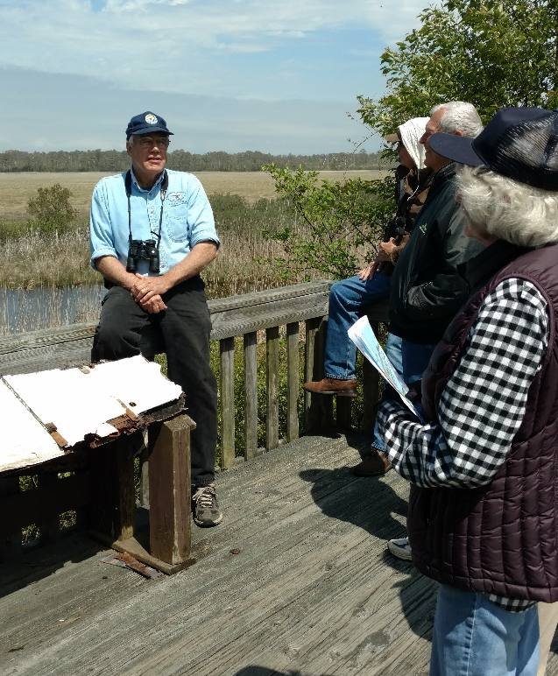
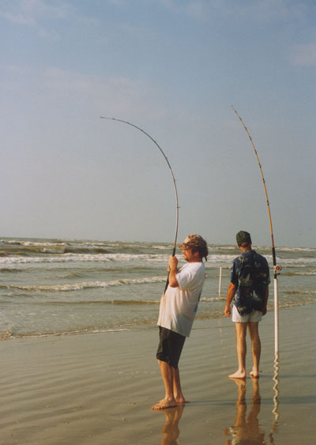
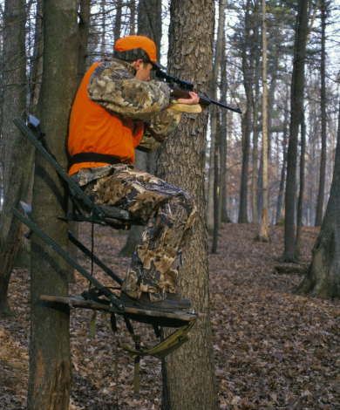
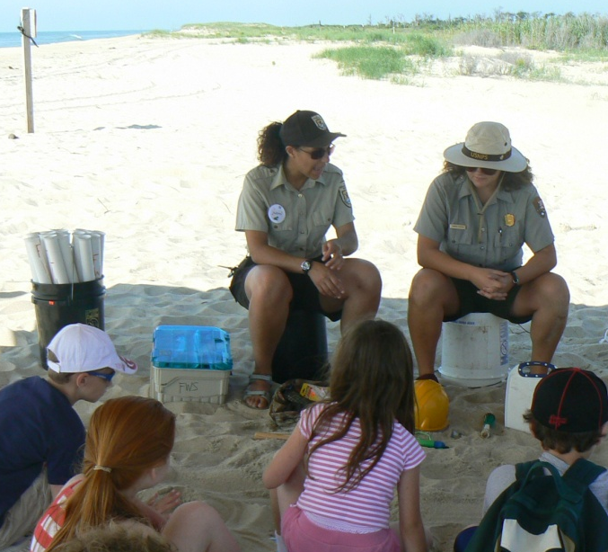
Wildlife-dependent recreational uses
Hunting
Fishing
Wildlife Observation
Photography
Environmental Education
Interpretation

Slide 8
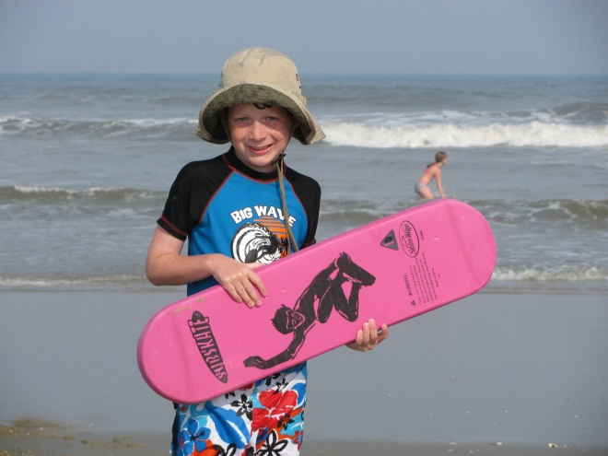
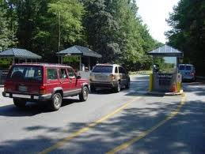
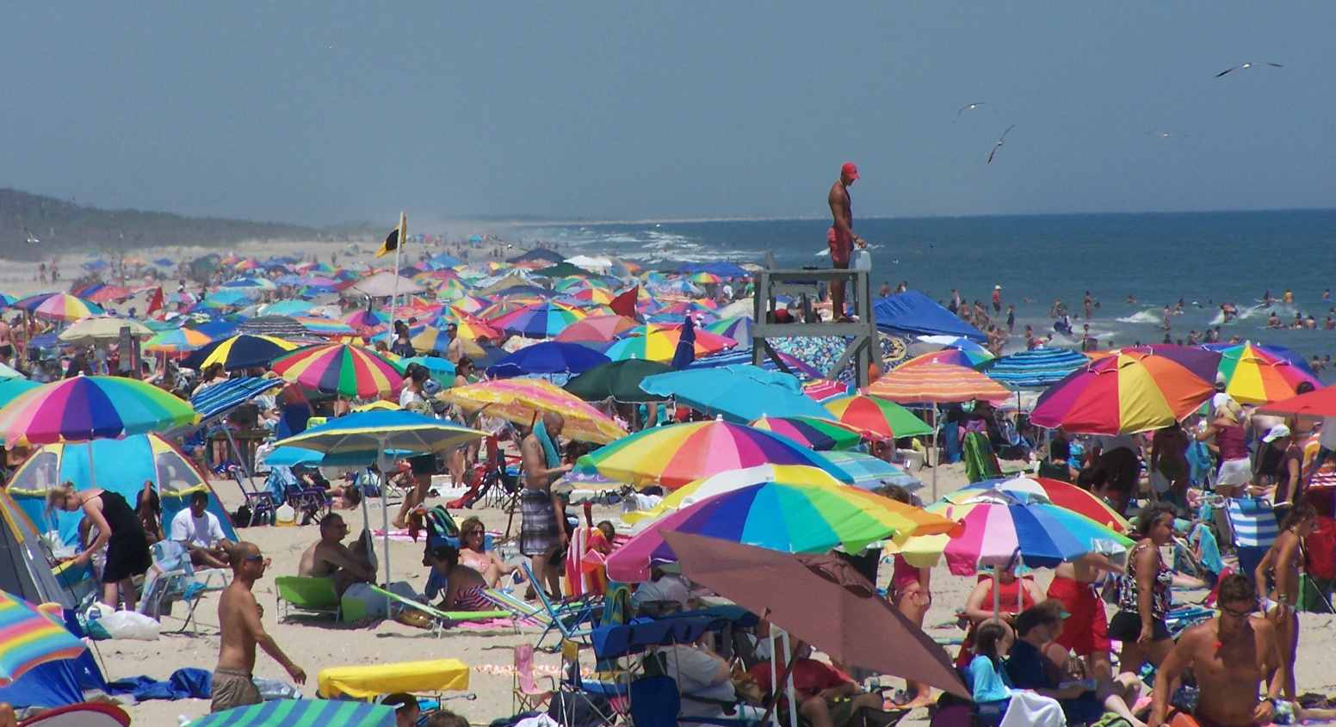
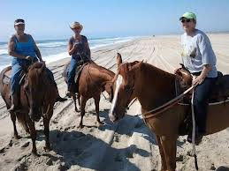

Recreational Beach & Public Use
Annual Visitation Averages 1.4 Million

Slide 9
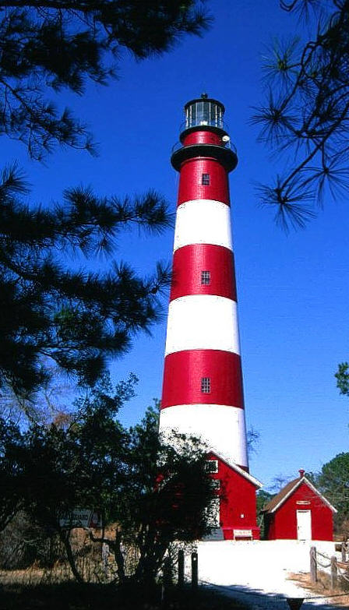

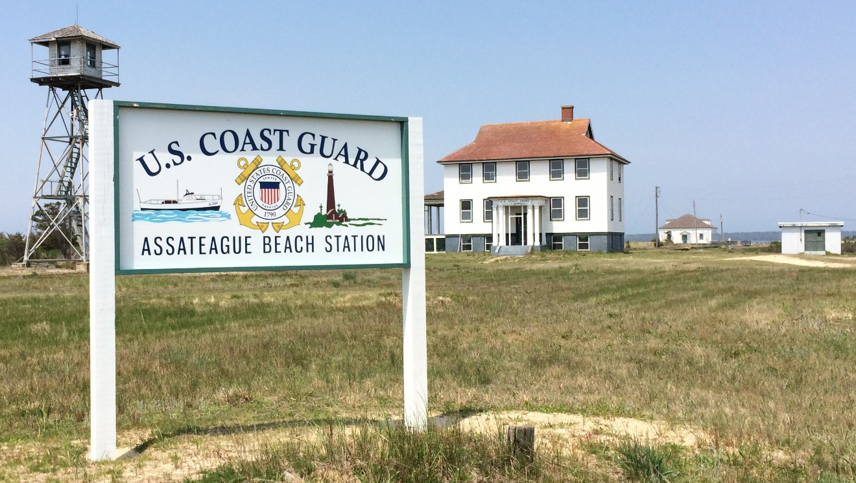
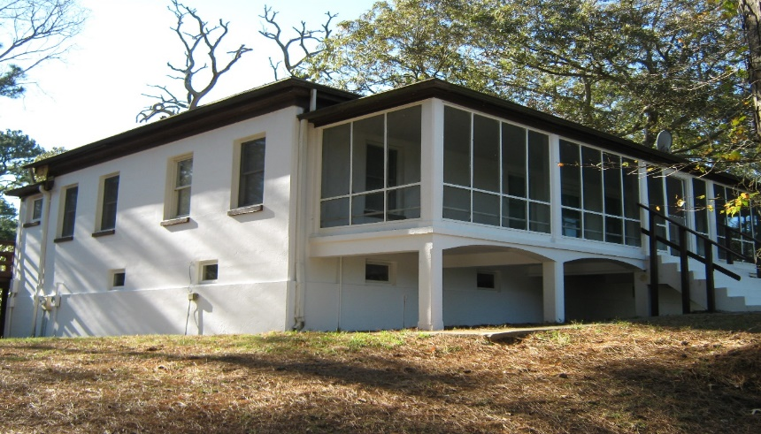
Cultural Resources
Assateague Lighthouse (1867 – present)
Assateague Village (circa 1850)
U.S. Coast Guard
Assateague Beach Station (1922 – 1967)

Slide 10
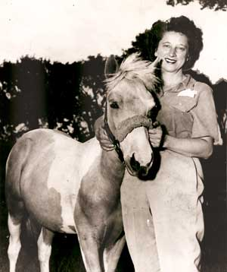
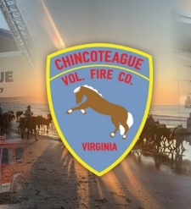
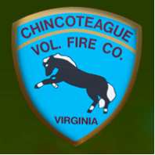


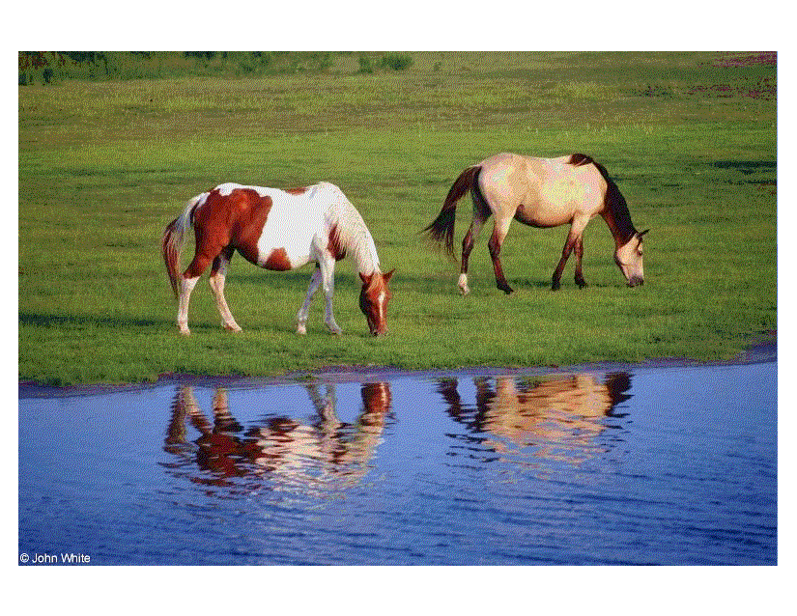
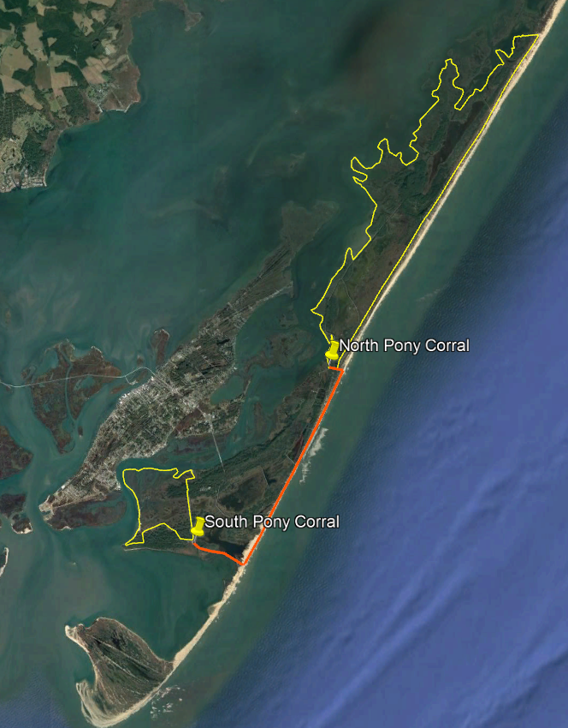
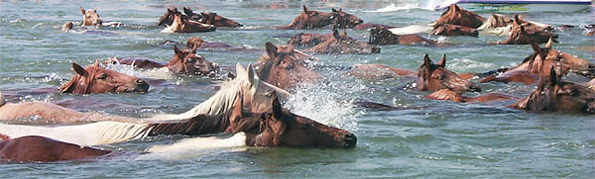
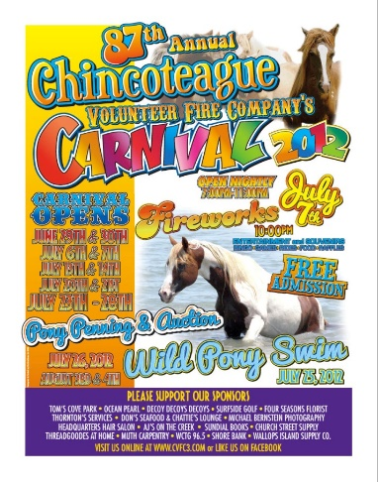
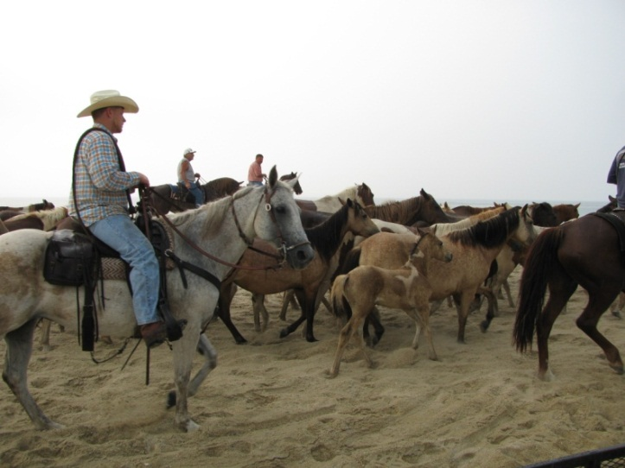
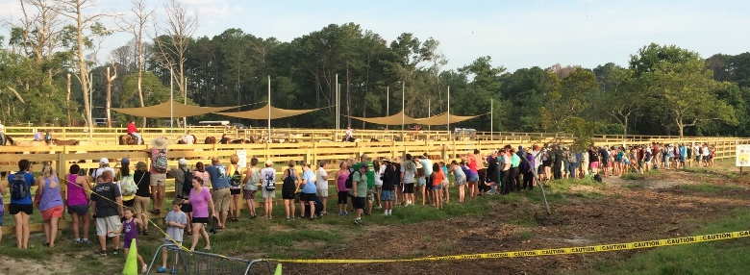
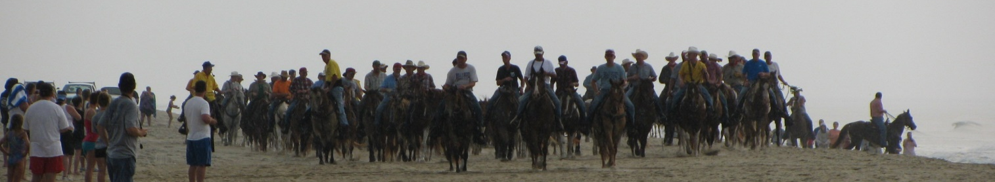
Chincoteague Ponies

Slide 11
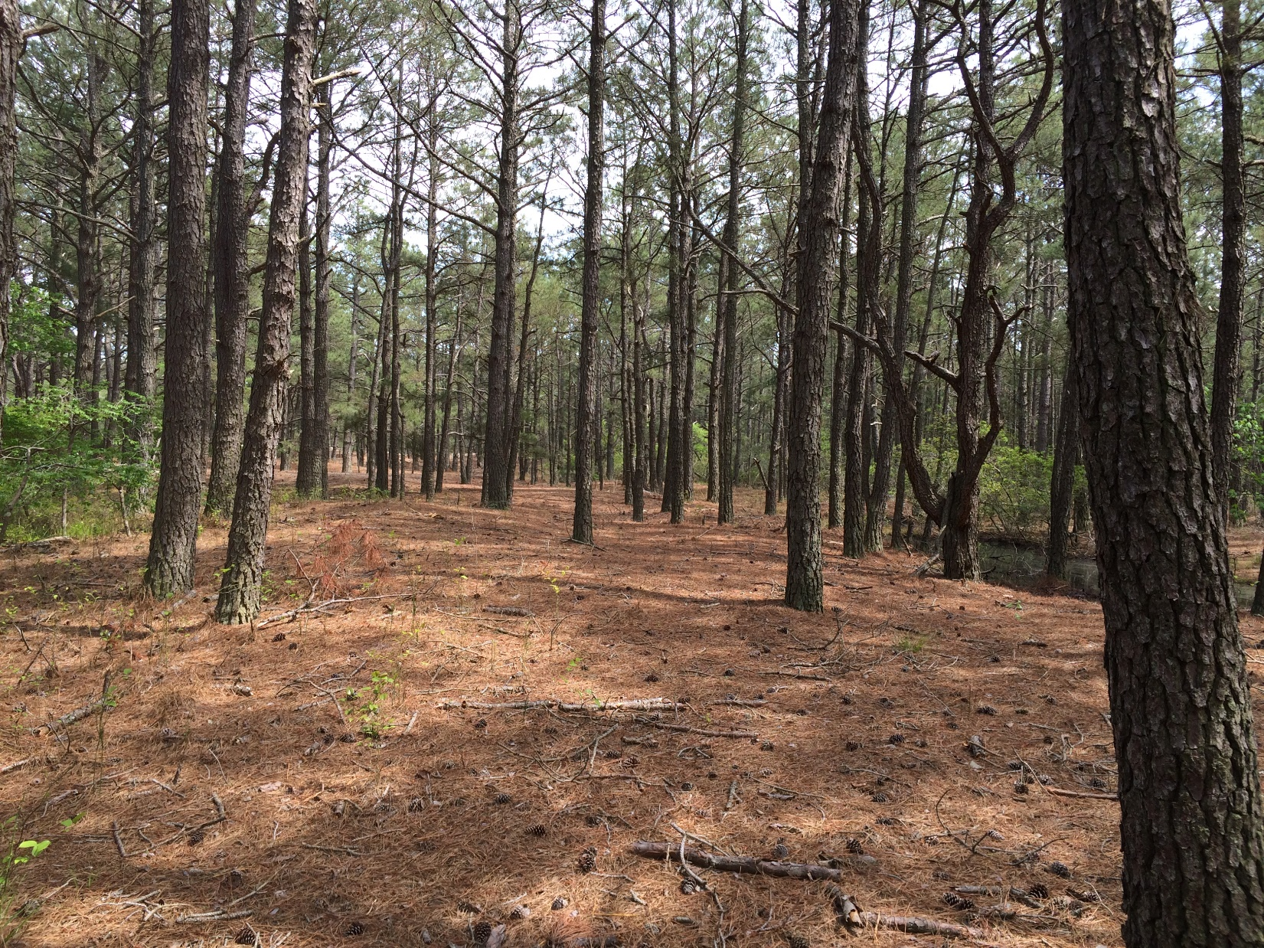
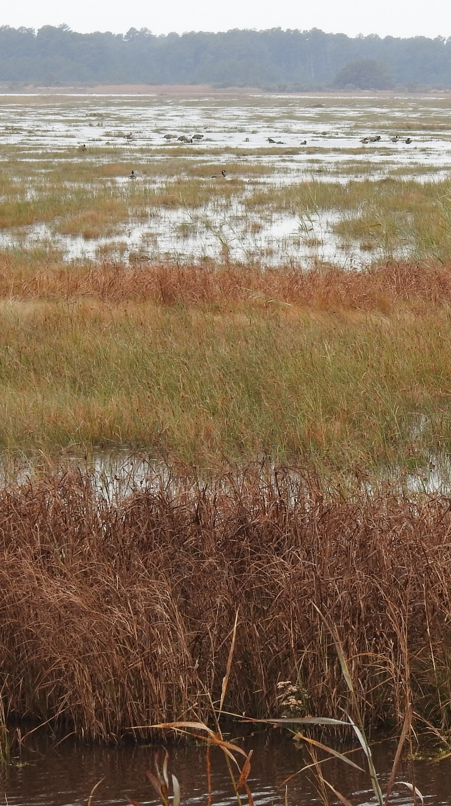
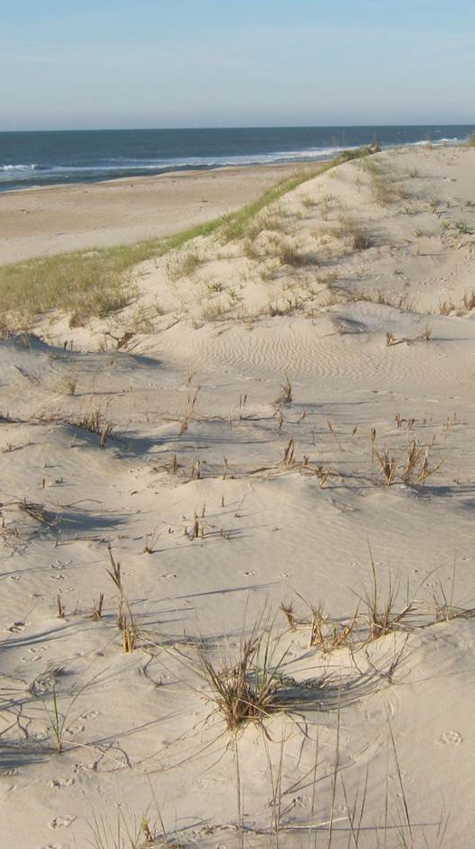
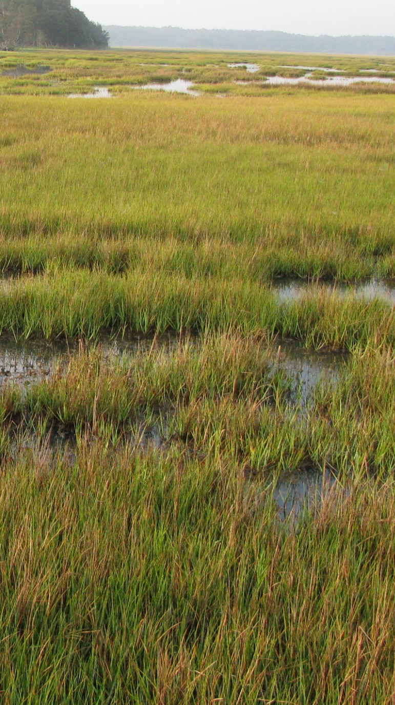
Habitats of Chincoteague NWR

Slide 12
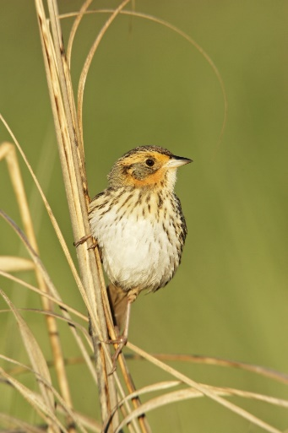
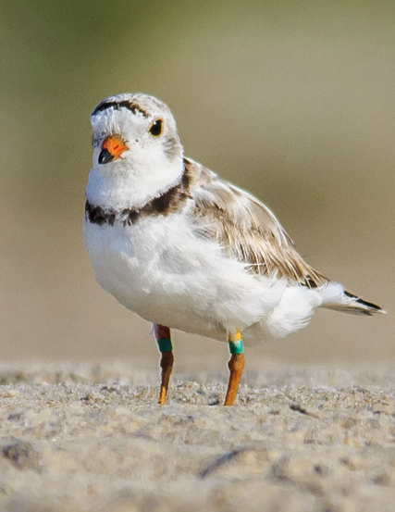
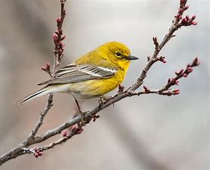
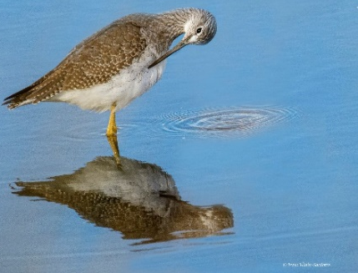
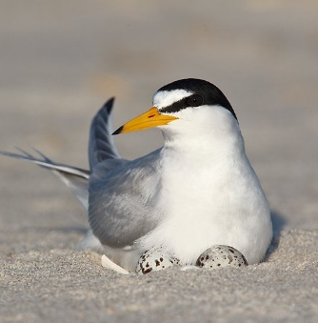
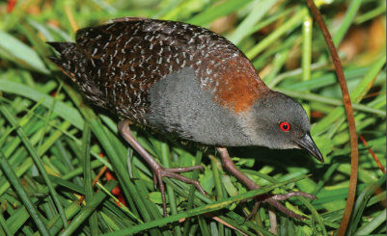
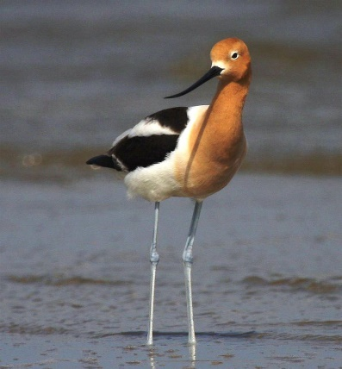
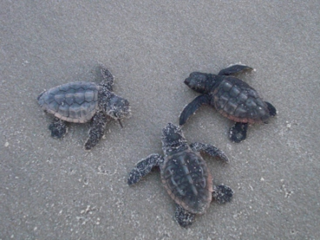
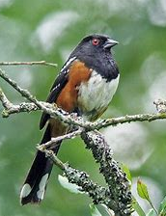
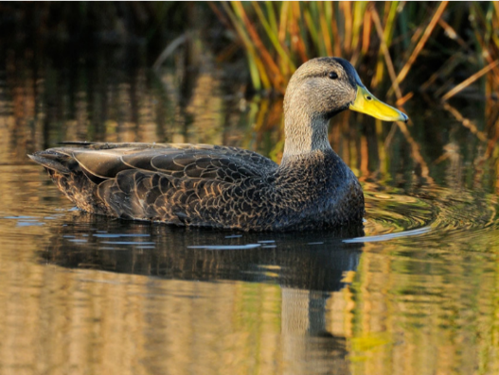
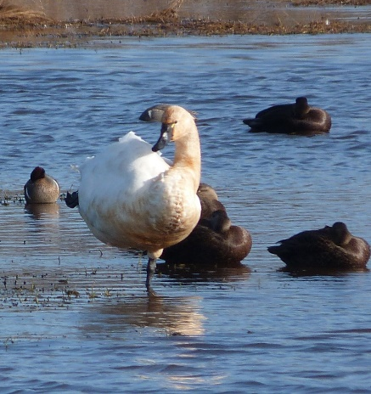



Inventory & Monitoring – CNWR
M. Hartley/FWS
ACJV

Slide 13






Beach Profile & Jurisdiction on Assateague Island
MEAN LOW WATER
Modified: FWS
Credit: Neil McCoy, courtesy of Explore Our Seaside

Slide 14



National Assessment of Shoreline Change

Slide 15


Barrier Island Migration – Shoreline Change Monitoring

Slide 16


Public Beach 2006-2024
(Patrick J. Hendrickson - Highcamera.com)
02-19-2024
03-16-2024
http://world.time.com/timelapse2/
https://earth.app.goo.gl/XKNJBG

Slide 17


Mixed-energy (wave and tide) barrier islands
Assawoman Island
Gargatha Inlet
Metompkin Island

Slide 18


Barrier Island Migration – Sand Overwash
Sand overwash
Exposed Peat
(former salt marsh)

Slide 19

Barrier Island Migration – Shoreline Change on Cedar Island

Slide 20

Salt Marsh Profile & Jurisdiction on Assateague Island
Modified: FWS

Slide 21








Integrated Waterbird Monitoring & Management (IWMM)
  10 impoundments
  (~2,000 ac)

Slide 22











Refuge Management Actions

Slide 23




Slide 24


Slide 25







Oyster Restoration Projects
3,550 linear feet of living shoreline, totaling 13,750 oyster castles at two sites
2.5 acres of oyster reef composed of dredged fossil oyster/clam shell in Little Toms Cove
created a living demonstration area for visitors to witness coastal resilience in action
Assateague Bay (Service Road) Site
Toms Cove (Beach Road) Site
900 linear feet or
3,100 oyster castles
500 linear feet or 2,000 oyster castles & .68 acres of shell plant
1.86 acres of shell plant

Slide 26


Slide 27


Slide 28



Patrick J. Hendrickson/ Highcamera.com

Slide 29


Slide 30



Environmental Sensitivity Index (ESI) Map

Slide 31

Incident Information
2009– Ship stranding on Toms Cove Hook.

Slide 32


Incident Information
At 8:00am on 31 March 2022, USCG Sector Virginia notified the NOAA SSC that a NAVY Hawkeye plane crashed just north of Chincoteague Island in a marsh at approximately 7:30pm on Wednesday 30 March. One crew member died, two rescued. Aircraft had 1,650 gals of JP-5 on board at time of incident. Navy and Sector Virginia response teams enroute. Sector Virginia requested resources at risk and trajectory.

Slide 33





Slide 34




Slide 35





























Partnerships!

Slide 36

Thank you… enjoy your visit!
    Region III Area Committee Meeting
    May 7, 2025

Slide 37


Delaware Bay
Public Beach
Overwash
Atlantic Ocean
Chesapeake
Bay
Hook

Slide 38

Public Beach Comparison 2011 vs 2018 (nor’easter)
(Patrick J. Hendrickson - Highcamera.com)

Slide 39

Chincoteague Recreational Beach Relocation
CNWR/ASIS jointly manage recreational beach
Relocation of beach to a more stable location - key decision in the 2015 CCP and EIS.
Design/NEPA completed
New entrance road, parking lots, boardwalks, and visitor amenities
Wetland permitting and mitigation pending
Proposed
Beach
INFLUENCES ALL ASPECTS OF FUTURE MANAGEMENT
Existing Beach
Notes:
As was discussed earlier, Chincoteague Refuge and Assateague Island National Seashore have jointly managed a public recreational beach for decades that hosts over a million visitors each year. The existing beach is subject to frequent and significant storm and weather damage, exacerbated by climate change and sea level rise. In our 2015 CCP, a key decision was made to relocate the beach to a more stable portion of the island in order to foster protection of the Refuge’s beach associated wildlife resources, while supporting the mission of the National Seashore and the local community. NEPA and most permitting have been completed on the beach relocation, and last year, the design for the associated roads, parking lots, boardwalks and other visitor amenities was finished. Now, we are in the process of acquiring a wetland permit from the VA DEQ and determining what mitigation will be needed. While we’ve tried twice to secure funding for the move, we’ve been unsuccessful. Fortunately, the Park Service is just about to submit a proposal for $48 million of GAOA funds to complete the project. We should know by Fall if they will be successful. If so, construction could start as early as 2023. Once funded, this will be a big project for Chincoteague. It will influence all aspects of our future management.

Slide 40











Chincoteague Beach Relocation
Timeline: Planning, NEPA & Current Status
2008-2010
Chincoteague Alternative Transportation Study
2010
Comprehensive Conservation Plan (CCP)
Purpose & Need
2011
CCP Significant Issues – Structured Decision-Making Workshop
2015
CCP EIS Final –
Record Of Decision Approved
2018
Environmental Assessment for Recreational Beach Relocation
2023
- NSFLPT Grant
- Wetland Permitting
- FHWA Design & Realignment
Structured Decision Making Workshop
Identified Best Location
for Recreational Beach (Approved in ROD)
$17.7M FHWA NSFLTP grant for construction of Phase 1.
“The purpose of the study is to gather information, identify transportation issues, and develop and analyze possible alternatives.”
What is the most responsible and sustainable (20-50 years) combination of a parking lot and access to a one-mile recreational beach on Assateague Island with the least impact to wildlife and habitat?
EA: The ROD committed to the completion of an additional study to analyze the site design of the parking areas (infrastructure and facilities needed to support the recreational beach relocation).

Slide 41


Recreational Beach Relocation
N
Chincoteague
Assateague
New Beach Access
Existing Beach

Slide 42

Recreational Beach Relocation

