Slide 1
Region III Regional Response Team Meeting
Chincoteague, VA
Frank Csulak
NOAA Report Out
Scientific Support Coordinator
7 May 2025

Slide 2
Responses
ORION Crane Vessel, offshore Virginia
2025-04-10 | Virginia Beach, VA | #$10950
Summary: At 1315 on 10 April 2025, USCG Sector Virginia notified the NOAA SSC that they received an anonymous report that a crane vessel supporting an offshore wind project was "illegally" discharging oil, cement, plastics, and other debris resulting in a visible plume. USCG inquired about the availability of any satellite imagery being available to substantiate report.
Tugboat Fire on Delaware River
2025-02-18 | Delaware City, DE, USA | #$10921
Summary: At 1100 hours, 18 February 2025, USCG Sector Delaware Bay notified the NOAA SSC that a tugboat was on fire in the Delaware River. Tug boat crew evacuated and several fire boats are on-scene assisting. Vessel has approximately 23,600 gallons of petroleum products on board. No pollution reported. No products requested at this time.
Tanker Truck Release, Colonna's Shipyard, Norfolk, VA
2025-03-17 | Norfolk, VA, USA | #$10936
Summary: At 083 on 17 March, USCG Sector Virginia notified the NOAA SSC that a fuel tanker truck with 8,000 gallons of diesel fuel rolled over due to equipment failure and discharge 7,500 gallons. An estimated 200-400 gallons of diesel entered the eastern branch of the Elizabeth River, Norfolk, Virginia. No products or services requested at this time.
MSC ANISHA R, Virginia Beach, VA
2025-03-08 | Offshore Virginia | #$10931
Summary: At 10:30pm, 8 March 2025, the NOAA SSC received a notification from USCG Sector Virginia that the containership, MSC ANISHA R, that had departed Philadelphia, PA on 6 March and en route to Port of Virginia, noticed fuel leaking out of its #1 port fuel tank, running down the port side hull and into water resulting in a visible sheen. Vessel is located approximately 80 miles east of Rudee Inlet,...

Slide 3
Responses
FV JANE CAROLYN Aground in Ocracoke Inlet, NC
2025-02-12 | Ocracoke, NC, USA | #$10917
Summary: On the morning on 12 Feb 2025, USCG Sector North Carolina notified the NOAA SSC that the FV JANE CAROLYNN, a 81 ft commercial fishing vessel ran aground on a shoal at the mouth of the Ocracoke Inlet. Vessel has 4,000 gallons of diesel fuel on board. No pollution reported. Sector North Carolina requested a NOAA spill trajectory.
IMTT Bulk Terminal No.6 Oil Spill, Elizabeth River, VA
2025-02-14 | 2837 S Military Hwy, Chesapeake, VA 23323, USA | #$10919
Summary: At 12:30pm on 14 Feb 2025, Virginia Dept of Environmental Quality notified the NOAA SSC that at 0710am the IMTT bulk terminal reported that an equipment failure resulted in the release of an estimated 1,700 gallons of No. 6 oil into the Elizabeth River. No products were requested.
Passenger Jet and Army Black Hawk Helicopter Collide Potomac River, Washington, DC
2025-01-30 | Washington, DC, USA | #$10907
Summary: At 0100 hours on 30 January 2025, USCG Sector Maryland NCR notified the NOAA SSC that at approximately 2100 hours on 29 January, a passenger aircraft and a Army Black Hawk helicopter collided mid-air over the Potomac River adjacent to Washington D.C.'s Ronald Reagan National Airport. Sector requested an spill trajectory.
Bulk Carrier Aground in Delaware River, Philadelphia, PA
2025-01-09 | Philadelphia, PA, USA | #$10896
Summary: At 0730 on 9 January, 2025, USCG Sector Delaware Bay notified the NOAA SSC that the ALGOMA BERITY, a 623 ft long bulk carrier, went aground in the Delaware River, approximately 1 nmi north of the Ben Franklin Bridge, Philadelphia, PA. Vessel cargo is salt. 14,600 bbls of diesel fuel on board. Vessel allegedly hit an unidentified object in the shipping channel, damaging one of the ballast tanks....

Slide 4
Responses
Newport News, VA. Navy Spill
2025-01-09 | Victory Landing Park, 50 26th St, Newport News, VA 23607, USA | #$10897
Summary: at 1230 hours on 9 January 2025, USCG Sector Virginia notified the NOAA SSC that there was an 11,000 gallon diesel fuel spill into the James River from a U.S. Navy vessel docked at the Newport News Terminal, Newport, Virginia. Source has been secured. OSROs on-scene. Booms have been deployed. Skimmers and vac trucks recovering product. USCG has requested a NOAA trajectory.

Slide 5
Upcoming Events
Atlantic Strike Team’s Advanced Responder Operations Exercise
Dates: 13-15 May 2025
Location: Fort Dix, New Jersey
Overview: Participants will discuss response activities using scripted questions to prompt participants to initiate planning activities that are required in the first 12-24 hours. Use real world case data from the Athos I oil spill in Sector Delaware Bay AOR.
POC: MST1 Aurea Vasquez
Aurea.E.Vasquez@uscg.mil

Slide 6
Upcoming Events
:
RRT 2 Meeting
11-12 June 2025
Meadowlands Environmental Center
One DeKorte Park Plaza
Lyndhurst, NY
Carl Pellegrino -EPA RRT2 Coordinator: pellegrino.carl@epa.gov
Brian Attardo – USCG RRT2 Coordinator: brian.attardo@uscg.mil

Slide 7
Alternative Fuel Fact Sheets
As the International Maritime Organizations (IMO) goal of reducing total emissions from marine shipping by 50% by 2050 approaches, new alternative fuels are emerging to help industry meet this target.
NOAA’s Emergency Response Division (ERD) is in the process of preparing fact sheets for each of these alternative fuels and the vessels that transport/use these fuels, addressing their characteristics, fate and effects, toxicity, potential impact on resources at risk and response recommendations. Currently being reviewed by International Tankers Owners Pollution Federation (ITOPF)
LNG
Methanol
Ammonia
Hydrogen
Biofuels (Renewable Diesel Fuels)
Low Sulphur Oils
Lithium Batteries

Slide 8
Key NOAA ORR Departures
Scott Lundgren – ORR Director
Charlie Henry – Former SSC, Disaster Preparedness Program, Science Emeritus
Doug Helton – ERD Operations Supervisor, supported over 700 spills
Jordan Stout – “SSC to the Stars”, supported over 300 spills
Paige Doeling – SSC in GOM, Chemist, supported over 200 spills
Nickie Scillo – ERD Training Liaison, ResponseLink/IncidentNews Manager, Logistics Coordinator
Nicole Rutherford – Biologist, Training Coordinator, ESI Coordinator
And many more….

Slide 9
New NOAA Job Aids and Training on Uncrewed Aircraft Systems Guidance for Oil Spill and Disaster Response, Assessment, and Data Management
MAR. 24, 2025 — Under a five-year operational agreement, NOAA's Office of Response and Restoration (OR&R) and the U.S. Coast Guard (USCG) have committed to using OR&R’s web-based geographic information system tool ERMA® as the common operating picture for oil spills, related disaster support functions, and training. A common operating picture is a continuously updated overview of an incident compiled throughout an incident's life cycle, providing real-time situational awareness across all levels of incident management and across jurisdictions.
NOAA’s OR&R and partners recently released two comprehensive job aids, titled "Oil Spill Response Uncrewed Aircraft Systems (UAS): Guidance and Training," and "Oil Spill Response Data Management, Storage, and Delivery Guidance.” These resources cover every stage of response operations for the use of UAS use for shoreline and on-water spill response—from mission planning and data collection to image mapping and short and long-term data storage—ensuring seamless integration with NOAA systems like the Data Integration Visualization and Reporting (DIVER) warehouse and ERMA.
Key highlights of the new resources include training materials for USCG pilots to capture imagery for oil characterization and mapping; tutorials and a quick reference matrix for selecting optimal remote sensing tools based on specific response needs, and updated resources integrated into USCG Aviation Training Center programs and UAS flight Operations protocols.
Funding for the Oil Spill Response Uncrewed Aircraft Systems (UAS) Guidance and Training Job Aid was provided by the USCG Great Lakes Oil Spill Center of Expertise (GLCOE). This job aid was developed by Research Planning, Inc. in close collaboration with USCG’s GLCOE and NOAA OR&R.

Slide 10
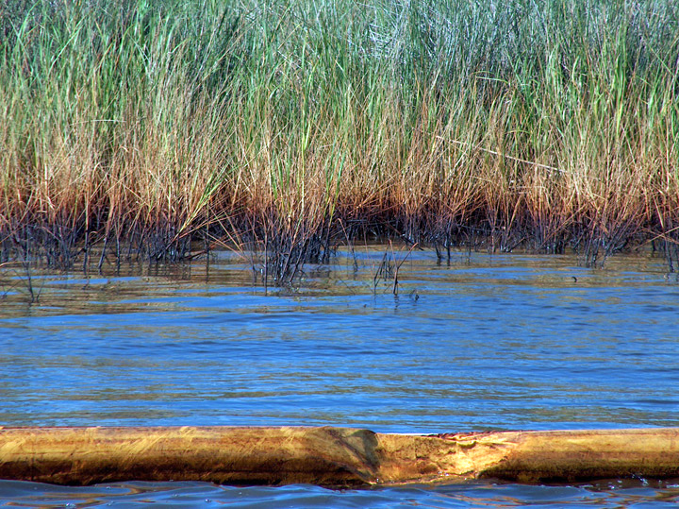
Questions?
Frank Csulak, NOAA SSC
frank.csulak@noaa.gov
732-371-1005 cell
206-526-4911 (24 hour emergency)
www.response.restoration.noaa.gov

