Slide 1
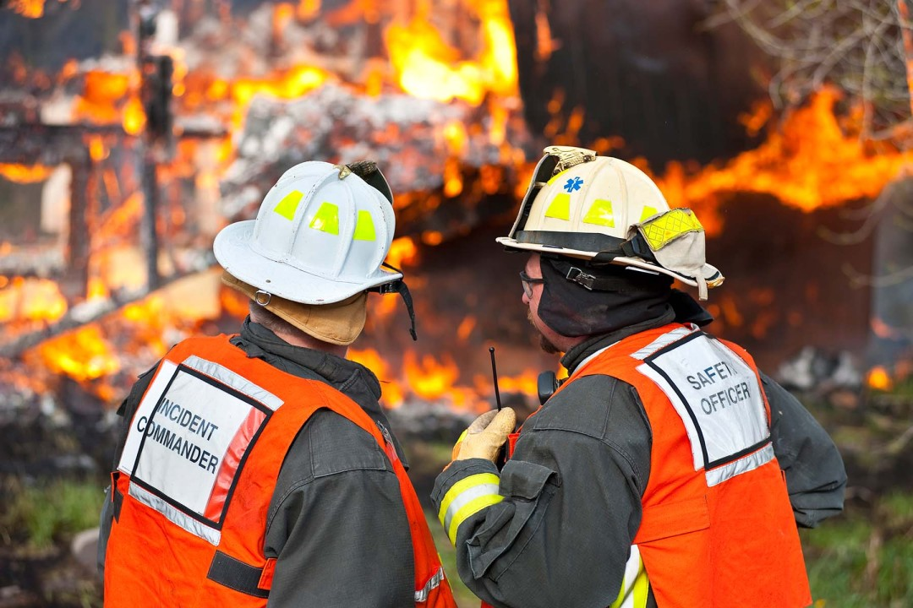
RRT III
Coordinator’s Report
Sabina Bastias
RRT3 Coordinator
May 7, 2025

Slide 2
Upcoming 2025 RRT Meetings
RRT Meeting
Locations
RRT Meeting
Locations
RRT Meeting
Dates
RRT Meeting
Dates
RRT 1
July 16, 2025 | Gloucester, MA
June 11-12, 2025 | Lyndhurst, NJ
May 19-22, 2025 | Carolina, PR
Dec 2-4, 2025 | TBD
TBD | TBD
Oct 28-29, 2025 | Springfield, IL
Nov 5-6, 2025 | Dallas, TX
RRT 7
Aug 27-28, 2025 | Lenexa, KS
Oct 15-16, 2025 | Denver, CO
July 23-24, 2025 | TBD – Coastal CA
Sept 24, 2025 | Spokane, WA
TBD | TBD
July 17, 2025 | Virtual
RRT 2
RRT 8
CRRT
RRT 9
RRT 3
RRT 10
RRT 4
Alaska
RRT 5
Oceania
RRT 6

Slide 3
Website DEMO: nrt.org/rrt3

Slide 4
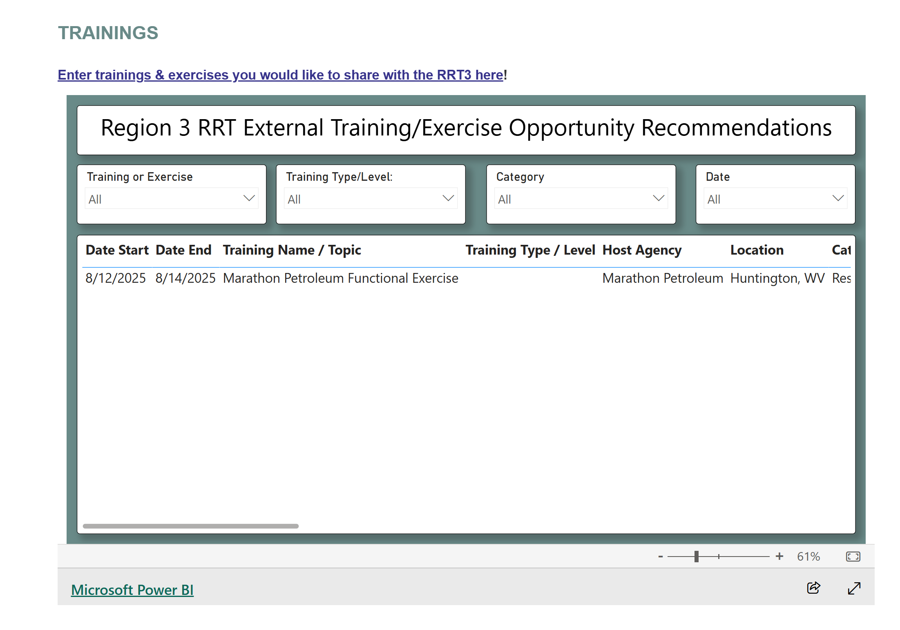

Slide 5
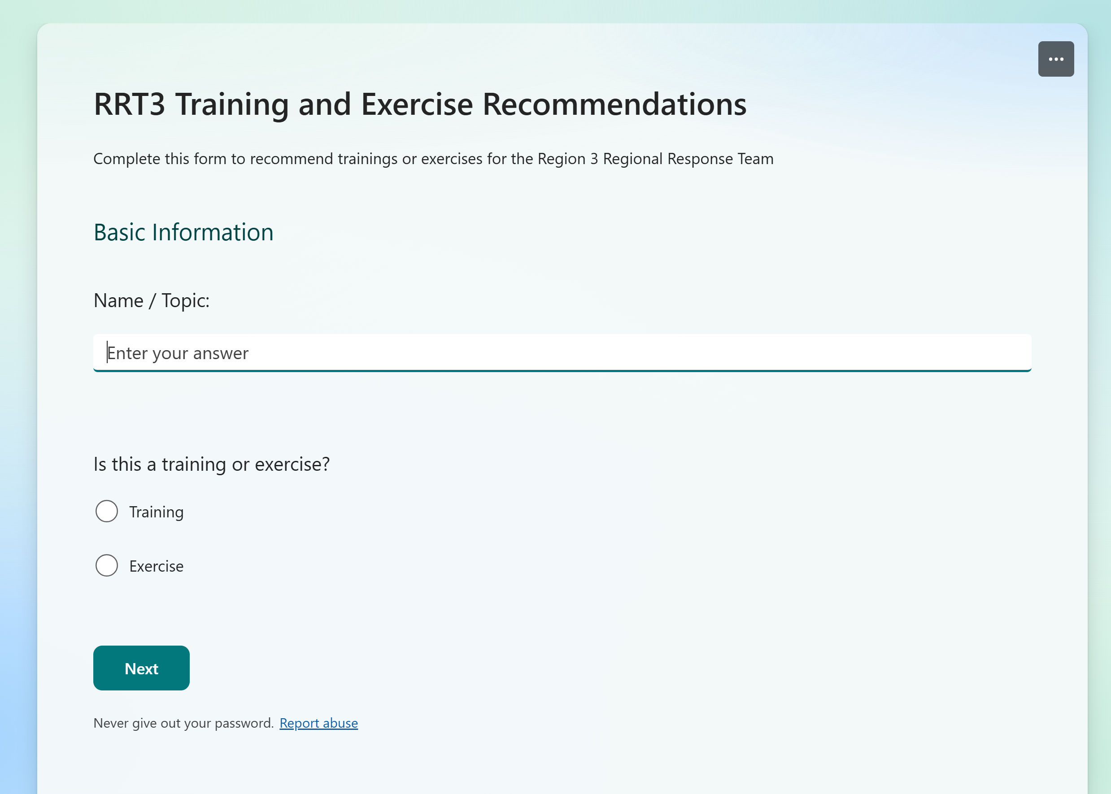
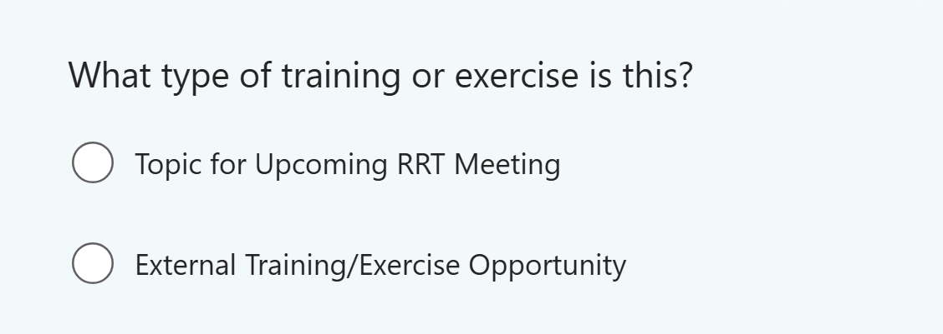

Slide 6
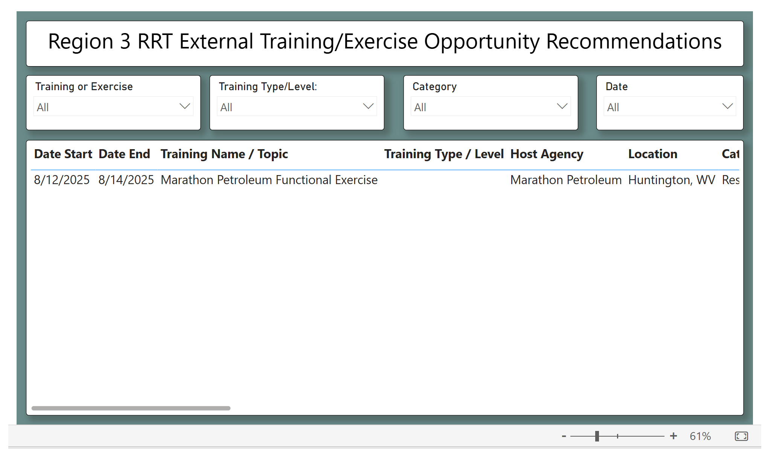

Slide 7
Marathon Petroleum Functional Exercise
Marathon Petroleum (MP) is planning a large functional exercise for their Corporate Emergency Response Team in Huntington, WV from Aug. 12 – Aug. 14.
Exercise participation is encouraged from agency partners; however overall numbers may be limited based on venue space.
Anyone interested in participating or being part of the planning team should reach out to Logan Hanneman, ldhanneman@marathonpetroleum.com.
The initial scenario will have an incident located on the Big Sandy River splitting Region 3 and Region 4. MP is not currently planning to impact Region 5 with the exercise, but with the potential to impact the Ohio River, Region 5 will be involved in discussions.

Slide 8
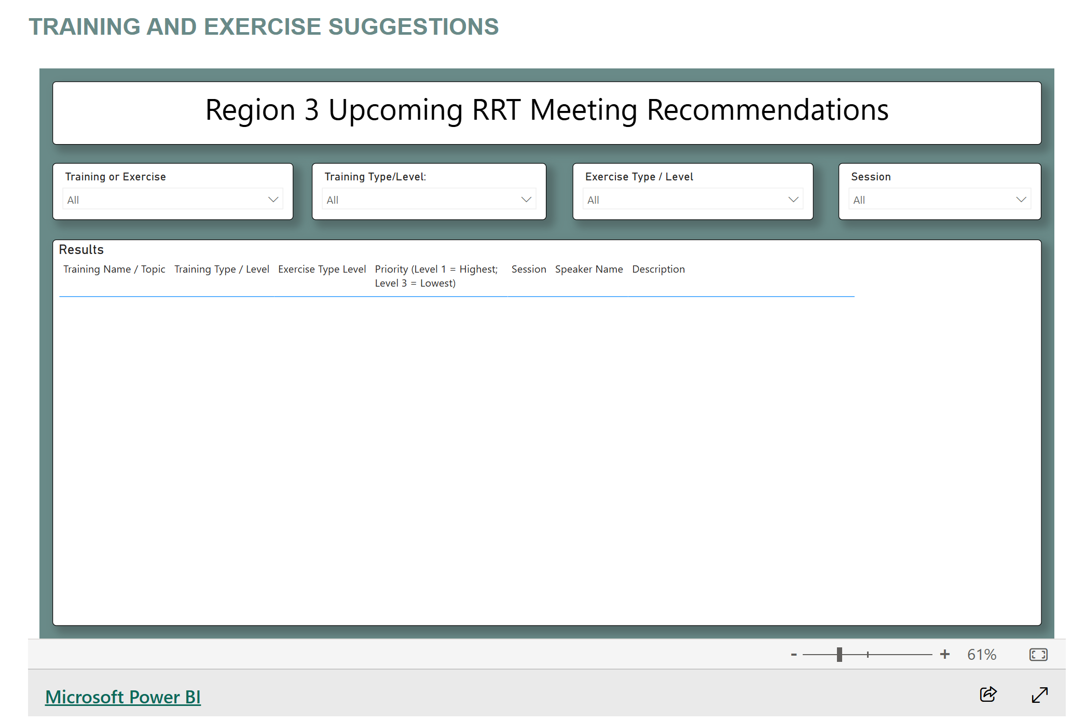

Slide 9
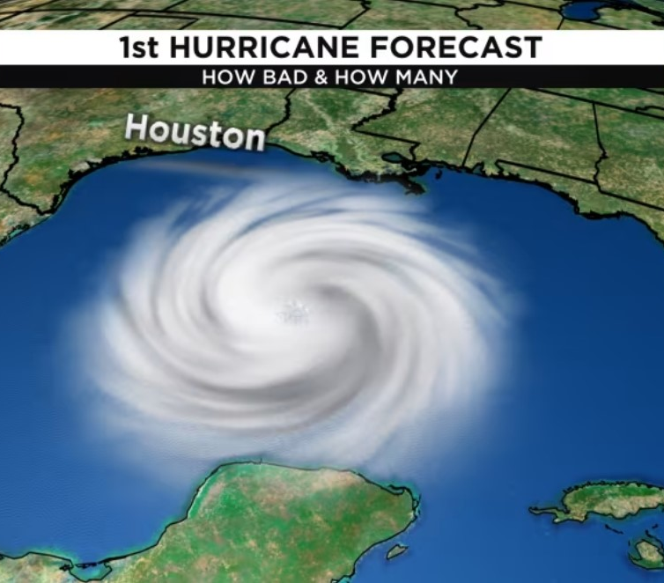
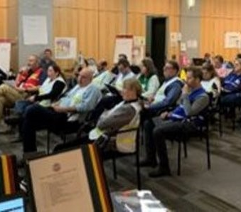
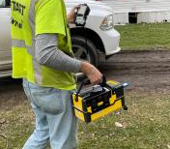
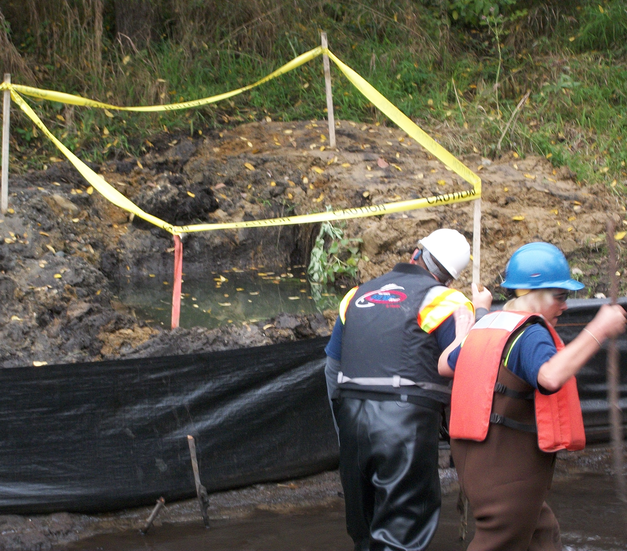
  New entry forms and dashboards coming to nrt.org/RRT3!
    Conferences
    Meetings
    Workshops
    Exercises
    Training
    Other Events that we can share in your area,
    region, nationally and internationally

